Slide 1
Online
Reputation
What to share and what to say

Slide 2
What does… Be Internet Sharp
& Be Internet Alert
…mean?
?
?
Notes:
Baseline activity
Class discussion around the two pillars Be Internet Sharp and Be Internet Alert to gauge the pupils’ starting point.
Being Sharp is thinking about what personal information is ok to share on the internet and what a positive digital footprint is
Being Alert means having the skills to stay safer online by spotting the clues that something may be suspicious, misleading or a scam.

Slide 3
Your ‘Online Reputation’ is anything that appears about you on the internet.
Notes:
Baseline activity
Explain to the class that someone’s online reputation is anything that appears about them on the internet.

Slide 4
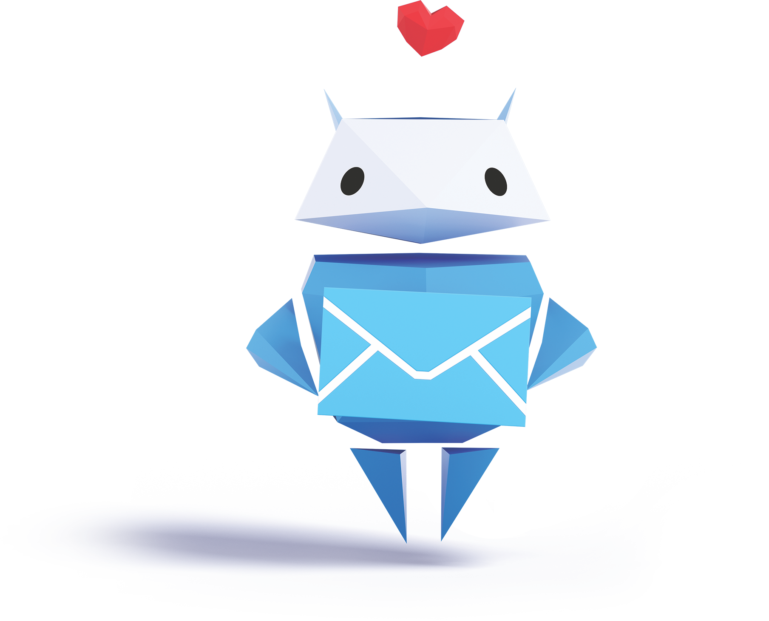
Being Internet Sharp
means knowing what to put online to protect your online reputation
Notes:
Baseline activity
‘Being Internet Sharp’ means knowing what kind of information to put online to protect your online reputation.

Slide 5
How can you make sure that what you say or do online doesn’t damage your online reputation?
Don’t post embarrassing photos or videos
Don’t write unkind or hurtful comments or posts
Check your privacy settings to make sure people can’t see all your personal information
Notes:
Baseline activity
Then ask, ‘How can someone make sure what they do or say online does not damage their online reputation?’
Examples may include: don’t post embarrassing photos or videos online, don’t write unkind or hurtful comments and posts online, be kind to others, check privacy settings to make sure people can’t see all your personal information.

Slide 6
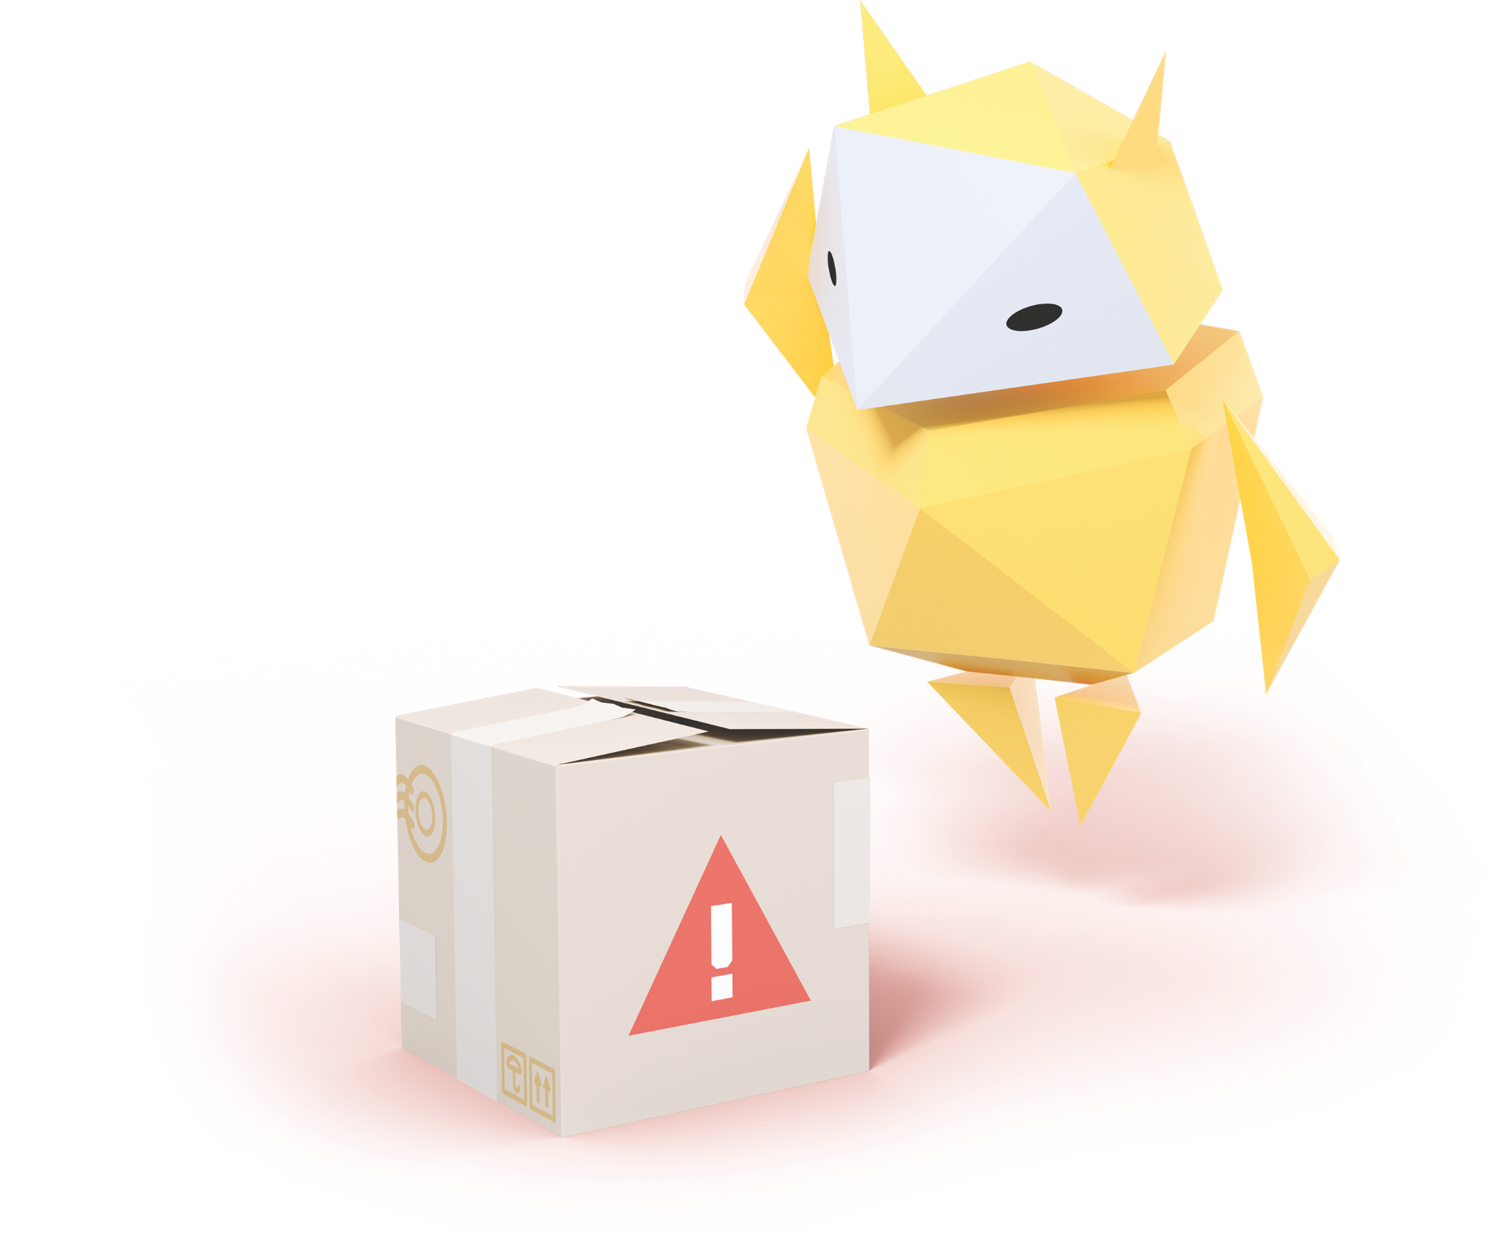
Being Internet Alert
means being able to work out whether what you see online is true
Notes:
Baseline activity
Explain that today we will also look at ‘Being Internet Alert’ – which means being able to work out whether things we see online are true.

Slide 7
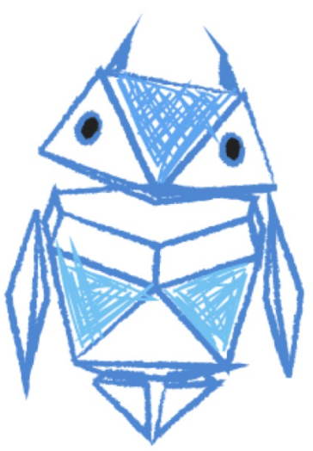
Your turn!
In pairs, draw a picture of someone your age who goes to a school like yours.
Now write down what personal information would help them build a positive online reputation.
Notes:
Be Internet Sharp: Activity 1 - Is it OK to share? (10 mins)
In pairs, ask pupils to invent a character around their age. Ask them to draw this character or write the character’s name in the middle of a piece of paper. Write up a list on the board of a character’s ‘personal’ information (e.g. name, address, photo of a friend, date of birth, password). Ask them to choose those which would help the person to build a positive online reputation.

Slide 8
Let’s talk!
How did you make your choices?
Why wouldn’t you post the other information online?
Why does it matter?
Notes:
Be Internet Sharp: Activity 1 - Is it OK to share? (10 mins)
Feedback as a class and ask them to discuss what the consequences of posting or sharing the other examples would be.
Support and Extension
If pupils need more support, provide them with a list of a character’s ‘personal’ information (e.g. name, address, photo of a friend, date of birth, password). See the support worksheet on Be Internet Sharp – Worksheet: Activity 2. Ask them to say, or to put a smiley or sad face next to each aspect to indicate if it is OK to share this information online or not. If pupils need more of a challenge, ask them to design a poster for the classroom with ‘Dos and Don’ts’ for a positive online reputation.

Slide 9
Keeping it private
Knowing what is OK to share and why
Notes:
Be Internet Sharp: Activity 4 - Keeping it private (10 mins)
Invite pupils to work in groups to review the three written privacy scenarios. Ask each group to discuss and agree upon the best privacy solution for each character.
Privacy scenarios: what should you do?
Example 1: A child at your school has a bad haircut and isn’t happy with it. Someone takes a picture and shares it online.
• Is it kind to share another person’s bad hair day?
• How do you think that person would feel?
Example 2: Someone writes in their diary. Another person copies what they wrote and posts it online.
• Was the other person wrong to post the diary entries?
• How would you feel if someone did this with your diary?
Example 3: A group of friends decide to meet at a friend’s house after school to play video games. One person in the group posts the house address and mobile number of the friend they are going to.
• Can you think of any reason why sharing a home address or a phone number on a public place online could be a problem?
• Are there more private ways to communicate this message – e.g. sending a private message or text?
For each scenario ask: ‘Is this OK to share?’
For pupils who need more of a challenge, provide them the definition for ‘digital footprint’ from the vocabulary section and ask how each scenario could leave a negative digital footprint.

Slide 10
1. Is it OK to share this?
Someone at your school has a bad haircut and isn’t happy with it.
Someone takes a photo and shares it online.
Notes:
Be Internet Sharp: Activity 4 - Keeping it private (10 mins)
Invite pupils to work in groups to review the three written privacy scenarios. Ask each group to discuss and agree upon the best privacy solution for each character.
Privacy scenarios: what should you do?
Example 1: A child at your school has a bad haircut and isn’t happy with it. Someone takes a picture and shares it online.
• Is it kind to share another person’s bad hair day?
• How do you think that person would feel?
For each scenario ask: ‘Is this OK to share?’
For pupils who need more of a challenge, provide them the definition for ‘digital footprint’ from the vocabulary section and ask how each scenario could leave a negative digital footprint.

Slide 11
2. Is it OK to share this?
Someone writes in their diary.
Another person copies what they wrote and posts it online.
Notes:
Be Internet Sharp: Activity 4 - Keeping it private (10 mins)
Example 2: Someone writes in their diary. Another person copies what they wrote and posts it online.
• Was the other person wrong to post the diary entries?
• How would you feel if someone did this with your diary?
For each scenario ask: ‘Is this OK to share?’
For pupils who need more of a challenge, provide them the definition for ‘digital footprint’ from the vocabulary section and ask how each scenario could leave a negative digital footprint.

Slide 12
3. Is it OK to share this?
A group of friends are playing games together after school.
One of them posts the address and mobile number of the friend they are going to.
Notes:
Be Internet Sharp: Activity 4 - Keeping it private (10 mins)
Example 3: A group of friends decide to meet at a friend’s house after school to play video games. One person in the group posts the house address and mobile number of the friend they are going to.
• Can you think of any reason why sharing a home address or a phone number on a public place online could be a problem? • Are there more private ways to communicate this message – e.g. sending a private message or text? For each scenario ask: ‘Is this OK to share?’
For pupils who need more of a challenge, provide them the definition for ‘digital footprint’ from the vocabulary section and ask how each scenario could leave a negative digital footprint.

Slide 13
Time to visit…
Interland’s
Mindful Mountain
g.co/interland
Notes:
Be Internet Sharp: Activity 7 - Interland: Mindful Mountain
Pupils now have the chance to play Mindful Mountain in Interland, you can do this as a class or on separate devices.

Slide 14
Let’s talk!
Why are they called an Oversharer?
How do Oversharer’s actions affect the game?
How has Mindful Mountain made you think about what people should share online?
When is making something public online a bad idea or unsafe?
What can someone do if they share something online and then regret it?
Notes:
Be Internet Sharp: Activity 7 - Interland: Mindful Mountain
Questions to ask after playing Mindful Mountain:
• Why is the character in the game called Oversharer? • How do Oversharer’s actions affect the game? • How has playing the game made you think about what people should share online?
• When is making something public online, instead of just with friends, not a good idea or potentially unsafe? • What can someone do, or how can they get help, if they share something they later regret online?

Slide 15
Don’t bite that phishing hook!
Knowing what’s real and what’s fake
Notes:
Be Internet Alert: Activity 1 - Don’t bite that phishing hook! (15 mins)
Divide the class into groups and give each group the examples of messages and websites from Be Internet Alert – Worksheet: Activity 1. Pupils decide which are real and reliable and which are fake and untrustworthy, giving reasons why.
Support and Extension
For pupils who need more support, use the real/fake clue cards (you will need to print duplicate copies of these) and ask them to match each card against the scenario they think it belongs to. Discuss the clues to ensure that they understand why the messages could be examples of scams or phishing. For pupils who need more of a challenge, ask them to write their own ‘Look out for Phishing!’ top five clues checklist.

Slide 16
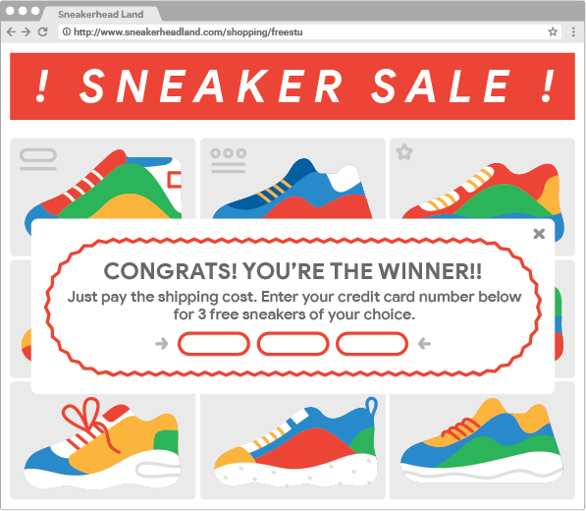
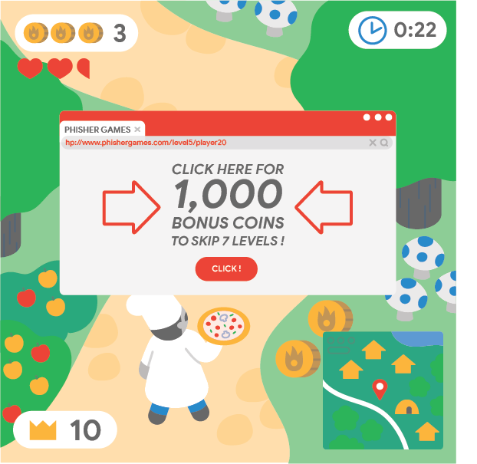
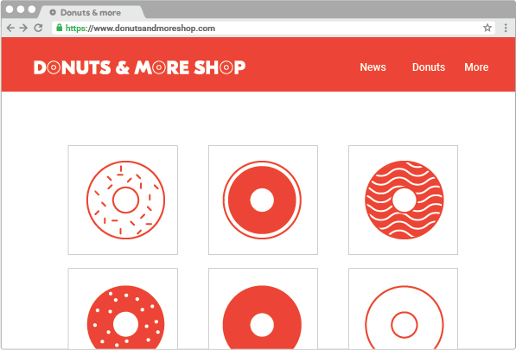
Real or fake?
Which of these are reliable?
Which of these are untrustworthy?
Notes:
Be Internet Alert: Activity 1 - Don’t bite that phishing hook! (15 mins)
Divide the class into groups and give each group the examples of messages and websites from Be Internet Alert – Worksheet: Activity 1. Pupils decide which are real and reliable and which are fake and untrustworthy, giving reasons why.
Support and Extension
For pupils who need more support, use the real/fake clue cards (you will need to print duplicate copies of these) and ask them to match each card against the scenario they think it belongs to. Discuss the clues to ensure that they understand why the messages could be examples of scams or phishing. For pupils who need more of a challenge, ask them to write their own ‘Look out for Phishing!’ top five clues checklist.

Slide 17
Time to visit…
Interland’s
Reality River
g.co/interland
Notes:
Be Internet Alert: Activity 7 - Interland: Reality River (20 mins)
Pupils now have the chance to play Reality River in Interland, you can do this as a class or on separate devices.

Slide 18
Let’s talk!
How did you decide what was real or fake? What were the signs?
What will you always try to remember when you’re online in future?
What should you do if you’re unsure about something you see online?
Will playing this game help you be safer online in the future?
Notes:
Be Internet Alert: Activity 7 - Interland: Reality River (20 mins)
Questions to ask after playing Reality River:
• How did you know if something in the game was real or fake? What were the signs? • Do you think that playing this game will help you to be safer online in the future? • Now that you’ve played this game, what will you always try to remember when you’re online in future? • What should you do if you’re unsure or worried about something you come across online?

Slide 19
What have you learned today?
Jot down or discuss…
Two things you probably shouldn’t share and make public online
Two examples of online scams you should watch out for
Notes:
Plenary
2 for 2 (5 mins)
Ask pupils to spend a few minutes reflecting on the activities in the lesson and ask them to write the following:
• Two things they probably shouldn’t share and make public online. • Two examples of online scams they should watch out for. (Stretch: ask them to give reasons for their answers)
Extension
Ask pupils to design an advice leaflet or poster based on what they have learned in the activities. They could take this home to their parents to teach them what it means to be ‘Internet Sharp’ and ‘Internet Alert’ and tips on how they can achieve this.

