Slide 1
Opinions & Differences
Everybody feels things differently

Slide 2
What does… Be Internet Sharp
& Be Internet Alert
…mean?
?
?
Notes:
Baseline activity
(10 mins)
Being Sharp is thinking about what personal information is ok to share on the internet and what a positive digital footprint is
Being Alert means having the skills to stay safer online by spotting the clues that something may be suspicious, misleading or a scam.
In our last lesson, we learned how we can protect our online reputation and how to work out whether information online was true and reliable.
What can we look out for when looking at online profiles to work out whether they’re real or fake?

Slide 3
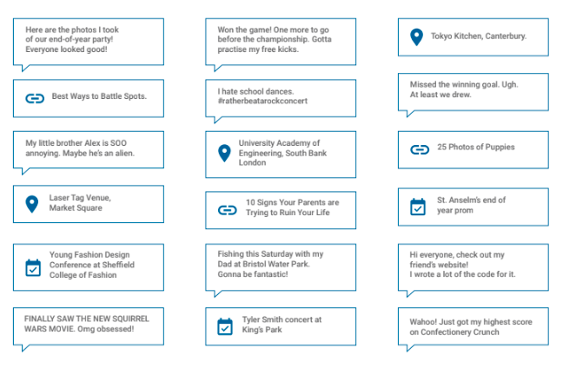
Let’s practise…
Notes:
Be Internet Sharp: Activity 3 - How do others see us? (10 mins)
Pupils need copies of the fictitious characters sheet from Be Internet Sharp: Activity 2 - Whose profile is it anyway?
We’re going to have a look at the fictitious characters from Sharp Activity 2 (page 18) through the eyes of different people.
Why might this be important to do?
What’s important to each of these people?
What conclusions would they reach about this profile?
Cross out the information that you think your character wouldn’t want your group to see or that it would be unwise for them to reveal.
Thinking about online information from different points of view enables us to really think about what the information means and whether it is appropriate to post it online.
Support and Extension
If some children find this concept too abstract then they can consider what personal information of theirs (e.g. full name, address, hobbies, pets) would be appropriate to share with the different groups of people.

Slide 4
Now choose a different person’s point of view
parent
friend
advertiser
sports coach
police officer
yourself in 10 years
employer
Notes:
Be Internet Sharp: Activity 3 - How do others see us? (10 mins)
In groups, ask pupils to choose a different point of view and to look at Gurpreet, Mark, and Leah’s information again from a new perspective.

Slide 5
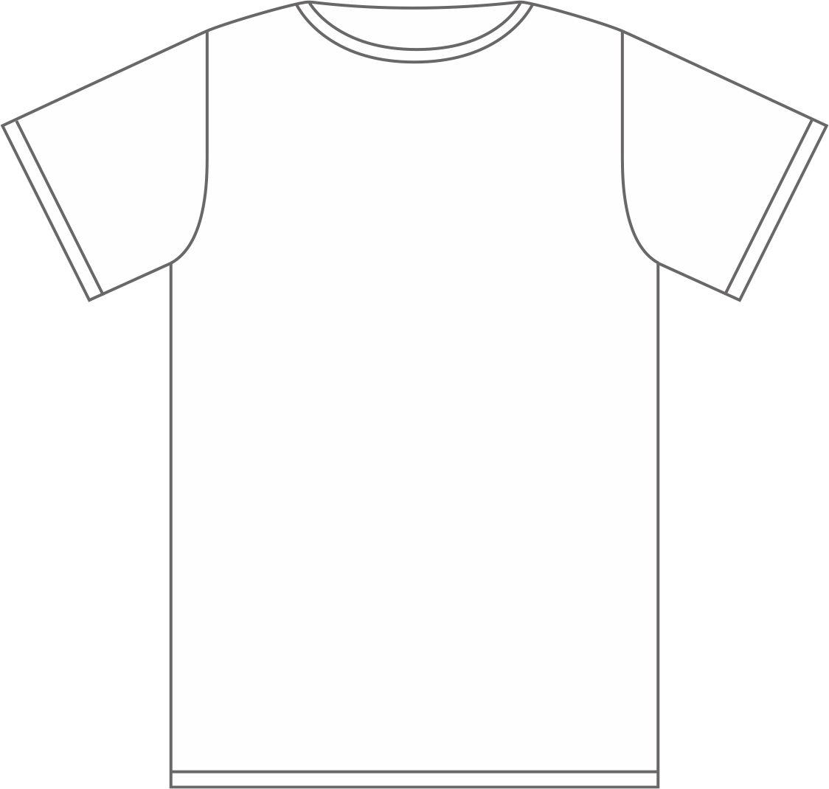
Time to become a fashion designer!
Cut out a few emojis which represent you and stick them on to your blank t-shirt
In pairs, guess what your partner’s emojis say about them
Notes:
Be Internet Sharp: Activity 5 - That’s not what I meant! (20 mins)
This is a lovely activity that enables children to design a t-shirt that represents them, using emojis. It provides discussion about how an individual sees themselves compared to how others see them.
Make sure children do not put their names on the front of their t-shirt designs as they will be guessing the designers in the second half of the activity.
Relate the t-shirt design to branded clothes that children may wear and what these brands may say about them when they are wearing them.
If someone has chosen the mad emoji, is it because they are always angry or they have a mad or crazy personality? It’s sometimes easy to misunderstand what someone means just by pictures.
Support and Extension
Some children may find it hard to choose emojis that represent them – if this is the case, children can discuss with each other and peers can choose some emojis to suit other pupils.

Slide 6
Now let’s guess who all of the other t-shirts belong to!
?
Notes:
Be Internet Sharp: Activity 5 - That’s not what I meant! (20 mins)
Collect in and randomly display the t-shirts – can the class recognise who the shirts belong to just by the emojis? How easy or difficult is it? Why?
Choose individuals and ask why they have chosen that emoji on their shirt. Do the rest of the class agree or disagree? If they disagree, can they explain why and provide another emoji that suits the person better?
Support and Extension
Some children may find it hard to choose emojis that represent them – if this is the case, children can discuss with each other and peers can choose some emojis to suit other pupils.

Slide 7
What or who is reliable?
Would you ask your Grandma for advice about video games?
Make a list of the pros and cons.
Notes:
Be Internet Alert: Activity 3 - Is that really true? (15 mins)
This is a media literacy activity that allows pupils to understand that information comes from lots of places. So it’s crucial they apply their skills to analyse all types of media. When they get to that point, they’re ready to move on to analysing special categories of media, like news or scientific data.
We will follow steps 1 and 2 from the activity:
1. Evaluating sources
If you wanted a recommendation for a great new video game, would you ask an elderly relative (e.g. Grandma)? Or, to ask it another way, is this elderly person likely to be the most credible source for information on video games?
A credible source is one that we can trust to give us accurate and relevant information.
Make a pros/cons list to explain the benefits and drawbacks of asking this elderly relative for video game advice.
Did your list look something like this?
PRO
E.g. Grandma loves me and wants me to be happy. Grandma is pretty good at finding information when she doesn’t know the answer herself.
CON
E.g. Grandma doesn’t play video games and doesn’t know much about them. Grandma doesn’t know which games I already have or what types of games I like.

Slide 8
We can decide what to trust by understanding expertise and motive
‘Expertise’ means having knowledge about something. Experts have expertise.
‘Motive’ is the reason that somebody says or does something.
Notes:
Be Internet Alert: Activity 3 - Is that really true? (15 mins)
You’ve just used two of the most common tools we have to decide if a source is credible: motive and expertise.
‘Expertise’ is a special skill or knowledge about a particular thing; experts have expertise. ‘Motive’ is someone’s intention, the reason they say or do something.
Which of the pros and cons from the lists you have just created are expertise and motive?
We may also know that Dad is a great cook but is clueless about gardening, our coach knows football but not gymnastics, or that Grandad can fix almost any toy but doesn’t know anything about video games. Just because a person is an expert on one thing doesn’t make them an expert on everything.

Slide 9
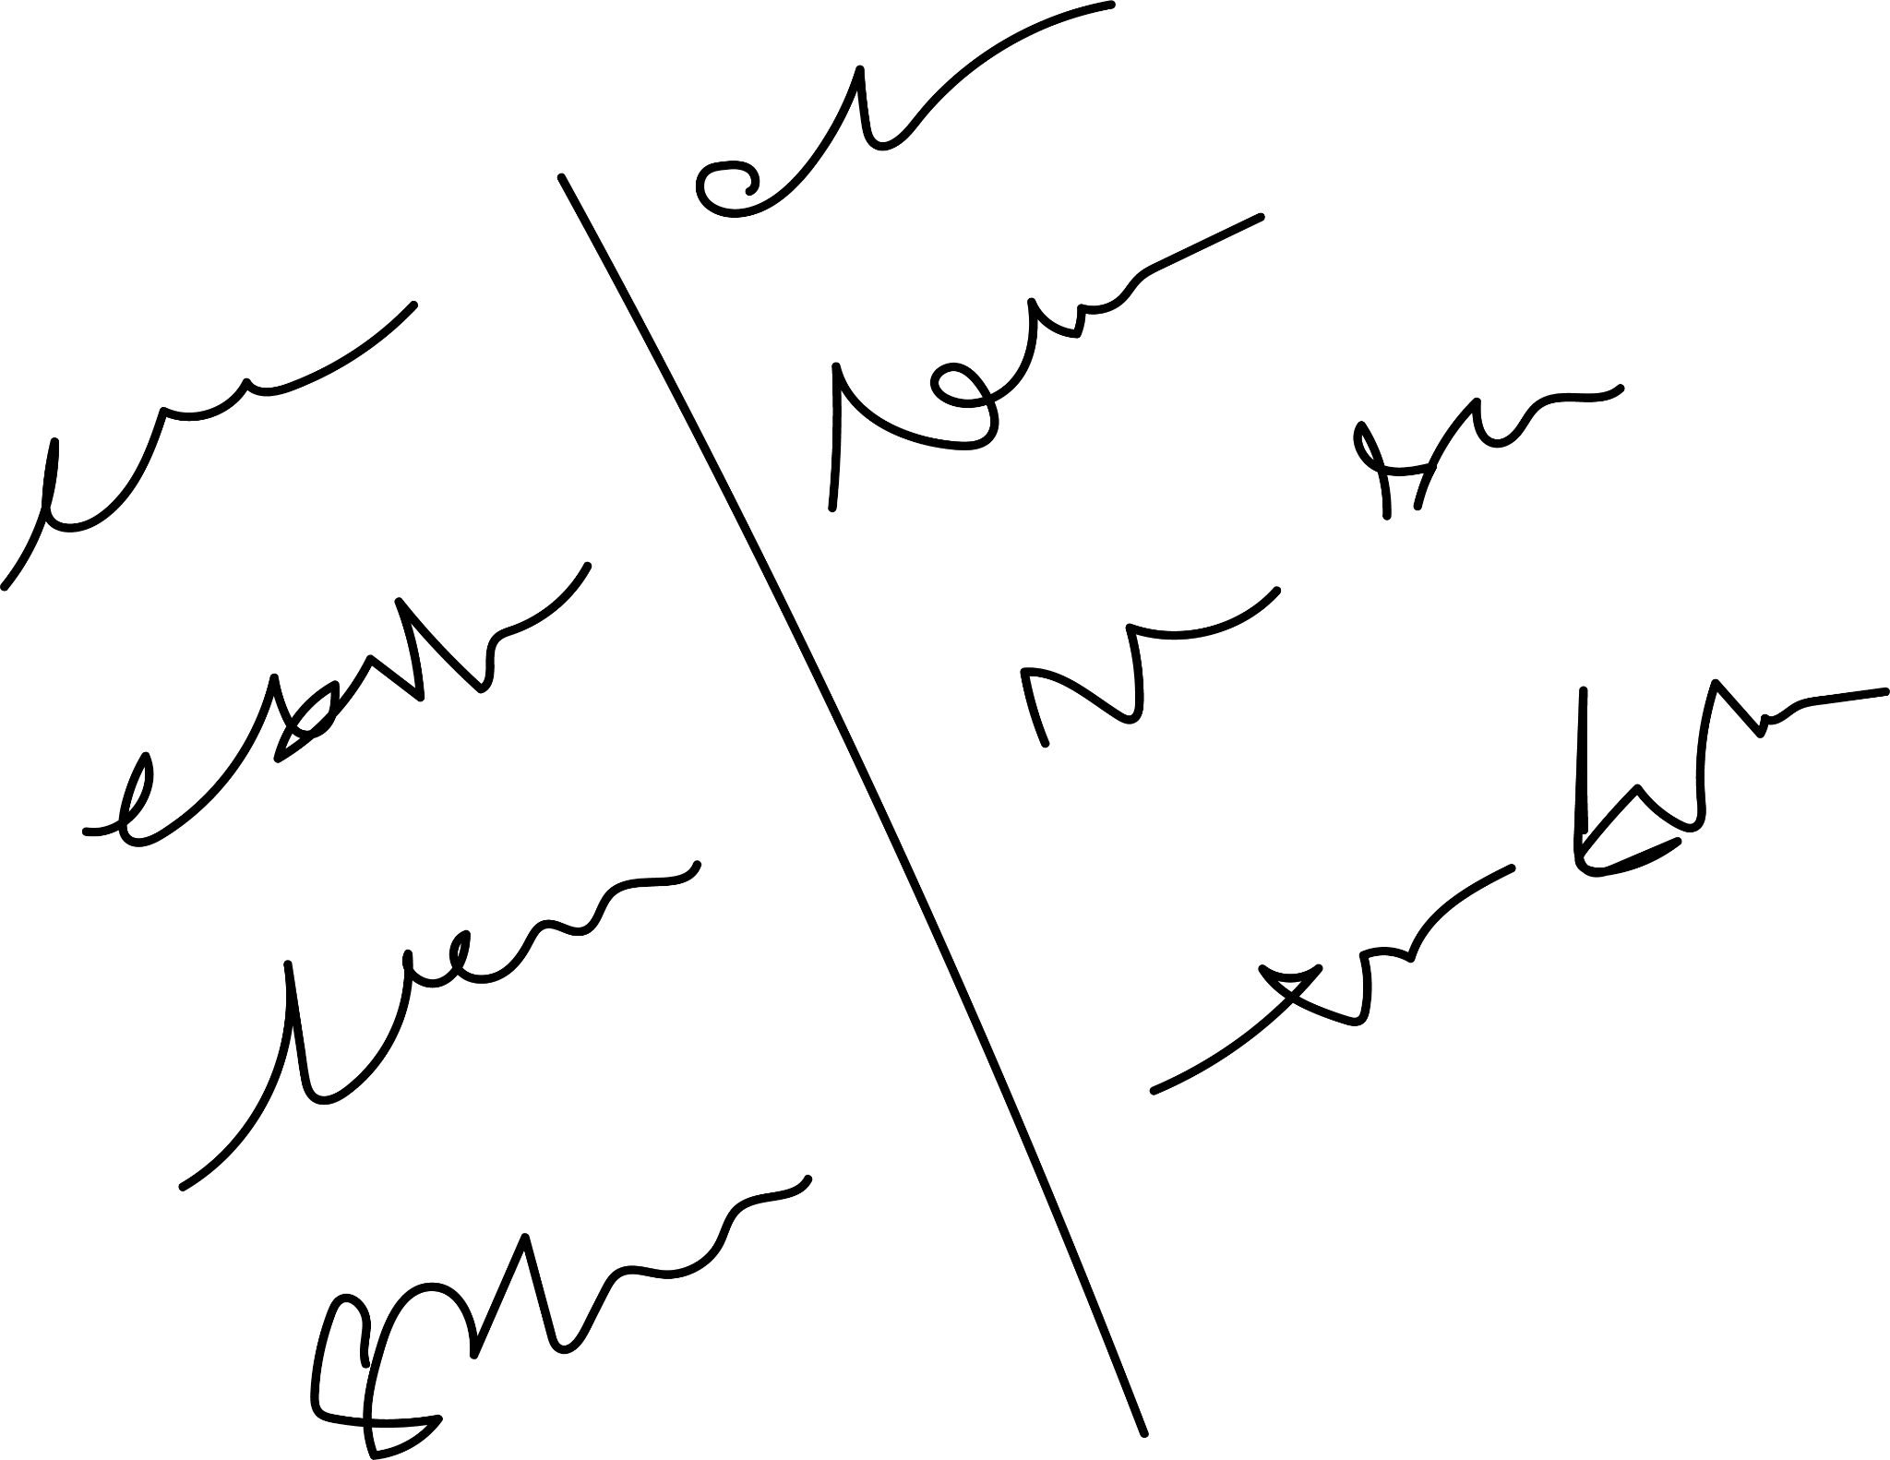
Would you ask your _______ for advice about _______?
Make a list of pros and cons for each person to decide who to ask.
Notes:
Be Internet Alert: Activity 3 - Is that really true? (15 mins)
2. Make your own pros and cons list
If this is the first time you have thought about how you use motive and expertise as clues to decide which information sources are credible, you might want to practise some more.
Imagine that you want to know how to be a better football player (or another suitable example). Make pro/con lists for these choices so you can decide if they’re credible sources:
your Grandma.
a blog by a winning secondary school hockey coach.
the best player on your team.
a website that sells football boots and gives advice.
videos that teach football practise techniques.
What do you notice about the strengths and weaknesses of each source?
Is there one that knows how to teach, but may not be familiar with football skills?
Is there one that is a football expert but may not know how to teach?
Is there one whose advice always seems to include buying something from them?
Is there one that knows football but doesn’t know you or which skills you need to work on?

Slide 10
Let’s talk!
Who did you choose and why?
Notes:
Be Internet Alert: Activity 3 - Is that really true? (15 mins)
Discuss: Who would be a good source to go to and why do you think so? Credibility is rarely an all-or-nothing call. Most sources have strengths and weaknesses. That’s why the very best answers often come from asking many sources and comparing their answers.
What makes something or someone credible or trustworthy?
Every day you make decisions about what to believe and what not to believe. Was that video you saw credible? Was it trying to persuade you of something? Is your older brother telling you the truth or teasing? Is that rumour you heard about a friend true?
What do you do when you’re trying to decide if someone is telling the truth? Do you already use these clues...?
What you know about a person
For example, you know if a classmate is really good at something or has a history of being truthful or playing practical jokes or being mean, so you can usually tell when they are serious, joking or lying.
What a person knows about you
For example, your parents know what kinds of foods give you a stomach ache; the ads on TV do not, so you follow your parents’ advice about what to eat. Your teacher knows your interests and what kinds of books you like, so you trust their book recommendations.
Tone of voice and facial expression
For example, you know that your friend means the opposite of the words they say if they roll their eyes and act sarcastic while they tell you they had a terrible time at the new skate park.
The situation
For example, when friends are playing around and one teases you about your new haircut, you know it’s just a joke. But if someone at school says the exact same words to embarrass you in front of the whole class, it’s an insult.
When we hear things from a media source like a video, a person on TV or a website, we don’t personally know the source and they don’t know us. We may not be sure about whether to believe them.
Even when someone we know sends us a message, there are no clues from facial expressions or tone of voice, so we might not be sure what they mean. That’s when we need to ask questions!

Slide 11
What have we learned?
Notes:
Plenary
(5 mins) Have an open discussion about what the learning was of the session: to understand that it’s actually quite hard to know what someone means just by seeing something drawn (as in the emoji t-shirts) or written without the person being there.
Extension
Pupils can make a classroom display of their emoji t-shirt designs on a wall. Following activity, allow pupils who want to think about choosing a different emoji for the display to have another go.

