Slide 1

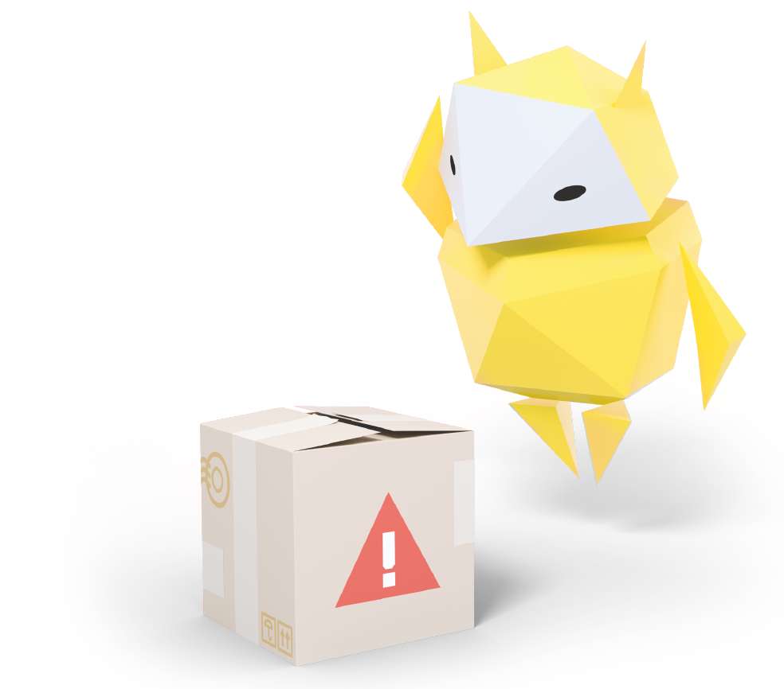
Making Good Decisions Online
When to act and what to do

Slide 2
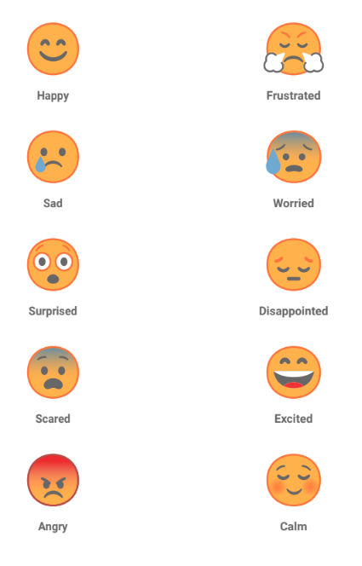
Notes:
Baseline Activity
(5 mins)
Warm-up pupils by acting out emotions (e.g. delighted, angry, sad, scared).
You could walk into the room giving high praise to one pupil but in a contrasting mood – encourage pupils to do the same.

Slide 3

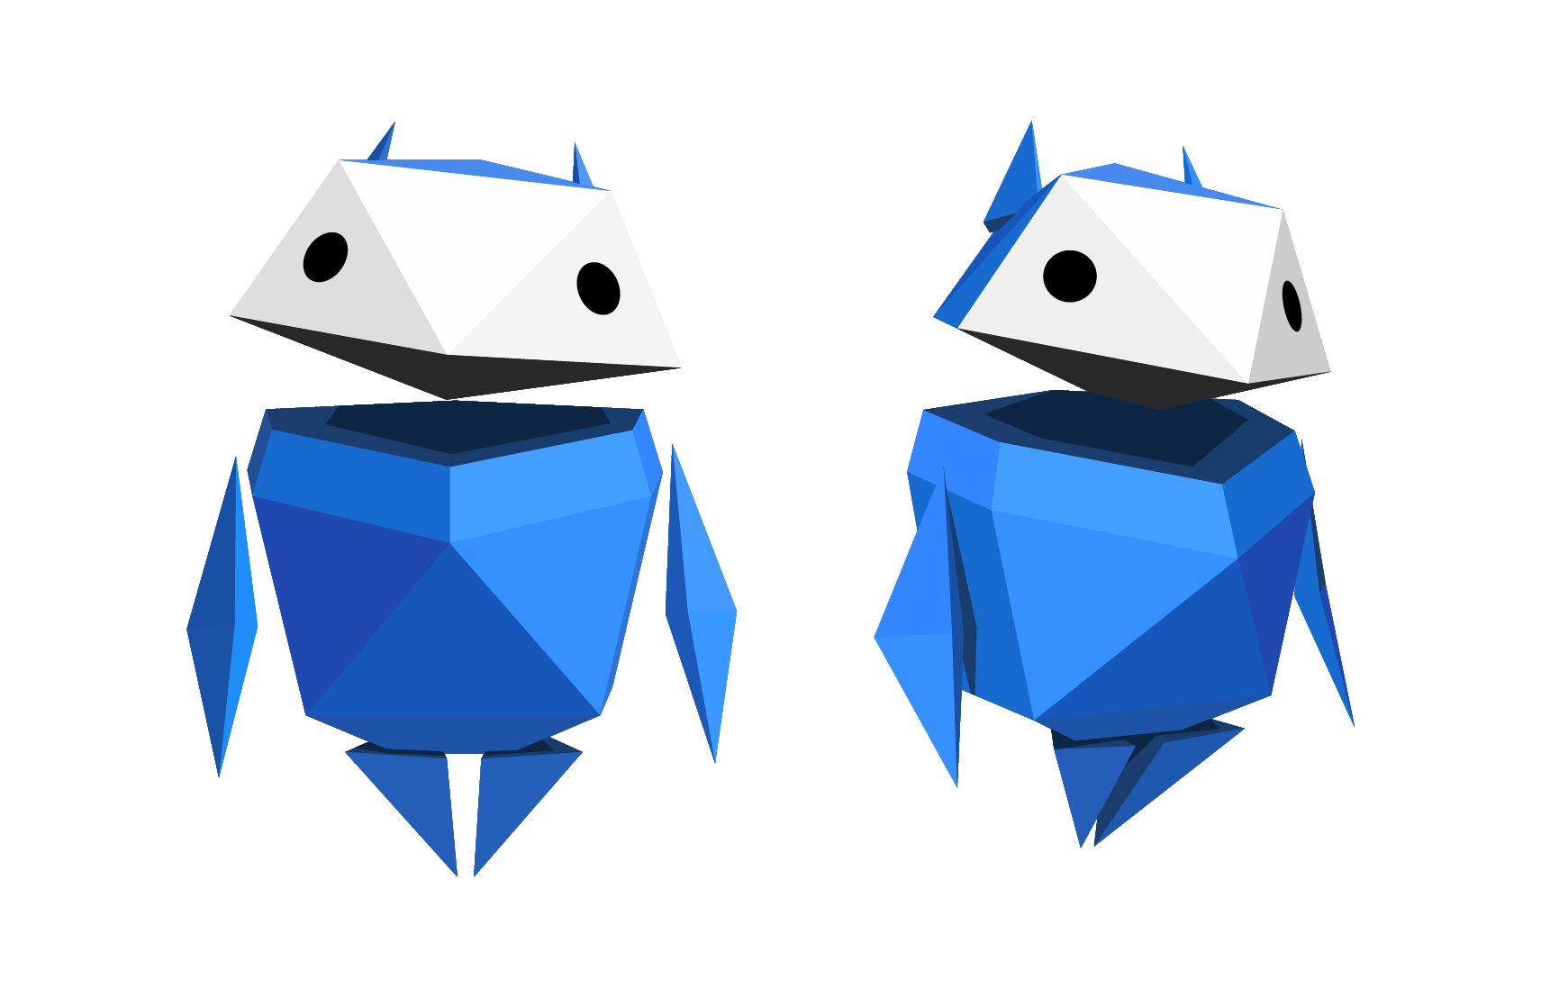
Let’s talk!
What happens when you share your password?
Notes:
Be Internet Secure: Activity 1 - But that wasn’t me! (10 mins)
Using the information provided in the Let’s Talk section, discuss with the class what happens when you share your password.
What happens when you share your password?
We all make passwords for the different devices we have or websites we use. Discuss if anyone has ever shared their password with anyone else – even a family member. All these passwords go towards making your digital footprint. This represents individuals online – everyone who goes online has one. It’s what all the things you leave online – likes, comments, your screen name, photos, messages, recordings, etc. – add up to and give other people an idea of what you’re really like.
It affects your reputation, how people think of you. People can make guesses, or assumptions, about you based on that footprint you leave. That’s one really important thing to be aware of when you’re online. When passwords are shared, you are giving someone else control of your digital footprint – you’re actually allowing them to help create it and shape how other people think of you. So, if someone with your password does something you don’t like, people will think that was you doing it! That’s why it’s super important not to share your passwords.
For example: Let’s say you share your password to a social media account with a friend. While logged in as you, your friend sends a message to someone in your class like, ‘Can you send me your homework answers?’ The next day in class, the pupil goes to the teacher and says you were trying to cheat on your homework by asking for answers. Then they show your teacher the message your friend sent from
your account. Who do you think your teacher will believe? How does this affect your reputation? What else might happen?
Brainstorm with the class possible outcomes. Examples: Teacher calls home. You get into trouble and miss break time at school and lose privileges at home. Your digital footprint shows that you tried to cheat in school. You get into a fight with your friend who sent the message.
Remember, your digital footprint represents you online. Any time you share your password with someone, you are giving them control of your digital footprint, which can impact how people see you on the internet and everywhere else.

Slide 4



Have you ever shared your password?
What would happen if you did?
Write down your thoughts
Notes:
Be Internet Secure: Activity 1 - But that wasn’t me! (10 mins)
Go through the discussion and activity in the Let’s Talk section, asking children to complete the handout with their responses.
Differentiation: Some pupils may find the abstract concepts of a digital footprint, passwords and social media difficult. If this is the case, work through the handout together as a class and discuss each element as you progress through. It is important to keep it relevant to the children and use something they are all interested in to ensure they get as much from the learning as possible.

Slide 5
1
Someone at your school has a bad haircut and isn’t happy with it.
What can you do if you feel unsafe online?
Who can you tell or go to?
Someone takes a photo
and shares it online.
What might happen when you tell?
What might happen after that?
Notes:
Be Internet Secure: Activity 4 - Taking care of yourself and others (10 mins)
Discuss the following with children:
• What can someone do if they feel unsafe online?
• Who can they tell or go to?
• What might happen when they tell?
• What might happen after that?
Differentiation: You might want to make the scenarios more relatable to pupils if you feel they are not relevant to your cohort of children.

Slide 6
2
Someone writes
in their diary.
What can you do if you feel unsafe online?
Another person copies what they wrote and posts it online.
Who can you tell or go to?
What might happen when you tell?
What might happen after that?
Notes:
Be Internet Secure: Activity 4 - Taking care of yourself and others (10 mins)
• What can someone do if they feel unsafe online?
• Who can they tell or go to?
• What might happen when they tell?
• What might happen after that?
Differentiation: You might want to make the scenarios more relatable to pupils if you feel they are not relevant to your cohort of children.

Slide 7
3
Someone posts
‘Have a great holiday!’ on a friend’s social media page.
What can you do if you feel unsafe online?
Who can you tell or go to?
What might happen when you tell?
What might happen after that?
Notes:
Be Internet Secure: Activity 4 - Taking care of yourself and others (10 mins)
• What can someone do if they feel unsafe online?
• Who can they tell or go to?
• What might happen when they tell?
• What might happen after that?
Differentiation: You might want to make the scenarios more relatable to pupils if you feel they are not relevant to your cohort of children.

Slide 8
4
Ronnie updates the password
he uses to play his favourite game, because somebody told him it’s a good idea.
What can you do if you feel unsafe online?
Who can you tell or go to?
His friend Farah normally plays the game using his account,
so Ronnie gives her his new password so she can continue playing.
What might happen when you tell?
What might happen after that?
Notes:
Be Internet Secure: Activity 4 - Taking care of yourself and others (10 mins)
• What can someone do if they feel unsafe online?
• Who can they tell or go to?
• What might happen when they tell?
• What might happen after that?
Differentiation: You might want to make the scenarios more relatable to pupils if you feel they are not relevant to your cohort of children.

Slide 9
5
Some friends are playing video games together online.
What can you do if you feel unsafe online?
A stranger joins their chat and asks their age. One of the friends tells the stranger, who then asks more questions, like their school and town.
Who can you tell or go to?
What might happen when you tell?
What might happen after that?
Notes:
Be Internet Secure: Activity 4 - Taking care of yourself and others (10 mins)
• What can someone do if they feel unsafe online?
• Who can they tell or go to?
• What might happen when they tell?
• What might happen after that?
Differentiation: You might want to make the scenarios more relatable to pupils if you feel they are not relevant to your cohort of children.

Slide 10

Imagine that you have seen or read some unkind behaviour online
upset
angry
scared
sad
Make a circle of words describing how that would make you feel.
Notes:
How can I stand up to others online? (15 mins)
This is a standalone activity and does not require any additional resources.
1. Ask pupils to make a circle of words to describe their feelings if they had witnessed or read unkind behaviour online.

Slide 11
What can you do to help?
Notes:
How can I stand up to others online? (15 mins)
This is a standalone activity and does not require any additional resources.
2. In groups, invite pupils to write down on a sticky note one practical suggestion for what they could do to deal with the situation.
3. Make a class graffiti wall of the suggestions and read them out to the pupils. Which ones do they think would be particularly helpful?
Differentiation: Pupils needing to be challenged could create a rap/poem to share at a school assembly giving advice on how to combat unkind online behaviour. For pupils requiring support, ask them to use the graffiti wall suggestions to compose their own ‘Be cool when someone is cruel’ advice message or tweet.

Slide 12
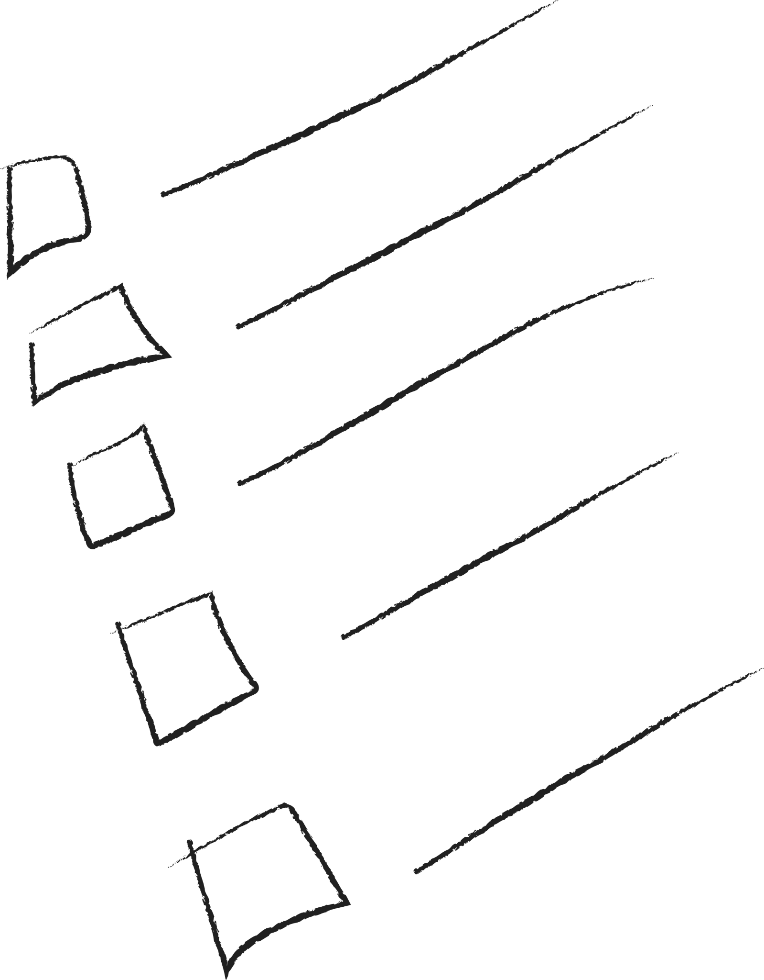
Be cool when someone is cruel
Notes:
How can I stand up to others online? (15 mins)
This is a standalone activity and does not require any additional resources.
4. Ask pupils to devise their own ‘Be cool when someone is cruel’ online advice checklist for classroom display.
Differentiation: Pupils needing to be challenged could create a rap/poem to share at a school assembly giving advice on how to combat unkind online behaviour. For pupils requiring support, ask them to use the graffiti wall suggestions to compose their own ‘Be cool when someone is cruel’ advice message or tweet.

Slide 13

That’s so cool
Whatever
I’m so mad at you
CALL ME NOW
Kk fine
Notes:
Plenary
Be Internet Secure: Activity 4 - Mixed messages (15 mins)
Pupils interpret the emotions behind text messages to practise thinking critically and avoiding misinterpretation and conflict in online exchanges. This is a great opportunity for some drama and role play!
Model reading out the messages in a range of moods – encourage children to think about what the messages mean in those moods. (E.g. ‘CALL ME NOW’ with a scared voice/facial expression compared to shouting and being visibly cross).
Give children time to practise reading the different text messages out loud in a range of moods, with corresponding expressions – you might want to list the moods on the board for children to choose from.

