Slide 1
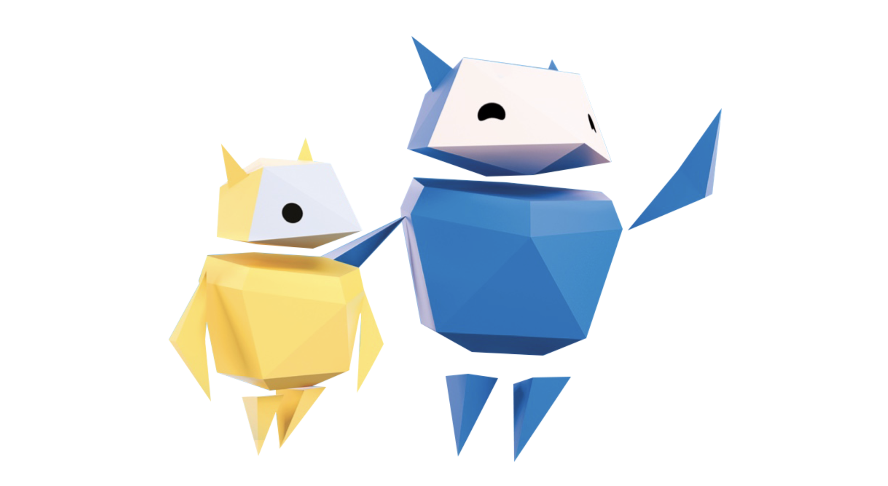
Being Brave Online
When in doubt, discuss

Slide 2
What activities do you do online?
Notes:
Baseline activity
(10 mins)
On sticky notes, children write down what they do online. (E.g. watch videos, play online games or chat.)
Stick the notes on the whiteboard/flipchart and use them to guide your teaching and discussion points throughout the lesson.
As the notes are collated and stuck up, discuss how doing these things makes the children feel and if they share these experiences of watching or playing games with anyone.

Slide 3
Why is it important to be kind?
When have you been kind, or somebody been kind to you?
Notes:
Be Internet Brave: Activity 1 - Upstanders have options (15 mins)
Pupils practise identifying the four roles of a bullying incident (the person who bullies, the target of the bullying, the bystander, and the helper, or upstander) and things to do if they witness bullying.
Discuss the importance of being kind – share examples when pupils have been kind or received kindness (e.g. having doors held open, being invited to a friend’s house).

Slide 4
What do we know about ______?
Add popular figure image
Notes:
Be Internet Brave: Activity 1 - Upstanders have options (15 mins)
Choose a popular figure that children know (this could be a streamer, singer or actor)
– discuss how much we know about them. Is it a lot or not much? Why is that? These people are human and need to be treated with kindness and respect.
Sometimes others are unkind and we can choose whether we want to be a bystander or an upstander (helper).
A bystander is a witness to what’s going on.
An upstander is a witness to what’s going on who tries to help the target or turn things around.

Slide 5
What do you and your friends like to do online?
Have you ever seen something upsetting online?
Notes:
Be Internet Brave: Activity 3.1 - Seeing upsetting stuff online (15 mins)
This activity explores the highs and potential lows of being online. Discuss with the class what children their age like doing online and how much fun they have when they’re online. Go on to discuss the positive feelings they may feel when we’re doing these things either alone or with friends and family.
There is, however, a flip side to this as sometimes we may see some upsetting things online. Talk about the feelings that children their age may experience when they see something upsetting.
Encourage children to be brave and assertive when practising what to say or do when they see something upsetting online.

Slide 6
Let’s practise…
Listen carefully to each scenario
When the music starts, think about what you’d say when reporting this to an adult
When the music stops, find a partner and practise reporting it with them
Notes:
Be Internet Brave: Activity 3.1 - Seeing upsetting stuff online (15 mins)
1. Explain the rules to the class, you may wish to model this first:
A. ‘I’ll read a scenario.’
B. ‘I’ll play music for 30 seconds.’
C. ‘While the music is playing, walk around and think about what you’d say while reporting the scenario to an adult.’
D. ‘When the music stops, find a partner and practise reporting with them.’
2. Choose a scenario and start the music.
3. Stop the music.
4. Listen to pupils as they practise. Choose one pair to demonstrate what they said to the class.
5. Call on a few other pupils at random to tell the class what they’d do in this situation.
6. Repeat steps 2−5 for other scenarios, as time allows.

Slide 7
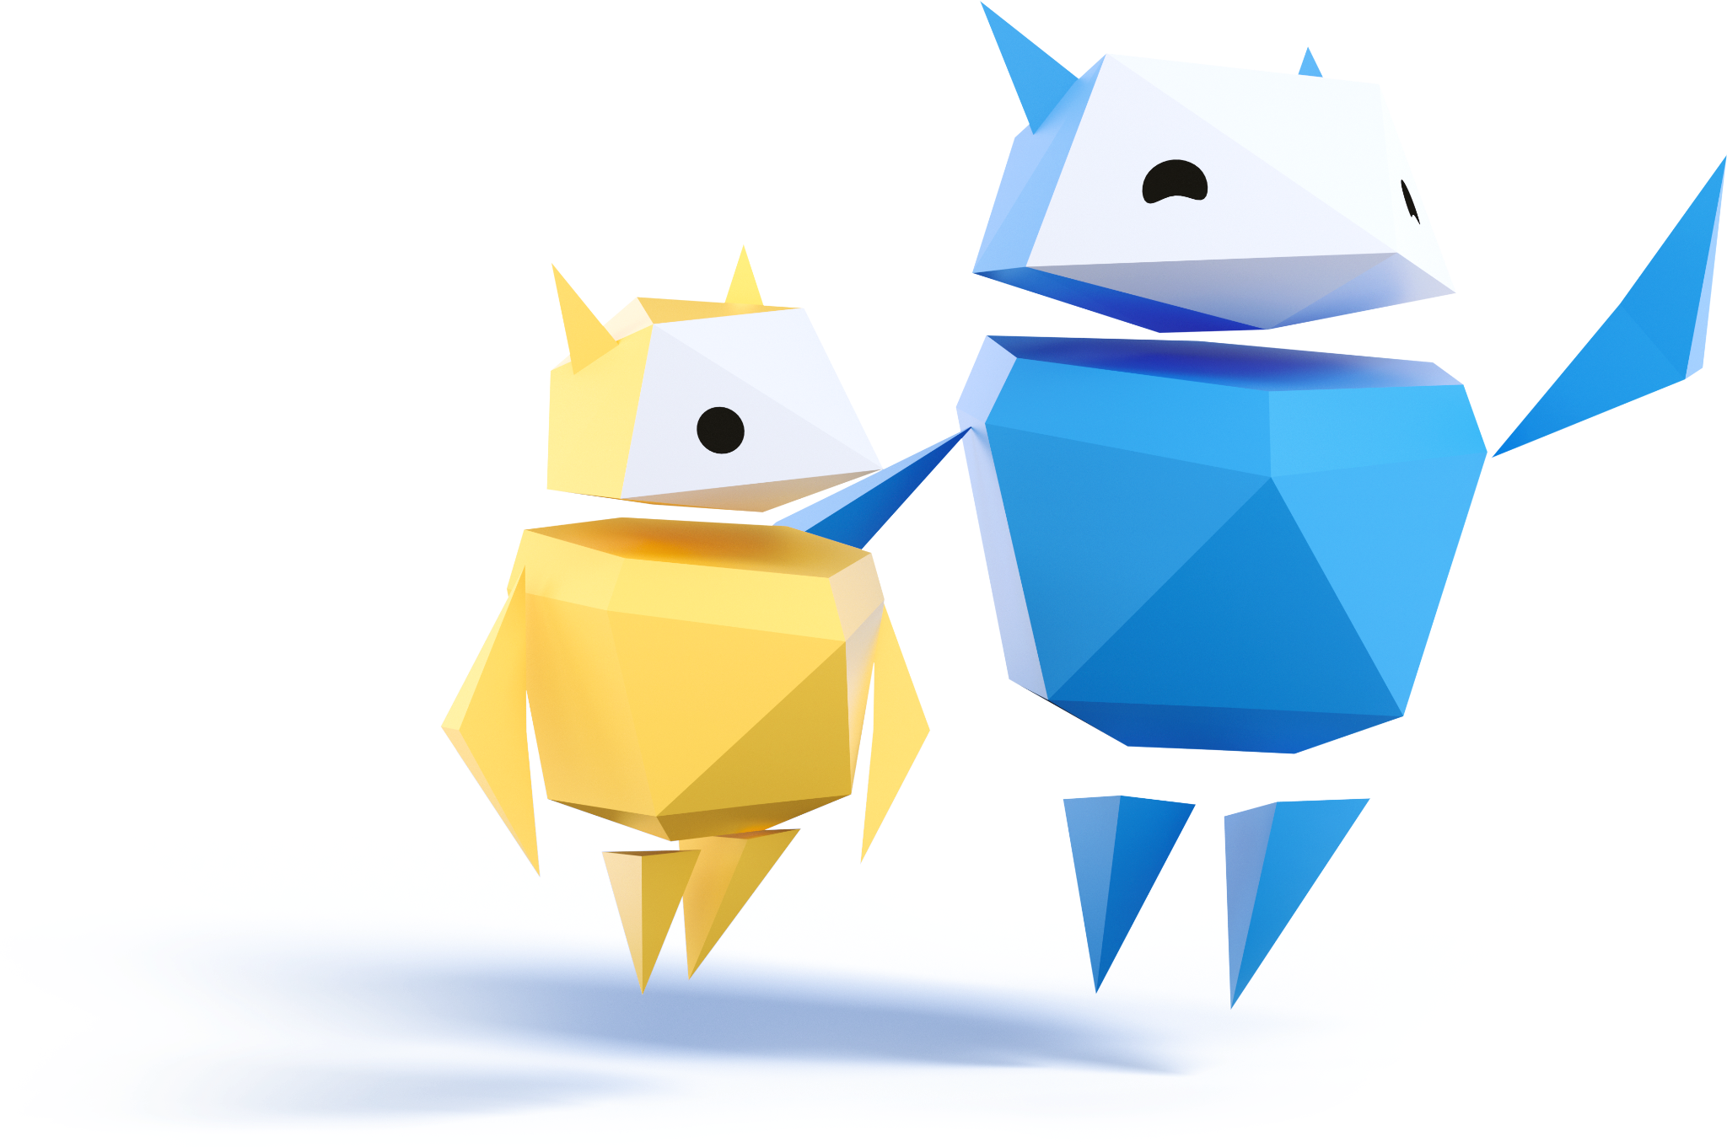
Let’s practise…
Find a friend
Listen carefully to each scenario
Take turns to practise how you would respond
Notes:
Be Internet Brave: Activity 4.1 - What to do about mean stuff online (15 mins)
Pupils practise what to do the next time they see or hear something upsetting in a video, online game or TV show.
This activity is a development from practising different ways to speak up when pupils see something upsetting online to actually framing what to do and say with a trusted partner – trying different things out and settling on one or two strategies they feel comfortable with.
Pairs work through the six scenarios (at their own time or together as a class) and take turns to practise what to do in each situation.

Slide 8
Let’s talk!
Find a friend and take turns discussing how you would respond in these situations.
Notes:
Be Internet Brave: Activity 4.1 - What to do about mean stuff online (15 mins)
Read a scenario to the pupils and encourage them to take turns in practising how they would respond in that situation.
Model the first one together. Work through the scenarios, encouraging pupils to work together and discuss responses.
If you’re watching a TV show or video by yourself and you see or hear something upsetting, you can turn it off.
If you’re still upset after you turn it off, find an adult you trust to talk to about what you saw and how it made you feel.
Who is a trusted adult you could talk to?
If you’re watching a TV show or online video with friends or family and you see or hear something upsetting, you can speak up and say how you feel.
Discuss what things you could do and record on the board under ‘speak up’.

Slide 9
1
You’re watching an online video with a family member.
The person in the video is using swear words and saying mean things that upset you.
You decide to speak up. What do you say?
Notes:
Be Internet Brave: Activity 4.1 - What to do about mean stuff online (15 mins)
Read a scenario to the pupils and encourage them to take turns in practising how they would respond in that situation.
Scenario 1: You’re watching an online video with a family member. The person in the video is using swear words and saying mean things that upset you. You decide to speak up. What do you say?

Slide 10
2
You’re watching a new TV show alone.
You’re halfway through the first episode when something super scary happens. Argh!
You can’t get it out of your mind and now you’re convinced it could happen to you.
You decide to turn off the show and tell a trusted adult.
Notes:
Be Internet Brave: Activity 4.1 - What to do about mean stuff online (15 mins)
Read a scenario to the pupils and encourage them to take turns in practising how they would respond in that situation.
Scenario 2: You’re watching a new TV show alone. You’re halfway through the first episode when something super scary happens. Argh! You can’t get it out of your mind and now you’re convinced it could happen to you. You decide to turn off the show and tell a trusted adult.

Slide 11
3
You’re watching online videos with your friends.
One friend shows a video with naked people in it. You feel upset.
You don’t know how your friends feel, but you don’t want to watch the video anymore.
You decide to speak up.
Notes:
Be Internet Brave: Activity 4.1 - What to do about mean stuff online (15 mins)
Read a scenario to the pupils and encourage them to take turns in practising how they would respond in that situation.
Scenario 3: You’re watching online videos with your friends. One friend shows a video with naked people in it. You feel upset. You don’t know how your friends feel, but you don’t want to watch the video anymore. You decide to speak up.

Slide 12
4
You’re playing a multiplayer game online when you see one player intentionally messing up what other players are doing.
Someone asks him to stop and he just laughs.
Notes:
Be Internet Brave: Activity 4.1 - What to do about mean stuff online (15 mins)
Read a scenario to the pupils and encourage them to take turns in practising how they would respond in that situation.
Scenario 4: You’re playing a multiplayer game online when you see one player intentionally messing up what other players are doing. Someone asks him to stop and he just laughs.

Slide 13
5
Your cousins are playing video games with lots of shooting in them.
There are lots of people getting hurt.
You ask them to play something else, but they ignore you.
Notes:
Be Internet Brave: Activity 4.1 - What to do about mean stuff online (15 mins)
Read a scenario to the pupils and encourage them to take turns in practising how they would respond in that situation.
Scenario 5: Your cousins are playing video games with lots of shooting in them. There are lots of people getting hurt. You ask them to play something else, but they ignore you.

Slide 14
6
You’re at a friend’s house and you overhear a news story on TV that makes you feel really sad.
When you get home, you decide to talk to a an adult you trust.
Notes:
Be Internet Brave: Activity 4.1 - What to do about mean stuff online (15 mins)
Read a scenario to the pupils and encourage them to take turns in practising how they would respond in that situation.
Scenario 6: You’re at a friend’s house and you overhear a news story on TV that makes you feel really sad. When you get home, you decide to talk to a an adult you trust.

