Slide 1
Relationships
& Being Kind
How to communicate with and support others

Slide 2
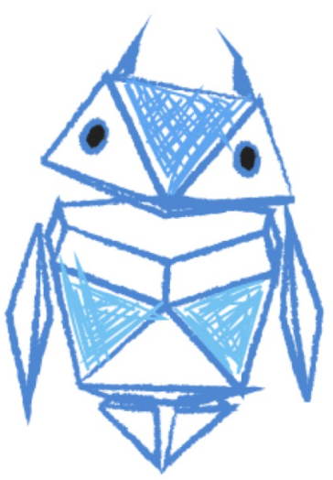
Draw someone who treats others kindly when they are online
Around the outside, draw or write the kind things that this person is thinking, saying, or doing
Notes:
Baseline Activity
(10 mins)
Be someone who stands up for others.
Ask pupils to draw someone who treats others kindly when they are online. Around the outside, ask pupils to draw or write what this person is thinking, saying and doing to demonstrate kindness.
Remind pupils about extending real-life behaviour into online behaviour (e.g. ‘Don’t say things online that you wouldn’t say to someone face-to-face’).

Slide 3
Let’s talk!
Share what you have drawn or written with your group.
Discuss with the class which was the most important.
Notes:
Baseline Activity
(10 mins)
Ask table groups to share what they have thought and written about. Invite each table group to feedback on one key factor that they felt was most important.

Slide 4
Let’s talk!
Why does kindness matter online?
What can we do if someone is being hurtful and unkind?
Notes:
Baseline Activity
(10 mins)
Ask pupils to consider:
• Why does kindness matter online?
• What can we do if someone is being hurtful and unkind?
Emphasise how it is important to stand up for others, in order to reduce negative and unkind messages online.
Possible answers might include: kindness online matters because being unkind could hurt someone in the same way as it does face-to-face; if someone is being unkind you can report/block/tell a trusted adult.

Slide 5
Imagine that you have seen or read some unkind behaviour online
Make a circle of words describing how that would make you feel.
Notes:
Be Internet Kind: Activity 1.2 - Practising empathy (15 mins)
1. Ask pupils to make a circle of words describing feelings for a bystander who has witnessed or read about unkind behaviour online.

Slide 6
What can you do to help?
Notes:
Be Internet Kind: Activity 1.2 - Practising empathy (15 mins)
2. In table groups, invite pupils to write down on a sticky note one practical suggestion for what the bystander could do to deal with the situation.
3. Make a class graffiti wall of the suggestions and read them out to the pupils. Which ones do they think would be particularly helpful?

Slide 7
Build a ‘Be cool when someone is cruel’ online advice checklist
Notes:
Be Internet Kind: Activity 1.2 - Practising empathy (15 mins)
4. Ask pupils to devise their own ‘Be cool when someone is cruel’ online advice checklist for classroom display.
Support and Extension
Pupils needing to be challenged could create a rap/poem to share at a school assembly giving advice on how to combat unkind online behaviour.
Pupils requiring support: Using the graffiti wall suggestions, ask pupils to compose their own ‘Be cool when someone is cruel’ advice message or tweet.

Slide 8
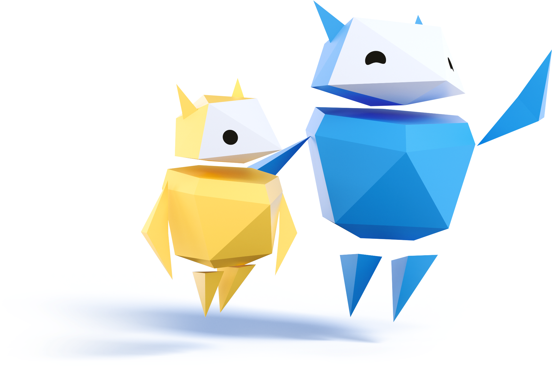
Let’s practise…
Reframing negative comments
People are leaving disrespectful comments on a selfie your friend posted.
You’re playing an online game and one player is insulting another player.
Several of your friends are making mean jokes about another pupil in a private group chat.
Notes:
Be Internet Kind: Activity 2.2 - Ways to show kindness (20 mins)
A 3-step activity to learn how to reframe negative comments into more positive ones.
1. Ask pupils to read the negative online comments listed on their worksheet.
2. Show the pupils how the first negative comment could be reframed so that it might be more positive/less hurtful to the recipient.
3. Invite pupils to work in pairs in order to reframe the rest of the negative comments into more positive ones.

Slide 9
Let’s talk!
How would you change these comments to be more positive?
Notes:
Be Internet Kind: Activity 2.2 - Ways to show kindness (20 mins)
Ask pupils to discuss with the class what they came up with.

Slide 10
That’s so cool
Whatever
I’m so mad at you
CALL ME NOW
Kk fine
Notes:
Be Internet Kind: Activity 4 - Mixed messages (5 mins)
Invite pupils to consider examples of text messages on the board and ask for volunteers to read out the texts in different tones (angry, sarcastic, friendly) to show that they are difficult to interpret and meanings can be confusing.

Slide 11
Let’s talk!
What do these text messages mean?
How might the person who receives these messages interpret them?
How could the messages be better communicated or phrased?
Notes:
Be Internet Kind: Activity 4 - Mixed messages (5 mins)
Ask pupils to consider:
• What do they mean?
• How might the recipient interpret them?
• How could they be better communicated/phrased?

Slide 12
Let’s talk!
Think about how some celebrities sometimes behave unkindly towards others on social media.
Are these people being good role models?
Is it OK to be unkind online?
Notes:
Be Internet Kind: Activity 4 - Mixed messages (5 mins)
Class discussion: Ask pupils to consider how some celebrities sometimes behave unkindly towards others when they are using social media. Remind them that this kind of behaviour does not present a good role model for others and only perpetuates that it is OK to be unkind online.
As a class, they now know how to stand up for others and how to respond to unkind or unhealthy behaviour online.
Remind pupils that how they treat each other online will have a big impact on each other and on the digital world. It is in their power to build an internet that is a kind and positive place to communicate and be heard.
Support & Extension
Pupils requiring support could be given a large selection of emojis that they will need to use to help them be kind online. Pupils needing to be challenged could prepare a short blog on how to be kind online for a publication on the school website.

Slide 13
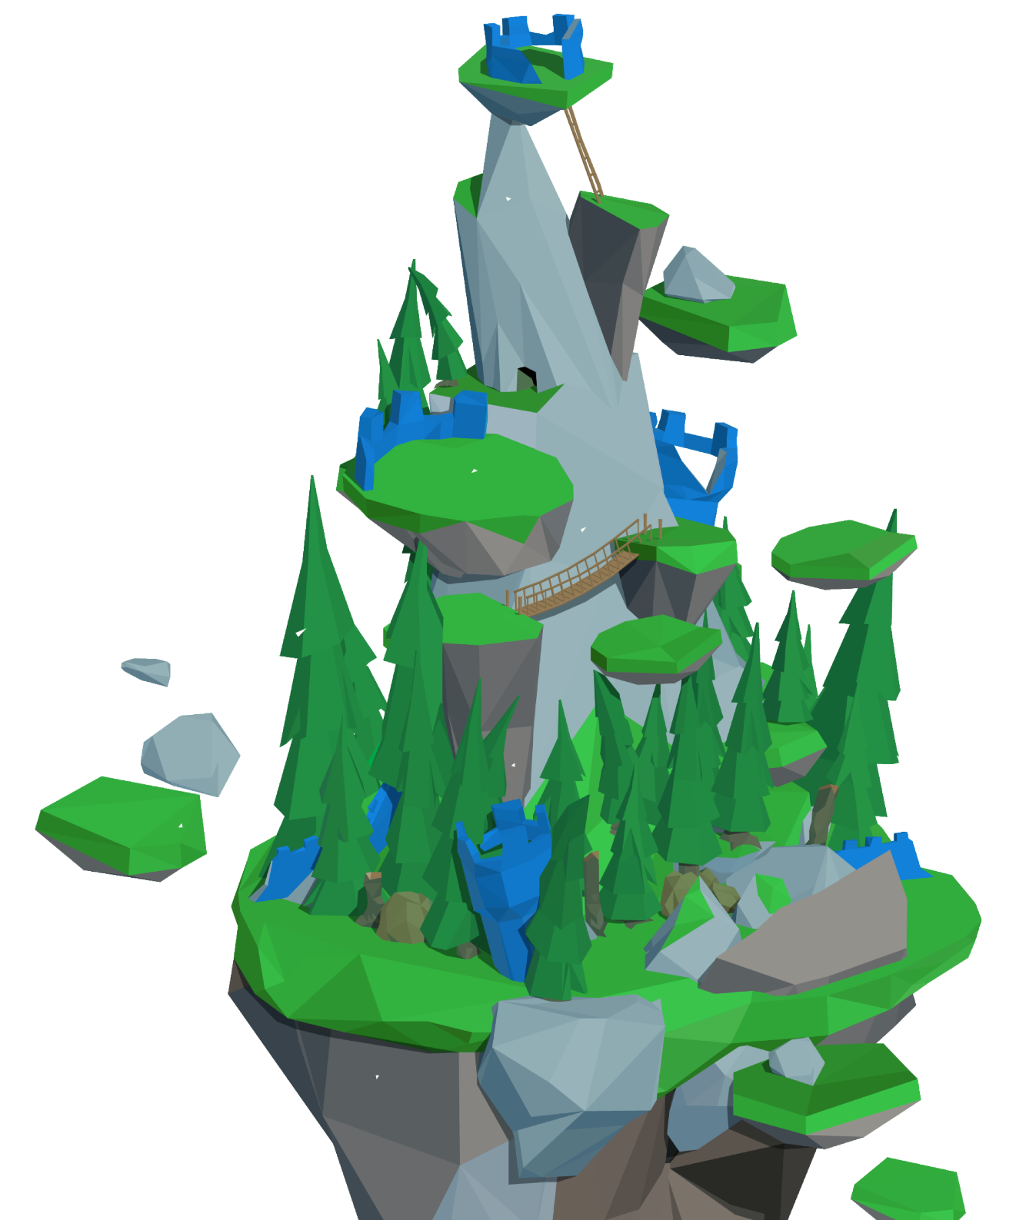
Time to visit…
Interland’s
Kind Kingdom
g.co/interland
Notes:
Be Internet Kind: Activity 6 - Interland: Kind Kingdom (20 mins)
Open a web browser on a desktop or mobile device (e.g. tablet), visit g.co/interland and navigate to the land called Kind Kingdom.
This is followed by the discussion questions in the activity section of the booklet.

Slide 14
1
What scenario in Kind Kingdom do you relate to most and why?
Notes:
Be Internet Kind: Activity 6 - Interland: Kind Kingdom (20 mins)
Questions to ask after playing Kind Kingdom:
• What scenario in Kind Kingdom do you relate to most and why? • Describe a time when youʼve taken action to spread kindness to others online. • In what situation would it be appropriate to block someone online? • In what situation would it be appropriate to report someoneʼs behaviour? • Why do you think the character in Kind Kingdom is called a Cyberbully? Describe this characterʼs qualities and how their actions affect the game. • Does this game change the way you plan to behave towards others?

Slide 15
2
Describe a time when youʼve taken action to spread kindness to others online.
Notes:
Be Internet Kind: Activity 6 - Interland: Kind Kingdom (20 mins)
Questions to ask after playing Kind Kingdom:
• What scenario in Kind Kingdom do you relate to most and why? • Describe a time when youʼve taken action to spread kindness to others online. • In what situation would it be appropriate to block someone online? • In what situation would it be appropriate to report someoneʼs behaviour? • Why do you think the character in Kind Kingdom is called a Cyberbully? Describe this characterʼs qualities and how their actions affect the game. • Does this game change the way you plan to behave towards others?

Slide 16
3
In what situation would it be appropriate to block someone online?
Notes:
Be Internet Kind: Activity 6 - Interland: Kind Kingdom (20 mins)
Questions to ask after playing Kind Kingdom:
• What scenario in Kind Kingdom do you relate to most and why? • Describe a time when youʼve taken action to spread kindness to others online. • In what situation would it be appropriate to block someone online? • In what situation would it be appropriate to report someoneʼs behaviour? • Why do you think the character in Kind Kingdom is called a Cyberbully? Describe this characterʼs qualities and how their actions affect the game. • Does this game change the way you plan to behave towards others?

Slide 17
4
In what situation would it be appropriate to report someoneʼs behaviour?
Notes:
Be Internet Kind: Activity 6 - Interland: Kind Kingdom (20 mins)
Questions to ask after playing Kind Kingdom:
• What scenario in Kind Kingdom do you relate to most and why? • Describe a time when youʼve taken action to spread kindness to others online. • In what situation would it be appropriate to block someone online? • In what situation would it be appropriate to report someoneʼs behaviour? • Why do you think the character in Kind Kingdom is called a Cyberbully? Describe this characterʼs qualities and how their actions affect the game. • Does this game change the way you plan to behave towards others?

Slide 18
5
Why do you think the character in Kind Kingdom is called a Cyberbully?
Describe this characterʼs qualities and how their actions affect the game.
Notes:
Be Internet Kind: Activity 6 - Interland: Kind Kingdom (20 mins)
Questions to ask after playing Kind Kingdom:
• What scenario in Kind Kingdom do you relate to most and why? • Describe a time when youʼve taken action to spread kindness to others online. • In what situation would it be appropriate to block someone online? • In what situation would it be appropriate to report someoneʼs behaviour? • Why do you think the character in Kind Kingdom is called a Cyberbully? Describe this characterʼs qualities and how their actions affect the game. • Does this game change the way you plan to behave towards others?

Slide 19
6
Does this game change the way you plan to behave towards others?
Notes:
Be Internet Kind: Activity 6 - Interland: Kind Kingdom (20 mins)
Questions to ask after playing Kind Kingdom:
• What scenario in Kind Kingdom do you relate to most and why? • Describe a time when youʼve taken action to spread kindness to others online. • In what situation would it be appropriate to block someone online? • In what situation would it be appropriate to report someoneʼs behaviour? • Why do you think the character in Kind Kingdom is called a Cyberbully? Describe this characterʼs qualities and how their actions affect the game. • Does this game change the way you plan to behave towards others?

Slide 20
Draw and write!
Using your drawing from earlier…
What else have you learned about being kind online that you can now add to your drawing?
Notes:
Plenary
(5 mins)
Revisit the template they filled out at the start of the lesson. Ask pupils to write around the template with any additional ideas and thoughts they have about how to be kind online.
Invite table groups to feedback three key skills that they think they would now use to respond to negative online behaviour.
Extension
Ask pupils to design a social media post with top tips for ‘How can I stand up to others online?’. One post could be chosen to share on the school social media or in the school newsletter for parents and other pupils. This could include:
• Reporting mean or bullying behaviour.
• Not passing on hurtful messages.
• Setting a good example by being friendly and kind to others.
• Not encouraging nasty behaviour by ‘liking’ mean posts online.

