Slide 1


Refusing
& Reporting
Deciding how and when to do something

Slide 2

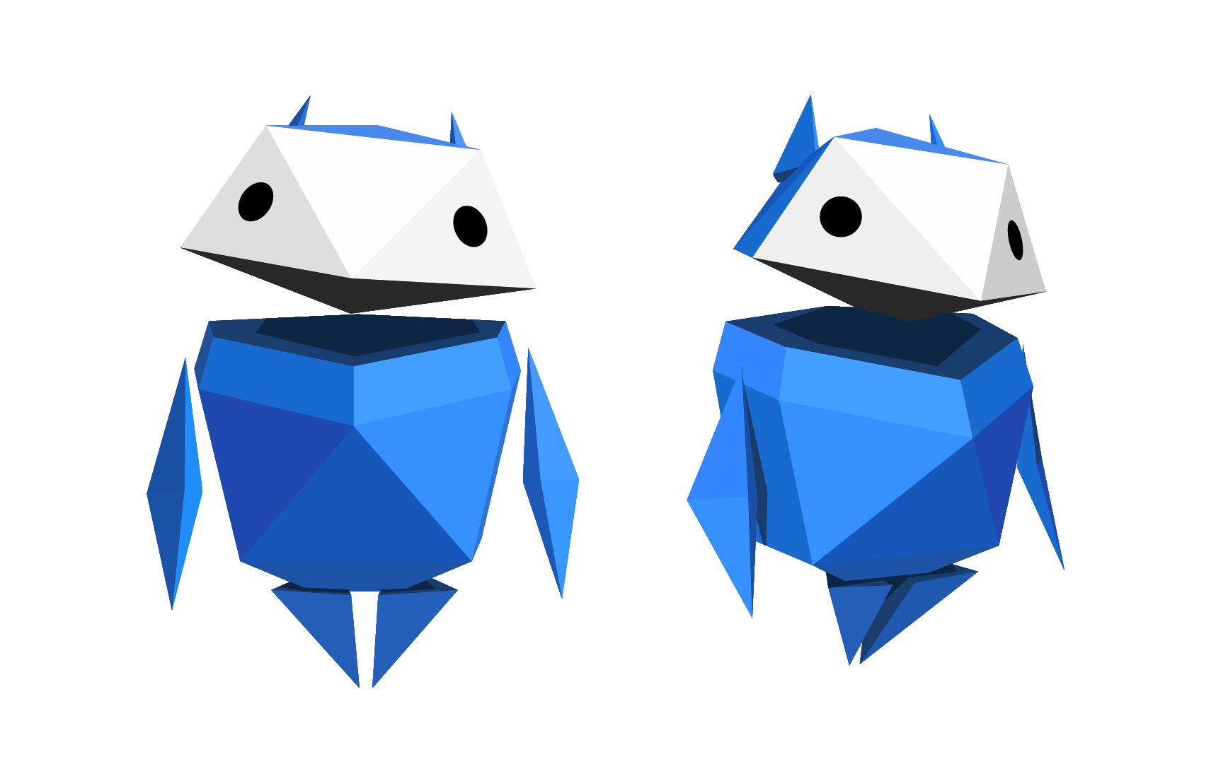
Let’s talk!
What would you do if you
saw someone being unkind
to someone else…
In the playground?
In the
park?
In the classroom?
Notes:
Baseline Activity
(10 mins)
Find out from pupils what they would do if they saw someone being unkind to someone else e.g. at a local park.

Slide 3
Let’s talk!
What about if you saw it online?
What would you do?
Who would you speak to?
Would you do things differently
if it was online? Why?
Notes:
Baseline Activity
(10 mins)
What would they do if this was happening online?
• What would they do?
• Who would they speak to?
• Is there a difference between what they would do in person or online? Why?

Slide 4

Why is it important to be kind?
When have you been kind, or somebody been kind to you?
Notes:
Be Internet Brave: Activity 1 - Upstanders have options (15 mins)
Pupils practise identifying the four roles of a bullying incident (the person who bullies, the target of the bullying, the bystander, and the helper, or upstander) and things to do if they witness bullying.
Discuss the importance of being kind – share examples when pupils have been kind or received kindness (e.g. having doors held open, being invited to a friend’s house).

Slide 5
What do we know about ______?
Teacher note:
Please add an image of a popular figure that your pupils will recognise - e.g Harry Styles or Zendaya.
Notes:
Be Internet Brave: Activity 1 - Upstanders have options (15 mins)
Choose a popular figure that children know (this could be a streamer, singer or actor.).
Discuss how much we know about them. Is it a lot or not much? Why is that? These people are human and need to be treated with kindness and respect.
Sometimes others are unkind and we can choose whether we want to be a bystander or an upstander (helper).

Slide 6
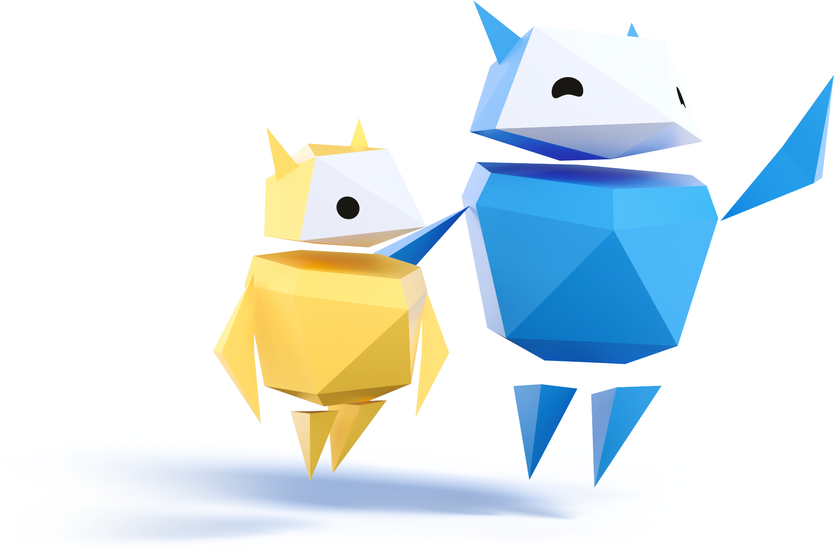
Let’s practise…
Read each scenario on your worksheet and decide whether each option is what a bystander or an upstander would do.
Mark bystander options with a B
Mark upstander options with a U
Notes:
Be Internet Brave: Activity 1 - Upstanders have options (15 mins)
Using the scenarios provided on the worksheet for Be Internet Brave: Activity 1, pupils work together to work out whether each option is what a bystander or upstander would do.

Slide 7
Let’s practise…
Get into groups of five and choose a reader and a writer.
The reader will read each scenario aloud. Then, as a group, discuss how an upstander might respond publicly and privately.
Notes:
Be Internet Brave: Activity 2 - Upstanders Options (15 mins)
Each group needs a reader and a writer. The reader reads each situation out loud and then the group spends time discussing them to decide how you’d support the target publicly and how you’d support them privately. The writer makes notes of the group's decisions on two sticky notes and sticks one note in the Public column and one note in the Private column on the whiteboard. OR make up your own way to help the target. Repeat that process for Situation 2 and Situation 3.
Note: There isn’t only one right way to support a target because each person (whether target or bystander) is different and each situation is different. We’re just trying out different helper options.

Slide 8
1
Someone in another
class posts a video of themselves singing a cover to a famous pop artist’s song.
Public support
Private support
Something else
People at your school start posting mean comments under the video.
Notes:
Be Internet Brave: Activity 2 - Upstanders Options (15 mins)
Often children want to help out a target of bullying but don’t know what to do.
This activity shows them that they have choices, offers examples, and gives them an opportunity to create positive responses of their own in their own way. Groups work through some scenarios and discuss how they would feel comfortable responding.
Pupils role-play being an upstander and decide whether they want to be a ‘public supporter’ or ‘private supporter’ in response to three different scenarios from the worksheet for Be Internet Brave: Activity 2.

Slide 9
2
Someone in your class sends another pupil a screenshot of a comment your friend posted and makes a nasty joke about it.
Public support
Private support
Something else
The screenshot gets reposted and goes viral
at school.
Notes:
Be Internet Brave: Activity 2 - Upstanders Options (15 mins)
Often children want to help out a target of bullying but don’t know what to do.
This activity shows them that they have choices, offers examples, and gives them an opportunity to create positive responses of their own in their own way. Groups work through some scenarios and discuss how they would feel comfortable responding.
Pupils role-play being an upstander and decide whether they want to be a ‘public supporter’ or ‘private supporter’ in response to three different scenarios from the worksheet for Be Internet Brave: Activity 2.

Slide 10
3
You find out that someone at your school created a fake social media account using another pupil's name and posts photos and memes that say mean things about other pupils, teachers and the school.
Public support
Private support
Something else
Notes:
Be Internet Brave: Activity 2 - Upstanders Options (15 mins)
Often children want to help out a target of bullying but don’t know what to do.
This activity shows them that they have choices, offers examples, and gives them an opportunity to create positive responses of their own in their own way. Groups work through some scenarios and discuss how they would feel comfortable responding.
Pupils role-play being an upstander and decide whether they want to be a ‘public supporter’ or ‘private supporter’ in response to three different scenarios from the worksheet for Be Internet Brave: Activity 2.

Slide 11
Let’s talk!
What have you seen online that made you think you should do something about it?
What options do you have if you see something negative online?
Notes:
Be Internet Brave: Activity 3.2 - Seeing upsetting stuff (15 mins)
Pupils learn to identify inappropriate online content and strategies for refusing it. Pupils also learn about reporting any content that suggests someone has or is about to hurt themselves or others.
Pupils share things that they have seen online and, if willing, use these as discussion points in the lesson and talk about what the options are for dealing with such things.
Emphasise that there are options – there is not one single way to deal with it but it is down to the individual to feel brave and choose the way that suits them best.
Safeguarding
If a child runs into upsetting content or communication online and reports this to you privately later, follow these steps, which are reflective of safeguarding procedures:
1. Thank them for telling you and reassure them that they did the right thing in coming to you.
2. Listen to their report and make a note of what they say. In this situation, your job is to listen, not be an investigator.
3. If the child indicates the content has been shared by an adult or that any inappropriate contact is involved, report what you’ve heard to a designated safeguarding lead, understanding the sensitivity of this information and the primary importance of caring for the child.
4. Follow your school’s safeguarding procedure with reporting.
A special note for educators
If during or after this activity a pupil tells you about an instance of bullying, harassment, abuse, threats of violence or even suicidal ideation, that is usually a sign of trust and it’s very important that you honour that trust. Research suggests that pupils will often report sensitive information to an adult only one time. If that first report doesn’t result in them feeling helped, pupils will not try again.
If a child does report something serious to you, follow the steps listed at the beginning of the activity.

Slide 12

Let’s talk!
Have you ever seen content, comments,
or behaviour online
that made you upset?
Notes:
Be Internet Brave: Activity 3.2 - Seeing upsetting stuff (15 mins)
This activity will help you handle situations where people do, say or show you things online that make you upset or scared.
Have you ever seen content, comments or behaviour online that made you upset? It could be texts, photos or videos.
Discuss the following: ‘Something that upset me online was .’ On a piece of paper, write some examples that fill in the blank in this sentence on the board.
As pupils are writing, walk around and look at their answers. Ask a few pupils if they’re willing to share their answers with the class.

Slide 13
Let’s talk!
How can you refuse upsetting things?
Is it different for
different platforms?
Notes:
Be Internet Brave: Activity 3.2 - Seeing upsetting stuff (15 mins)
You have the same right to feel as safe and comfortable online as you do here at school. You get to decide what you watch and who you talk with online. You can refuse to see anything that makes you upset. This activity is all about growing your refusal skills – skills everybody needs to have.
So what are some ways you can refuse upsetting things? Pupils might come up with the following examples: “Turn off your device.” “Delete things people send you.” “Block or remove senders.” “Tell them you don’t like whatever it is.” Make sure they hear all of these options. Encourage pupils to share specifics of how they can refuse content on different platforms. This will also be a chance for you to learn more, for future discussions, about your pupils’ experiences online. To maximise trust and communication, try to remain judgement-free.

Slide 14

Let’s talk!
Sometimes you might not know how to respond if you see something upsetting.
What are some things you could do?
Notes:
Be Internet Brave: Activity 3.2 - Seeing upsetting stuff (15 mins)
Sometimes you might not know how to handle a situation – which is just fine. What could you do in this situation? A good response is: “Get help from an adult I trust.”
Remember, just because you refuse doesn’t mean you can’t also report the content or the behaviour. You can definitely do both.
If you need help and report what happened to an adult, but they can’t help you, what should you do? (“Find another adult to report to.”) Reporting isn’t always easy, keep reporting until you find an adult who really helps you.
Think of some adults here at school you trust to help you.

Slide 15
Let’s practise…
Listen to each scenario carefully.
If you would refuse the scenario, move to the REFUSE sign.
If you would report what
is happening to an adult,
move to the REPORT sign.
Notes:
Be Internet Brave: Activity 3.2 - Seeing upsetting stuff (15 mins)
Complete the activity with pupils moving around the room choosing ‘refuse’ or ‘report’ following different scenarios being read out from page 111.
1. Place the two signs on opposite sides of the room.
2. Choose a scenario from the list and read it to the class or create a relevant scenario of your own.
3. Ask pupils to think about whether they’d refuse the scenario themselves or report what happened to an adult and ask for help.
4. Pupils move to the side of the room corresponding to what they’d do.
5. Each group discusses what they’d say or do when refusing or reporting and why.
6. Have some pupils demonstrate reporting and refusing.
7. Repeat with another scenario, as time allows.

Slide 16
1
A friend of yours keeps
using bad language in chats.
Quite
confident
REFUSE
REPORT
Notes:
Be Internet Brave: Activity 3.2 - Seeing upsetting stuff (15 mins)
Complete the activity with pupils moving around the room choosing ‘refuse’ or ‘report’ following different scenarios being read out from page 111.
Scenario 1: A friend of yours keeps using bad language in chats.

Slide 17
2
You keep seeing sexist
statements in a comment thread.
Quite
confident
REFUSE
REPORT
Notes:
Be Internet Brave: Activity 3.2 - Seeing upsetting stuff (15 mins)
Complete the activity with pupils moving around the room choosing ‘refuse’ or ‘report’ following different scenarios being read out from page 111.
Scenario 2: You keep seeing sexist statements in a comment thread.

Slide 18
3
Someone makes fun
of a photo you’re in.
Quite
confident
REFUSE
REPORT
Notes:
Be Internet Brave: Activity 3.2 - Seeing upsetting stuff (15 mins)
Complete the activity with pupils moving around the room choosing ‘refuse’ or ‘report’ following different scenarios being read out from page 111.
Scenario 3: Someone makes fun of a photo you’re in.

Slide 19
4
Someone says something
really racist about you.
Quite
confident
REFUSE
REPORT
Notes:
Be Internet Brave: Activity 3.2 - Seeing upsetting stuff (15 mins)
Complete the activity with pupils moving around the room choosing ‘refuse’ or ‘report’ following different scenarios being read out from page 111.
Scenario 4: Someone says something really racist about you.

Slide 20
5
Someone asks you to send
them a picture of you naked.
Quite
confident
REFUSE
REPORT
Notes:
Be Internet Brave: Activity 3.2 - Seeing upsetting stuff (15 mins)
Complete the activity with pupils moving around the room choosing ‘refuse’ or ‘report’ following different scenarios being read out from page 111.
Scenario 5: Someone asks you to send them a picture of you naked.

Slide 21
6
You see a post saying someone is going to bring a gun to school.
Quite
confident
REFUSE
REPORT
Notes:
Be Internet Brave: Activity 3.2 - Seeing upsetting stuff (15 mins)
Complete the activity with pupils moving around the room choosing ‘refuse’ or ‘report’ following different scenarios being read out from page 111.
Scenario 6: You see a post saying someone is going to bring a gun to school.

Slide 22
Let’s talk!
What can you do or say when you see something upsetting online?
Notes:
Plenary
(10 mins)
Make notes on flipchart paper that can be displayed in your classroom, of the key things children can do or say when they see upsetting stuff online.
Extension
Pupils make a checklist of the things they would say or do when they see something upsetting online.

