Slide 1

Positive Digital
Footprints
How to build and maintain yours

Slide 2



Your ‘Online Reputation’
is anything that appears about you on the internet.
Notes:
Baseline activity
(10 mins)
Write the following on the board: Your online reputation is anything that appears about you on the internet.

Slide 3
How can you create
a positive digital
footprint for yourself
to help protect your
online reputation?
Notes:
Baseline activity
(10 mins)
Ask, ‘How could someone create a positive digital footprint for themselves in order to help protect their online reputation?’
Ask pupils to work in pairs and come up with three suggestions which they write on sticky notes.

Slide 4

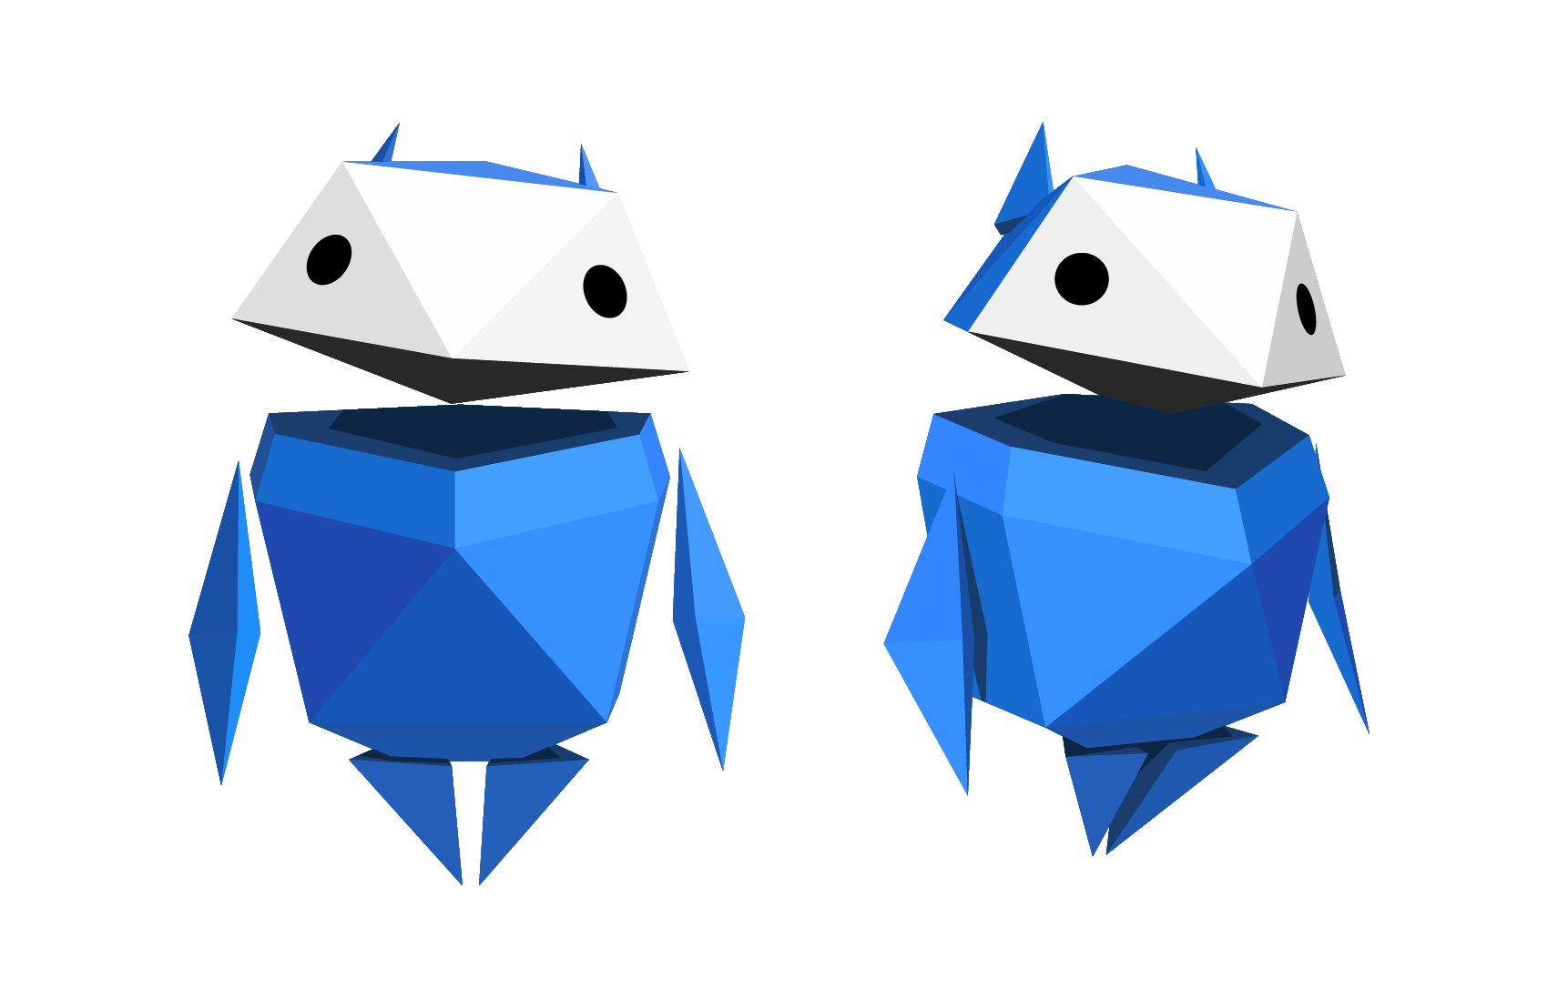
Let’s talk!
Share your responses with your table and choose the best ones to discuss with the class.
Notes:
Baseline activity
(10 mins)
Invite pairs to share their responses with their table group. Ask each group to then share with the rest of the class one or two of what they consider to be the most important points about creating a positive digital footprint to maintain their online reputation.
Examples of responses may include: don’t post embarrassing photos or videos online, don’t write unkind or hurtful comments and posts online, be kind to others, check privacy settings to make sure people can’t see all your personal information.
After discussion, reiterate the theme of the lesson: ‘Being Internet Sharp means knowing what kind of information to put online to create a positive digital footprint and protect your online reputation.’

Slide 5
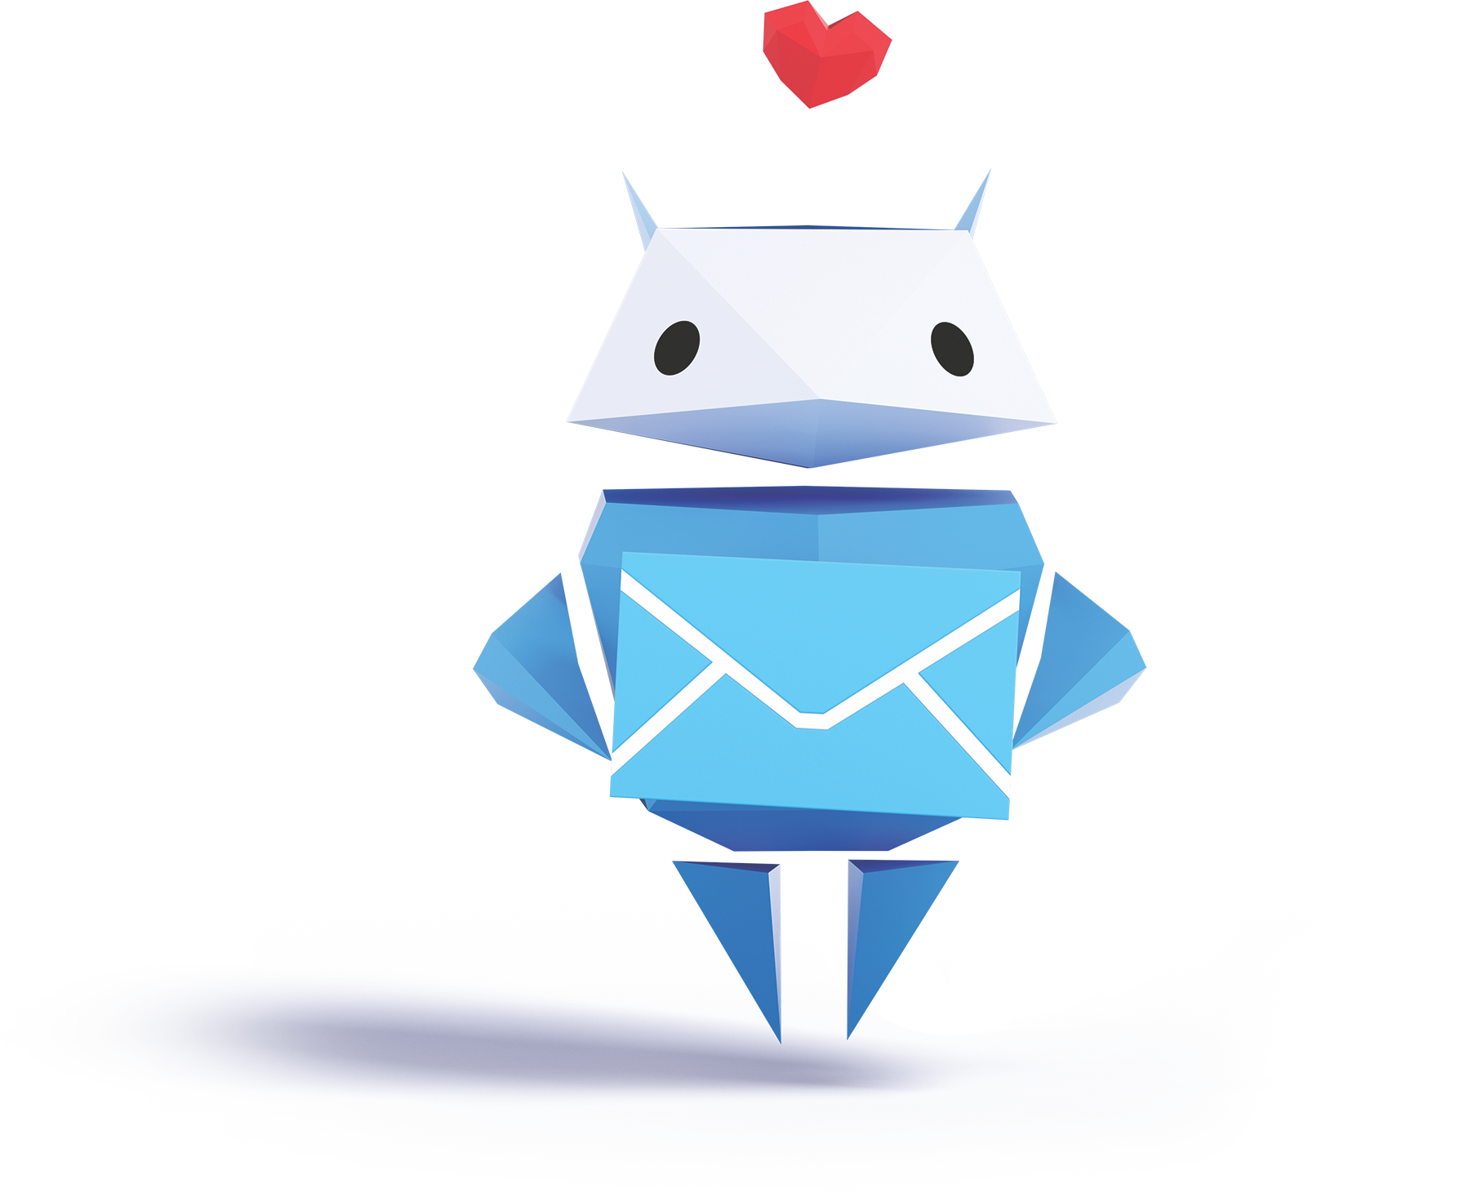


Being
Internet
Sharp
means knowing what
to put online to protect your online reputation
Notes:
Baseline activity
(10 mins)
After discussion, reiterate the theme of the lesson: ‘Being Internet Sharp means knowing what kind of information to put online to create a positive digital footprint and protect your online reputation.’

Slide 6


Draw and write!
In pairs, draw a picture of someone your
age who goes to a school like yours.
Now write down some made up fictional
information about them.
Examples
Favourite
foods or
colours
Number
of siblings
Silly
nicknames
Name
of their
school
Notes:
Be Internet Sharp: Activity 1 - Is it OK to share? (10 mins)
In pairs, ask pupils to invent a character around their age. Ask them to draw this character or write the character’s name in the middle of a piece of paper, and around the outside, write or draw ‘personal’ information about this person.
Remind pupils that this shouldn’t be real information, or about themselves or anyone they know.
Examples of information could include things like favourite foods or colours, names of teddies or toys, silly nicknames, number of siblings, the school they attend, etc.

Slide 7
Which of these pieces
of information are OK
to share?
Notes:
Be Internet Sharp: Activity 1 - Is it OK to share? (10 mins)
When they have finished, ask pupils to look at each piece of ‘personal’ information and identify whether it is OK to share that information online or not.
What effect might sharing have on the character’s online reputation?
Support and Extension.
If pupils need more support, provide them with a list of a character’s ‘personal’ information (e.g. name, address, photo of a friend, date of birth, password) – we have provided a support worksheet on page 18 in the booklet, although this will be used for the next part of the lesson. Ask them to say or to put a smiley or sad face next to each aspect to indicate if it is OK to share this information online or not.
If pupils need more of a challenge, ask them to create two social media profiles of their character: one with personal information that would create a negative digital footprint, and one which would create a positive digital footprint.

Slide 8
What effect might sharing them have
on someone’s online reputation?
Notes:
Be Internet Sharp: Activity 1 - Is it OK to share? (10 mins)
When they have finished, ask pupils to look at each piece of ‘personal’ information and identify whether it is OK to share that information online or not.
What effect might sharing have on the character’s online reputation?
Support and Extension.
If pupils need more support, provide them with a list of a character’s ‘personal’ information (e.g. name, address, photo of a friend, date of birth, password) – we have provided a support worksheet on page 18 in the booklet, although this will be used for the next part of the lesson. Ask them to say or to put a smiley or sad face next to each aspect to indicate if it is OK to share this information online or not.
If pupils need more of a challenge, ask them to create two social media profiles of their character: one with personal information that would create a negative digital footprint, and one which would create a positive digital footprint.

Slide 9


Think about Gurpreet, Mark,
and Leah
Write down at least two pieces of personal information that you have found out about them.
Notes:
Be Internet Sharp: Activity 2 - Whose profile is this, anyway? (10 mins)
Pupils need copies of the fictitious characters sheet from Be Internet Sharp: Activity 2
Pupils study a collection of online personal information about three fictitious characters to see what it tells them about each one.
Ask pupils to list at least two pieces of personal information they have obtained by reading each character’s profile.
Support and Extension
Pupils who need more support could use highlighter pens to underline the personal information on their sheet instead of writing it out. Pupils who need a challenge could write or prepare to present to the group a short ‘future forecast’ outlining the possible impact of the information that has been shared on their character’s future life.

Slide 10
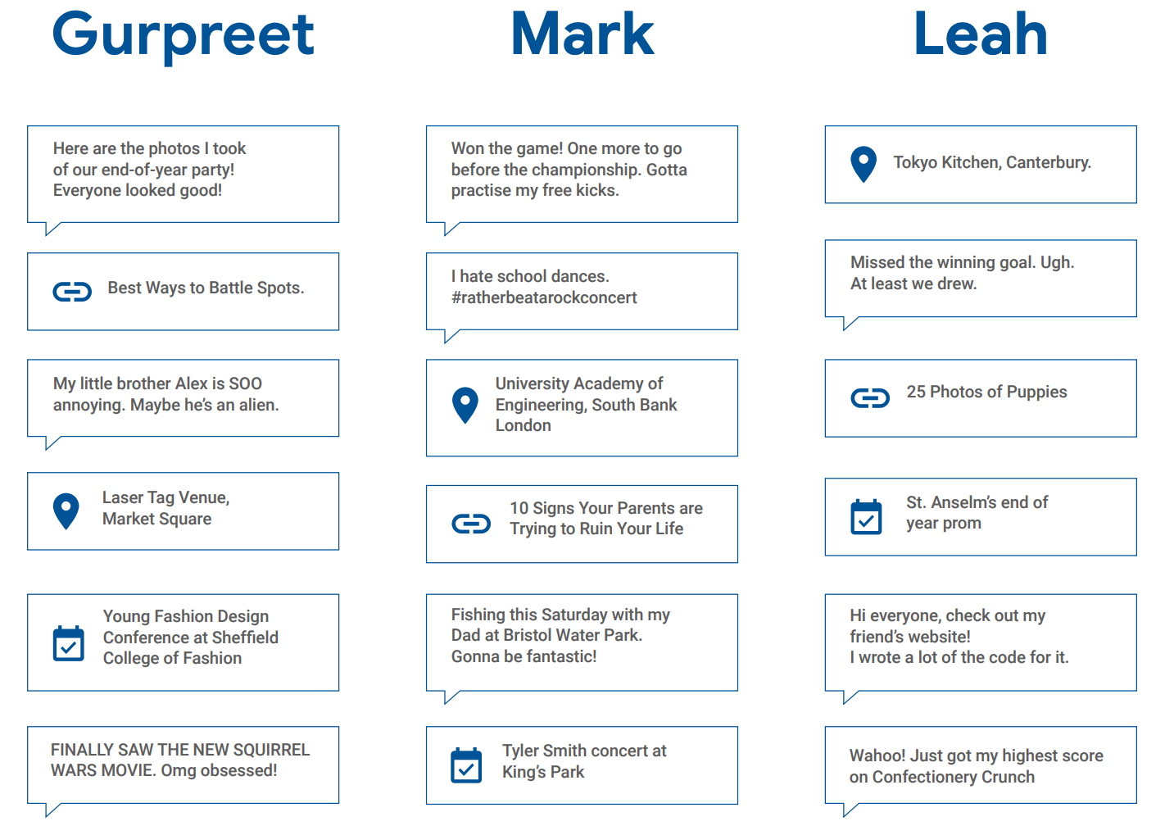
Let’s practise…
Notes:
Be Internet Sharp: Activity 2 - Whose profile is this, anyway? (10 mins)
Pupils need copies of the fictitious characters sheet from Be Internet Sharp: Activity 2
Pupils study a collection of online personal information about three fictitious characters to see what it tells them about each one.
Ask pupils to list at least two pieces of personal information they have obtained by reading each character’s profile.
Support and Extension
Pupils who need more support could use highlighter pens to underline the personal information on their sheet instead of writing it out. Pupils who need a challenge could write or prepare to present to the group a short ‘future forecast’ outlining the possible impact of the information that has been shared on their character’s future life.

Slide 11


Think about Gurpreet, Mark, and Leah
How risky is your character’s
digital footprint?
1 2 3 4 5 6 7 8 9 10
Not
risky
Very
risky
Notes:
Be Internet Sharp: Activity 2 - Whose profile is this, anyway? (10 mins)
On a scale of 1-10, how would they rate their character’s digital footprint in terms of risk now?

Slide 12
Think about Gurpreet, Mark, and Leah
How risky might their digital
footprint be in the future?
1 2 3 4 5 6 7 8 9 10
Not
risky
Very
risky
Notes:
Be Internet Sharp: Activity 2 - Whose profile is this, anyway? (10 mins)
On a scale of 1-10, how would they rate their character’s digital footprint in terms of risk in the future?

Slide 13
Let’s talk!
How much can we find out about somebody from what they post online, even if we don’t know them?
Notes:
Be Internet Sharp: Activity 2 - Whose profile is this, anyway? (10 mins)
Discussion: How much can we find out about someone just from what they post online, even if we don’t know them?

Slide 14
Let’s talk!
What are the consequences of accidentally sharing
too much information online?
Notes:
Be Internet Sharp: Activity 3 - How do others see us? (20 mins)
Please note: this requires the completion of Activity 2 first.
Recap with pupils the possible consequences of their characters sharing more information than they intended to online.

Slide 15
Think about Gurpreet,
Mark, and Leah
Choose a point of view:
parent
friend
advertiser
sports coach
police officer
yourself in 10 years
employer
Notes:
Be Internet Sharp: Activity 3 - How do others see us? (20 mins)
Pupils consider the viewpoints of how other people might view the characters’ profiles.
In groups, ask pupils to choose a different point of view and to look at Gurpreet, Mark, and Leah’s information again from a new perspective.

Slide 16
Let’s talk!
What is important to your
new person’s point of view?
What would they think about
your character?
What wouldn’t your character
want this new person to see?
Cross this information out
on your worksheet.
Notes:
Be Internet Sharp: Activity 3 - How do others see us? (20 mins)
Discuss the following in groups:
What’s important to each of these people?
What conclusions would they reach about this profile?
Cross out the information that you think your character wouldn’t want your group to see or that it would be unwise for them to reveal.

Slide 17
1
Is this OK
to share?
Someone at your school
has a bad haircut and isn’t happy with it.
Someone takes a photo
and shares it online.
In groups, discuss
and choose the best privacy solution.
Notes:
Be Internet Sharp: Activity 4 - Keeping it private (10 mins)
Invite pupils to work in groups in order to review the three written privacy scenarios.
Ask each group to discuss and agree upon the best privacy solution for each character.
Pictures have been provided of each scenario for pupils who need more support.
For each scenario ask: ‘Is this OK to share?’
For pupils who need a challenge, ask how each scenario could damage someone’s online reputation, both now and in the future, and how it might leave a negative digital footprint.

Slide 18
2
Is this OK
to share?
Someone writes
in their diary.
Their friend copies what they wrote and posts it online.
In groups, discuss
and choose the best privacy solution.
Notes:
Be Internet Sharp: Activity 4 - Keeping it private (10 mins)
Invite pupils to work in groups in order to review the three written privacy scenarios.
Ask each group to discuss and agree upon the best privacy solution for each character.
Pictures have been provided of each scenario for pupils who need more support.
For each scenario ask: ‘Is this OK to share?’
For pupils who need a challenge, ask how each scenario could damage someone’s online reputation, both now and in the future, and how it might leave a negative digital footprint.

Slide 19
3
Is this OK
to share?
Someone posts ‘Have
a great holiday!’ on a
friend’s social media page.
In groups, discuss
and choose the best privacy solution.
Notes:
Be Internet Sharp: Activity 4 - Keeping it private (10 mins)
Invite pupils to work in groups in order to review the three written privacy scenarios.
Ask each group to discuss and agree upon the best privacy solution for each character.
Pictures have been provided of each scenario for pupils who need more support.
For each scenario ask: ‘Is this OK to share?’
For pupils who need a challenge, ask how each scenario could damage someone’s online reputation, both now and in the future, and how it might leave a negative digital footprint.

Slide 20
4
Ronnie updates the password he uses to
play his favourite game, because somebody
told him it’s a good idea.
His friend Farah normally
plays the game using his account, so Ronnie gives her his new password so she can continue playing.
Is this OK
to share?
In groups, discuss
and choose the best privacy solution.
Notes:
Be Internet Sharp: Activity 4 - Keeping it private (10 mins)
Invite pupils to work in groups in order to review the three written privacy scenarios.
Ask each group to discuss and agree upon the best privacy solution for each character.
Pictures have been provided of each scenario for pupils who need more support.
For each scenario ask: ‘Is this OK to share?’
For pupils who need a challenge, ask how each scenario could damage someone’s online reputation, both now and in the future, and how it might leave a negative digital footprint.

Slide 21
5
Some friends are
playing video games together online.
A stranger joins their chat and asks their age.
One of the friends tells the stranger, who then asks more questions, like their school and town.
Is this OK
to share?
In groups, discuss
and choose the best privacy solution.
Notes:
Be Internet Sharp: Activity 4 - Keeping it private (10 mins)
Invite pupils to work in groups in order to review the three written privacy scenarios.
Ask each group to discuss and agree upon the best privacy solution for each character.
Pictures have been provided of each scenario for pupils who need more support.
For each scenario ask: ‘Is this OK to share?’
For pupils who need a challenge, ask how each scenario could damage someone’s online reputation, both now and in the future, and how it might leave a negative digital footprint.

Slide 22
6
Is this OK
to share?
You know that another pupil made a fake social media account that’s impersonating someone else and makes them look bad. It also includes their personal information.
In groups, discuss
and choose the best privacy solution.
Notes:
Be Internet Sharp: Activity 4 - Keeping it private (10 mins)
Invite pupils to work in groups in order to review the three written privacy scenarios.
Ask each group to discuss and agree upon the best privacy solution for each character.
Pictures have been provided of each scenario for pupils who need more support.
For each scenario ask: ‘Is this OK to share?’
For pupils who need a challenge, ask how each scenario could damage someone’s online reputation, both now and in the future, and how it might leave a negative digital footprint.

Slide 23



Time to visit…
Interland’s
Mindful Mountain
g.co/interland
Notes:
Additional activity: Be Internet Sharp: Activity 7 - Mindful Mountain (20 mins)
Pupils now have the chance to play Mindful Mountain in Interland, you can do this as a class or on separate devices.

Slide 24
Let’s talk!
Why are they called an Oversharer?
How do Oversharer’s actions affect the game?
Of the posts you shared in Mindful Mountain,
which type do you think you would share
most often in real life? Why?
How has Mindful Mountain made you think about
what people should share online?
Notes:
Additional activity: Be Internet Sharp: Activity 7 - Mindful Mountain (20 mins)
Questions to ask after playing Mindful Mountain:
• Why is the character in the game called Oversharer?
• How do Oversharer’s actions affect the game?
• Of all the posts you shared in the game, which type do you think you would share most often in real life? Why?
• How has playing the game made you think about what people should share online?
• How can sharing something publicly online instead of just with friends affect someone’s online reputation?
• What is one example of a possible negative consequence from sharing something with the public instead of just your friends?
• What can someone do, or how can they get help, if they share something they later regret online?

Slide 25
Let’s talk!
How can sharing something publicly online affect someone’s online reputation?
Could anything bad happen if you share something with the public instead of just your friends?
What can someone do if they share something online and then regret it?
Notes:
Additional activity: Be Internet Sharp: Activity 7 - Mindful Mountain (20 mins)
Questions to ask after playing Mindful Mountain:
• Why is the character in the game called Oversharer?
• How do Oversharer’s actions affect the game?
• Of all the posts you shared in the game, which type do you think you would share most often in real life? Why?
• How has playing the game made you think about what people should share online?
• How can sharing something publicly online instead of just with friends affect someone’s online reputation?
• What is one example of a possible negative consequence from sharing something with the public instead of just your friends?
• What can someone do, or how can they get help, if they share something they later regret online?

Slide 26
Draw and write!
3
ways you can
create a positive
digital footprint.
2
ways you can ask
for help if you regret posting something online.
1
question
you have.
Notes:
Plenary: 3-2-1 (5 mins)
Ask pupils to spend a few minutes reflecting on the activities in the lesson and ask them to write down or draw the following:
3. Three ways in which they can create a positive digital footprint.
2. Two ways in which someone can ask for help if they regret posting something online.
1. One question they have – they should be given the opportunity to provide this anonymously.
Extension:
Ask pupils to design a Be Internet Sharp advice leaflet or poster based on what they have learned in the activities. They could take this home to their parents to teach them what it means to Be Internet Sharp with tips on how they can achieve this.

