Slide 1
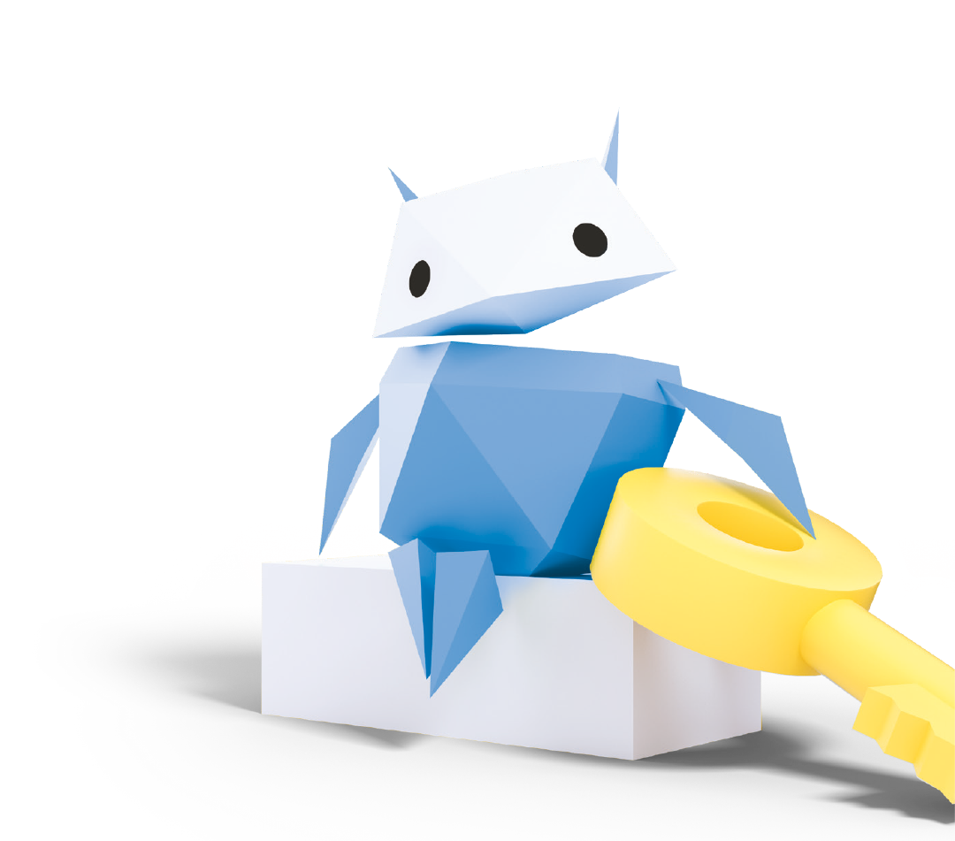
Sharing, Settings
& Passwords
How to protect yourself and stay safe online

Slide 2
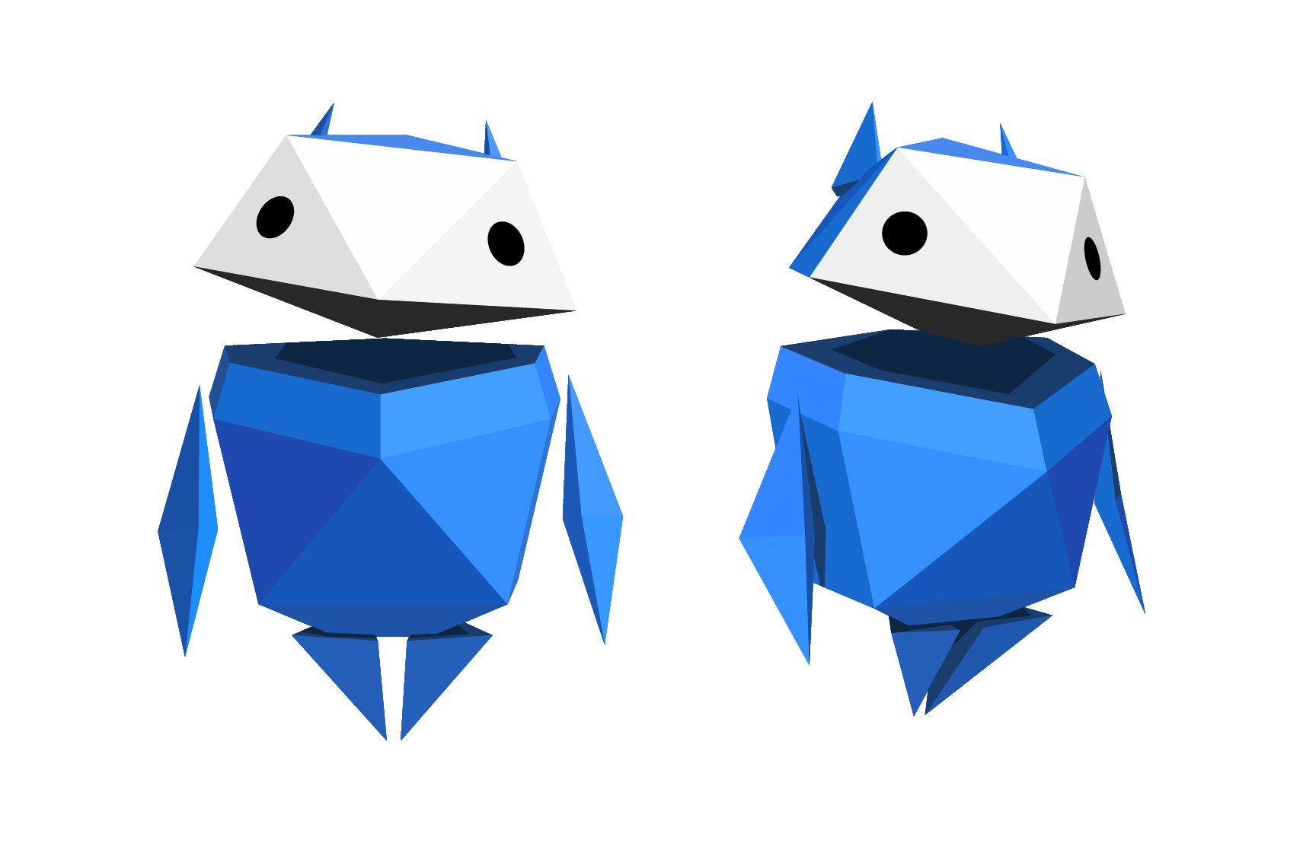
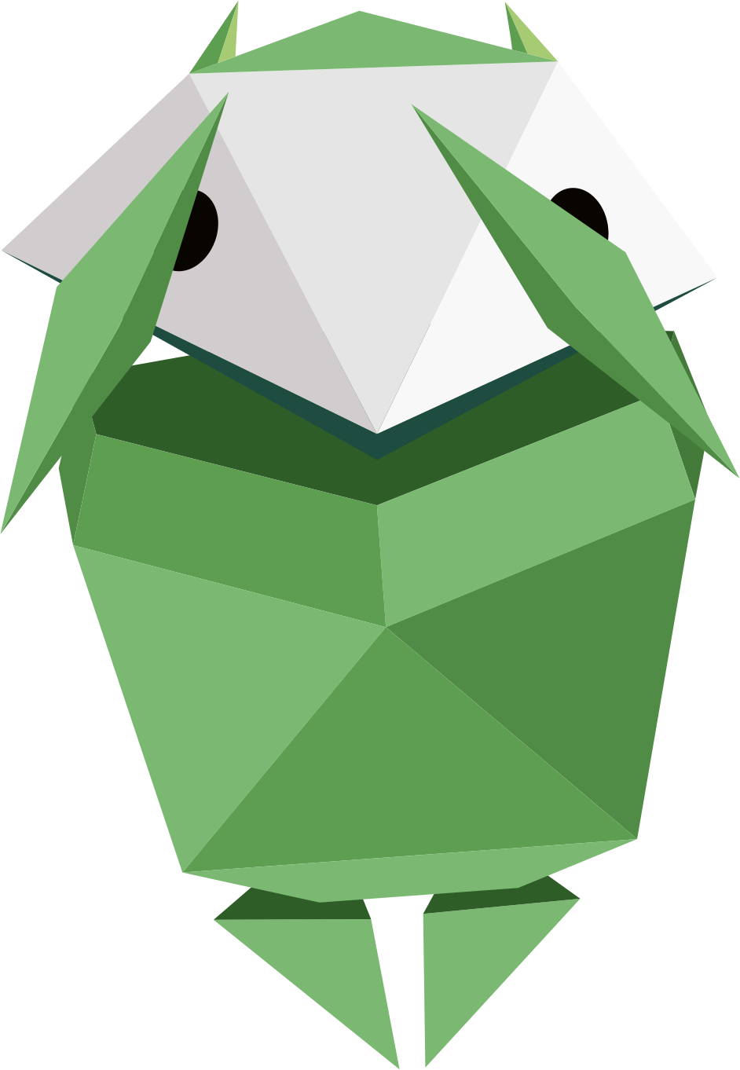
How confident are you in protecting your personal information online?
Draw a scale like this…
1 2 3 4 5 6 7 8 9 10
Not
confident
Very
confident
Notes:
Baseline Activity (10 mins)
Protecting my personal information online: how confident am I?
Ask pupils to draw a scale from 1-10. 1 representing ‘not at all confident’, all the way to 10, representing ‘very confident’.
Invite them to mark on their scale how confident they feel in terms of their knowledge and understanding of protecting their own personal information online.

Slide 3
Now close your eyes…
Notes:
Baseline Activity (10 mins)
Ask pupils to close their eyes and to put up their hand when you call out where they have rated themselves, 1-3, 4-7, 8-10. This will be revisited at the end of the lesson.
Support and Extension
Ask pupils, which privacy settings are available to use to keep safer online? Examples could include secure passwords, privacy settings on social media, two-step login process.

Slide 4




Why is it important to protect your personal information online?
Example
“Somebody might find out where I live”
Notes:
Baseline Activity (10 mins)
Ask pupils to discuss in table groups why it is important to protect personal information and to write as many reasons as they can on separate sticky notes.
Invite one or two pupils from each table to bring up their sticky note ideas and place them on a flipchart/display board.
Summarise and share what pupils have written on their sticky notes.
Possible answers: people may access your home address, phone number, see photos, messages and emails that you don’t want to be made public, etc.
Support and Extension
Ask pupils, which privacy settings are available to use to keep safer online? Examples could include secure passwords, privacy settings on social media, two-step login process.

Slide 5
Strong passwords can
keep you safe online
What makes a password strong?
A mix of uppercase
and lowercase letters
Symbols and numbers
Long passwords
Notes:
Be Internet Secure: Activity 2 - How to build a strong password (10 mins)
Remind pupils that one of the ways that can help to ensure personal information is safe online is to use a ‘strong’ password.
Ask them to define what they think are the features of a ‘strong’ password (mix of upper and lowercase letters, symbols, numbers for letters, etc.)

Slide 6
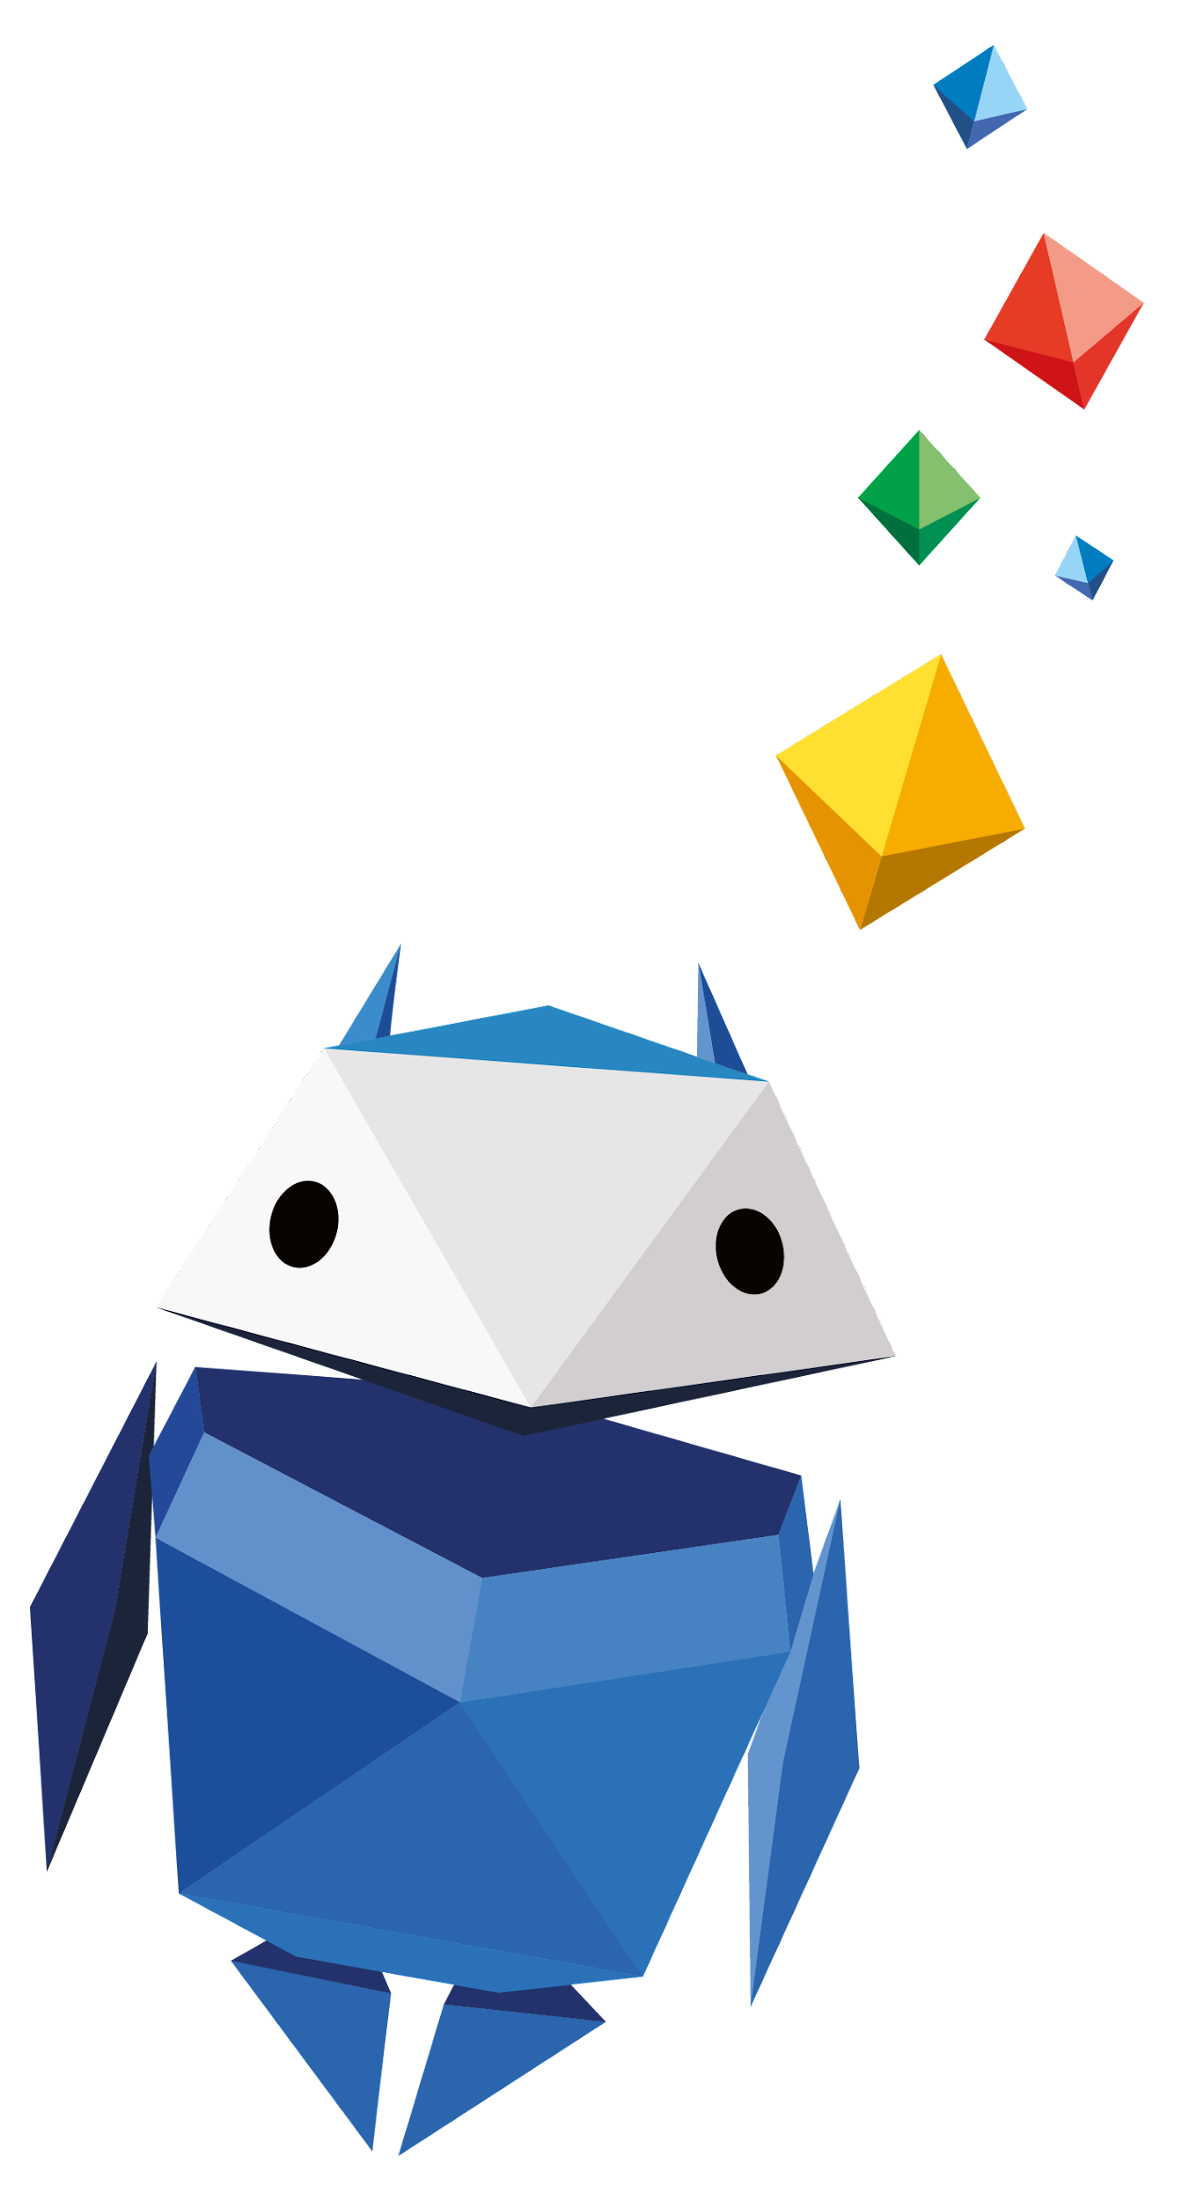
60-second challenge!
Create a strong password
Notes:
Be Internet Secure: Activity 2 - How to build a strong password (10 mins)
Divide the class into pairs.
Each team has 60 seconds to come up with what they think is a ‘strong’ password.
Ask two teams at a time to write their ‘strong’ passwords on the board.
Invite the class to vote on which passwords they think are ‘strong’. Pupils could also come up with examples of weak passwords and what makes them weak.
Support and Extension
Pupils needing support could be given some examples of weak passwords and asked how they could improve them (e.g ‘password’ ‘school’ ‘their name’). Pupils needing to be challenged could create a ‘Dos and Don’ts’ checklist on how to write a strong password and give clues to what a weak password would be.

Slide 7

How can we change privacy settings?
Notes:
Be Internet Secure: Activity 3 - Shh… Keep it to yourself! (15 mins)
Choose a school device to demonstrate where pupils can locate privacy settings.
This can be undertaken on the teacher’s class computer and demonstrated via the class whiteboard, via pupils’ own school tablets or in the place in school where laptops are located for lessons in computing.

Slide 8


What is two-step verification?
How do you turn on two-step verification?
Notes:
Be Internet Secure: Activity 3 - Shh… Keep it to yourself! (15 mins)
Ask pupils if they have heard of the two-step verification process and explain how it works. (When you log into an account, it will be a two-step process, i.e. entering a password and another piece of memorable data about you.)
Demonstrate going into ‘My Account’ or ‘Settings’ to explore privacy and security settings and show how privacy can be protected in this way.

Slide 9


Shh… keep it
to yourself!
Write down a catchy phrase to help you remember to change
your privacy settings
and turn on your
two-step verification.
Notes:
Be Internet Secure: Activity 3 - Shh… Keep it to yourself! (15 mins)
Ask pupils to compose a short slogan which helps them to remember the key advice.
Support and Extension
Pupils needing support should be given a one-to-one explanation of the demonstration and could create a ‘Shh... Keep it to yourself!’ cartoon giving key advice. This could be shared on the school website.
Pupils needing to be challenged could create a ‘Shh... Keep it to yourself!’ rule to be shared in assembly. This could take the form of a mnemonic/acrostic poem or rap.

Slide 10
1
Someone at your school has a bad haircut and isn’t happy with it.
What can you do if you feel unsafe online?
Who can you tell or go to?
Someone takes a photo
and shares it online.
What might happen when you tell?
What might happen after that?
Notes:
Be Internet Secure: Activity 4 - Taking care of yourself and others (10 mins)
This activity revisits the scenarios in Be Internet Sharp: Activity 4 - Keeping it Private, this time focusing on help-seeking.
Give out the three scenarios/dilemmas to pupils to be discussed in their table groups.
Key questions to answer are:
1. What can the person do if they feel unsafe online?
2. Who can they tell or go to?
3. What might happen when they tell?
4. What might happen after that?
Ask each group to share their responses with the rest of the class.
Support and Extension
Ask pupils who need support to discuss the scenarios with you, the teacher, or another adult, focusing on what the person could do if they feel unsafe online and whom they tell in school and outside of school in each case. Ask those that need more challenge to design a ‘who to go to’ flyer or poster for display in the classroom.

Slide 11
2
Someone writes
in their diary.
What can you do if you feel unsafe online?
Their friend copies
what they wrote
and posts it online.
Who can you tell or go to?
What might happen when you tell?
What might happen after that?
Notes:
Be Internet Secure: Activity 4 - Taking care of yourself and others (10 mins)
This activity revisits the scenarios in Be Internet Sharp: Activity 4 - Keeping it Private, this time focusing on help-seeking.
Give out the three scenarios/dilemmas to pupils to be discussed in their table groups.
Key questions to answer are:
1. What can the person do if they feel unsafe online?
2. Who can they tell or go to?
3. What might happen when they tell?
4. What might happen after that?
Ask each group to share their responses with the rest of the class.
Support and Extension
Ask pupils who need support to discuss the scenarios with you, the teacher, or another adult, focusing on what the person could do if they feel unsafe online and whom they tell in school and outside of school in each case. Ask those that need more challenge to design a ‘who to go to’ flyer or poster for display in the classroom.

Slide 12
3
Someone posts
‘Have a great holiday!’
on a friend’s social
media page.
What can you do if you feel unsafe online?
Who can you tell or go to?
What might happen when you tell?
What might happen after that?
Notes:
Be Internet Secure: Activity 4 - Taking care of yourself and others (10 mins)
This activity revisits the scenarios in Be Internet Sharp: Activity 4 - Keeping it Private, this time focusing on help-seeking.
Give out the three scenarios/dilemmas to pupils to be discussed in their table groups.
Key questions to answer are:
1. What can the person do if they feel unsafe online?
2. Who can they tell or go to?
3. What might happen when they tell?
4. What might happen after that?
Ask each group to share their responses with the rest of the class.
Support and Extension
Ask pupils who need support to discuss the scenarios with you, the teacher, or another adult, focusing on what the person could do if they feel unsafe online and whom they tell in school and outside of school in each case. Ask those that need more challenge to design a ‘who to go to’ flyer or poster for display in the classroom.

Slide 13
4
Ronnie updates the password he uses to
play his favourite game, because somebody told him it’s a good idea.
What can you do if you feel unsafe online?
Who can you tell or go to?
His friend Farah normally plays the game using his account, so Ronnie gives her his new password so she can continue playing.
What might happen when you tell?
What might happen after that?
Notes:
Be Internet Secure: Activity 4 - Taking care of yourself and others (10 mins)
This activity revisits the scenarios in Be Internet Sharp: Activity 4 - Keeping it Private, this time focusing on help-seeking.
Give out the three scenarios/dilemmas to pupils to be discussed in their table groups.
Key questions to answer are:
1. What can the person do if they feel unsafe online?
2. Who can they tell or go to?
3. What might happen when they tell?
4. What might happen after that?
Ask each group to share their responses with the rest of the class.
Support and Extension
Ask pupils who need support to discuss the scenarios with you, the teacher, or another adult, focusing on what the person could do if they feel unsafe online and whom they tell in school and outside of school in each case. Ask those that need more challenge to design a ‘who to go to’ flyer or poster for display in the classroom.

Slide 14
5
Some friends are
playing video games together online.
What can you do if you feel unsafe online?
Who can you tell or go to?
A stranger joins their chat and asks their age.
One of the friends tells the stranger, who then asks more questions, like their school and town.
What might happen when you tell?
What might happen after that?
Notes:
Be Internet Secure: Activity 4 - Taking care of yourself and others (10 mins)
This activity revisits the scenarios in Be Internet Sharp: Activity 4 - Keeping it Private, this time focusing on help-seeking.
Give out the three scenarios/dilemmas to pupils to be discussed in their table groups.
Key questions to answer are:
1. What can the person do if they feel unsafe online?
2. Who can they tell or go to?
3. What might happen when they tell?
4. What might happen after that?
Ask each group to share their responses with the rest of the class.
Support and Extension
Ask pupils who need support to discuss the scenarios with you, the teacher, or another adult, focusing on what the person could do if they feel unsafe online and whom they tell in school and outside of school in each case. Ask those that need more challenge to design a ‘who to go to’ flyer or poster for display in the classroom.

Slide 15
6
You know that another pupil made a fake social media account that’s impersonating someone else and makes them look bad. It also includes their personal information.
What can you do if you feel unsafe online?
Who can you tell or go to?
What might happen when you tell?
What might happen after that?
Notes:
Be Internet Secure: Activity 4 - Taking care of yourself and others (10 mins)
This activity revisits the scenarios in Be Internet Sharp: Activity 4 - Keeping it Private, this time focusing on help-seeking.
Give out the three scenarios/dilemmas to pupils to be discussed in their table groups.
Key questions to answer are:
1. What can the person do if they feel unsafe online?
2. Who can they tell or go to?
3. What might happen when they tell?
4. What might happen after that?
Ask each group to share their responses with the rest of the class.
Support and Extension
Ask pupils who need support to discuss the scenarios with you, the teacher, or another adult, focusing on what the person could do if they feel unsafe online and whom they tell in school and outside of school in each case. Ask those that need more challenge to design a ‘who to go to’ flyer or poster for display in the classroom.

Slide 16

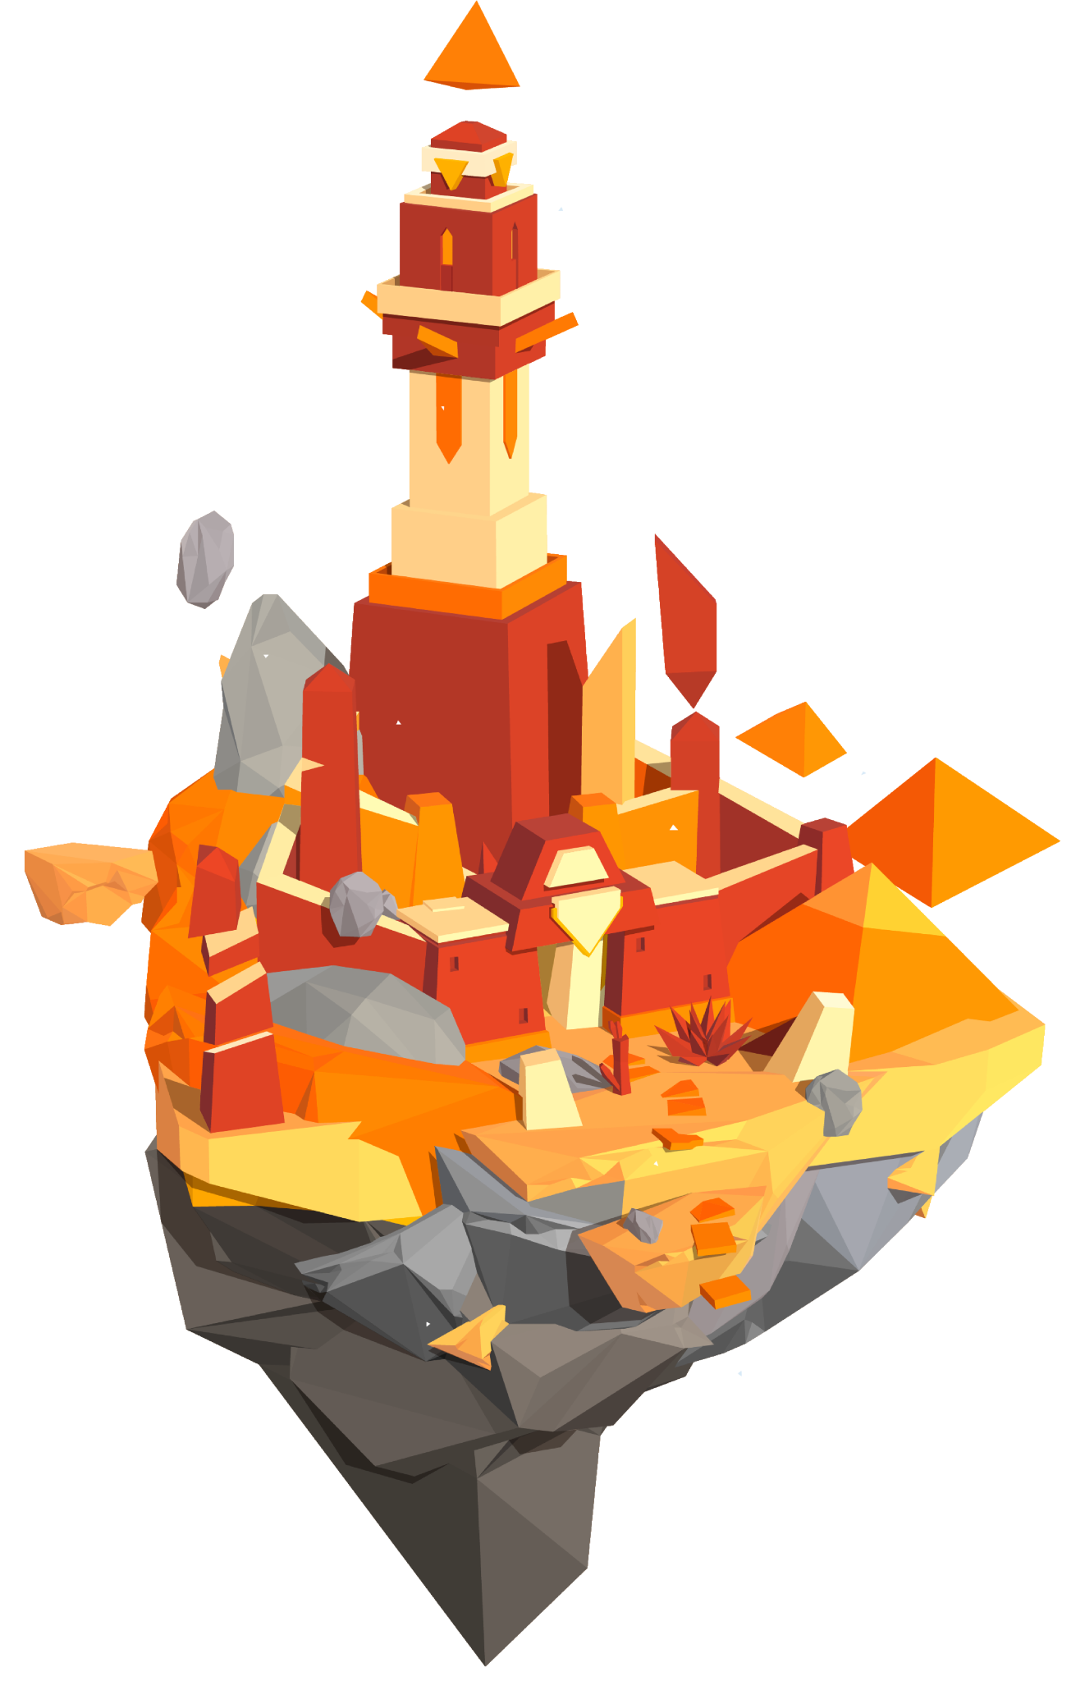

Time to visit…
Interland’s
Tower of Treasure
g.co/interland
Notes:
Be Internet Secure: Activity 5 - Interland: Tower of Treasure (10 mins)
An online game where pupils are asked to build an ‘untouchable’ password and secure made-up ‘private’ information on the game.
Pupils now have the chance to play Tower of Treasure in Interland, you can do this as a class or on separate devices.

Slide 17

Let’s talk!
What are the elements of a super strong password?
When is it important to create strong passwords
in real life? What tips have you learned on how
to do so?
What’s a Hacker? Describe this character’s behaviours and how they affect the game.
Did Tower of Treasure change the way you plan
to protect your information in the future? How?
Notes:
Be Internet Secure: Activity 5 - Interland: Tower of Treasure (10 mins)
What are the elements of a super strong password?
When is it important to create strong passwords in real life? What tips have you learned on how to do so?
Whatʼs a Hacker? Describe this characterʼs behaviours and how they affect the game.
Did Tower of Treasure change the way you plan to protect your information in the future? How?

Slide 18
Let’s talk!
Name one thing you’ll do differently after learning these lessons and playing the game.
Craft three practice passwords that pass the ‘super strong’ test.
What are some examples of sensitive information that should be protected?
Notes:
Be Internet Secure: Activity 5 - Interland: Tower of Treasure (10 mins)
What are the elements of a super strong password?
When is it important to create strong passwords in real life? What tips have you learned on how to do so?
Whatʼs a Hacker? Describe this characterʼs behaviours and how they affect the game.
Did Tower of Treasure change the way you plan to protect your information in the future? How?

Slide 19
Where do you rate
your confidence now?
1 2 3 4 5 6 7 8 9 10
Not
confident
Very
confident
Protecting your personal information online
Notes:
Plenary (5 mins)
Invite pupils to revisit the scales they filled in at the beginning of the lesson. Where would they rate their confidence levels now?
Support and Extension
Ask pupils to make a poster with top tips on how to stay secure online that can be shared with their parents and siblings. This may include tips on how to create a strong password, what to do if they receive messages from people they don’t know and how to manage their privacy settings on an app of their choosing. These could also form part of a display in the classroom or elsewhere at school.

