Slide 1
Resilient Families
Critical thinking skills

Slide 2
Use your critical thinking skills to decide what to do if these things happen…

Slide 3
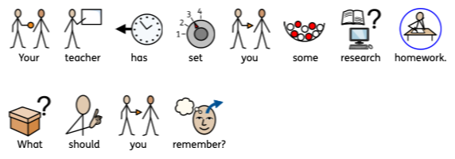


1.
a)
b)

Slide 4


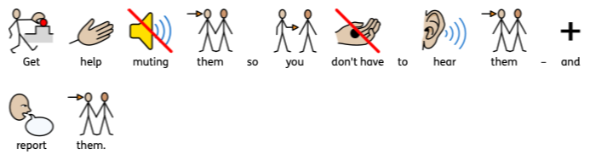
2.
a)
b)

Slide 5
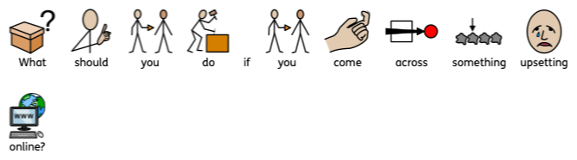


3.
a)
b)

