Slide 1
Teacher notes
This slide won’t be visible when you present the lesson.
Check the speaker notes for more information about
Lesson context
Delivery suggestions
Learning objectives
Safeguarding
If you have any questions at all, don’t hesitate to contact the Be Internet Legends Team on legends@parentzone.org.uk
Notes:
Lesson context
This Be Internet Legends lesson is adapted from Google and Parent Zone’s Be Internet Legends Scheme of Work – especially Be Internet Alert: Check it’s For Real (page 16).
You can order your physical copy of the scheme of work. Visit: https://parentzone.org.uk/curriculum
The lesson also includes a video from the Legends Family Adventure. Visit: https://beinternetlegends.withgoogle.com/en_uk/parents/adventure
You can use Episode 1 - This Could Be A Scam. Play the video to 2:16 and use the story as a narrative to frame the context of the lesson, as well as setting up a creative writing challenge to help children think about what might happen in the next part of the story. The activity can use some of the lesson activities to help tell the story. Please note: the Legends Family Adventure is designed as an activity for children to undertake with parents. You could share the full adventure as part of a follow-up home learning activity for families to experience together.
Delivery suggestions
The lesson is designed to be delivered live using video chat OR pre-recorded as a video file and hosted on Google Classroom or another e-learning platform. We’ve included script suggestions for both. You can also adapt the live script to deliver the lesson in the classroom, or another face-to-face setting. It’s completely up to you.
We’ve included a creative writing activity that can challenge pupils’ understanding of critical thinking and online scams. This can be uploaded as a Google Form, Google Doc or Word Doc – or copied into a format of your choosing. It works well as a follow-up or homework activity.
You might also want to share resources from Be Internet Legends to engage parents at home. Find out more about these resources – including how parents get get involved in the Legendary Family Adventure, featured in this lesson here: https://www.legendaryteacher.parentzone.org.uk/parents
If you have any questions at all, don’t hesitate to contact the Be Internet Legends Team on legends@parentzone.org.uk
Learning objectives
This lesson will help pupils become more aware of scams and phishing online – and how they can use their critical thinking skills to spot when something online can be trusted, or might be trying to trick them. Pupils will have the opportunity to test their digital detective skills to spot if something is a scam and learn why someone might want to trick them online.
Pupils will learn
About phishing and scams online and how to spot them.
How to spot if websites are more trustworthy and clues to spot if they are not.
After the lesson, pupils will be able to
Think critically when they go online and develop their media literacy.
Understand why some online spaces and messages might try to trick them.
Identify ways an online space or message might try to manipulate them – and why.
Know that when things online seem too good to be true, they sometimes are.
Safeguarding
We encourage you to use scenario-based learning for conversations around digital, including potential risks online. You can find more advice in the Be Internet Legends scheme of work. Read the pupil safety advice on page 2 before you begin. You can order copies of the curriculum at https://parentzone.org.uk/curriculum
Make sure pupils know who they can turn to and what they can do if they think they have spotted a scam online, any misinformation online, or if they ever feel something online on a site or in a message doesn’t feel right. You can also refer back to Be Internet Brave: When in Doubt, Discuss in the Be Internet Legends curriculum.
Pupils need to know who they can turn to within your school for pastoral support if they are worried about anything they come across online or through using tech. Signpost your pupils – and any adults working with them – to local and national support groups or helplines such as the National Crime Agency’s Child Exploitation and Online Protection Command (NCA-CEOP), NSPCC and Childline.

Slide 2
Check it’s
For Real
Lesson
How to Be Internet Alert and
know what to trust online
Notes:
These activities from Google’s Be Internet Legends programme are designed to help you spot scams online and know when things are real or fake.
To Be Internet Alert, you need to understand that people and situations online aren’t always what they seem.
Not everything can be trusted online – and to be a true Internet Legend, you can develop the skills to be aware when things are real or fake.
This lesson talks about how to spot the clues to help you stay safer. And we are going to discover your critical thinking skills, which will help you spot and dodge online scams.
[TEACHER NOTE: FOR LIVE DIGITAL DELIVERY]
Have you got a pen and paper ready? If you haven’t, I’ll give you a couple of minutes to get yourself sorted now.... [PAUSE] OK ready? Let’s go.
[TEACHER NOTE: IF PRE-RECORDING] I’ll tell you throughout this lesson when you need to pause the video for a challenge. Pause the lesson now so you can get paper, pens and a timer or clock. When you have what you need, just unpause me and we can carry on. Ready? Let’s go.

Slide 3
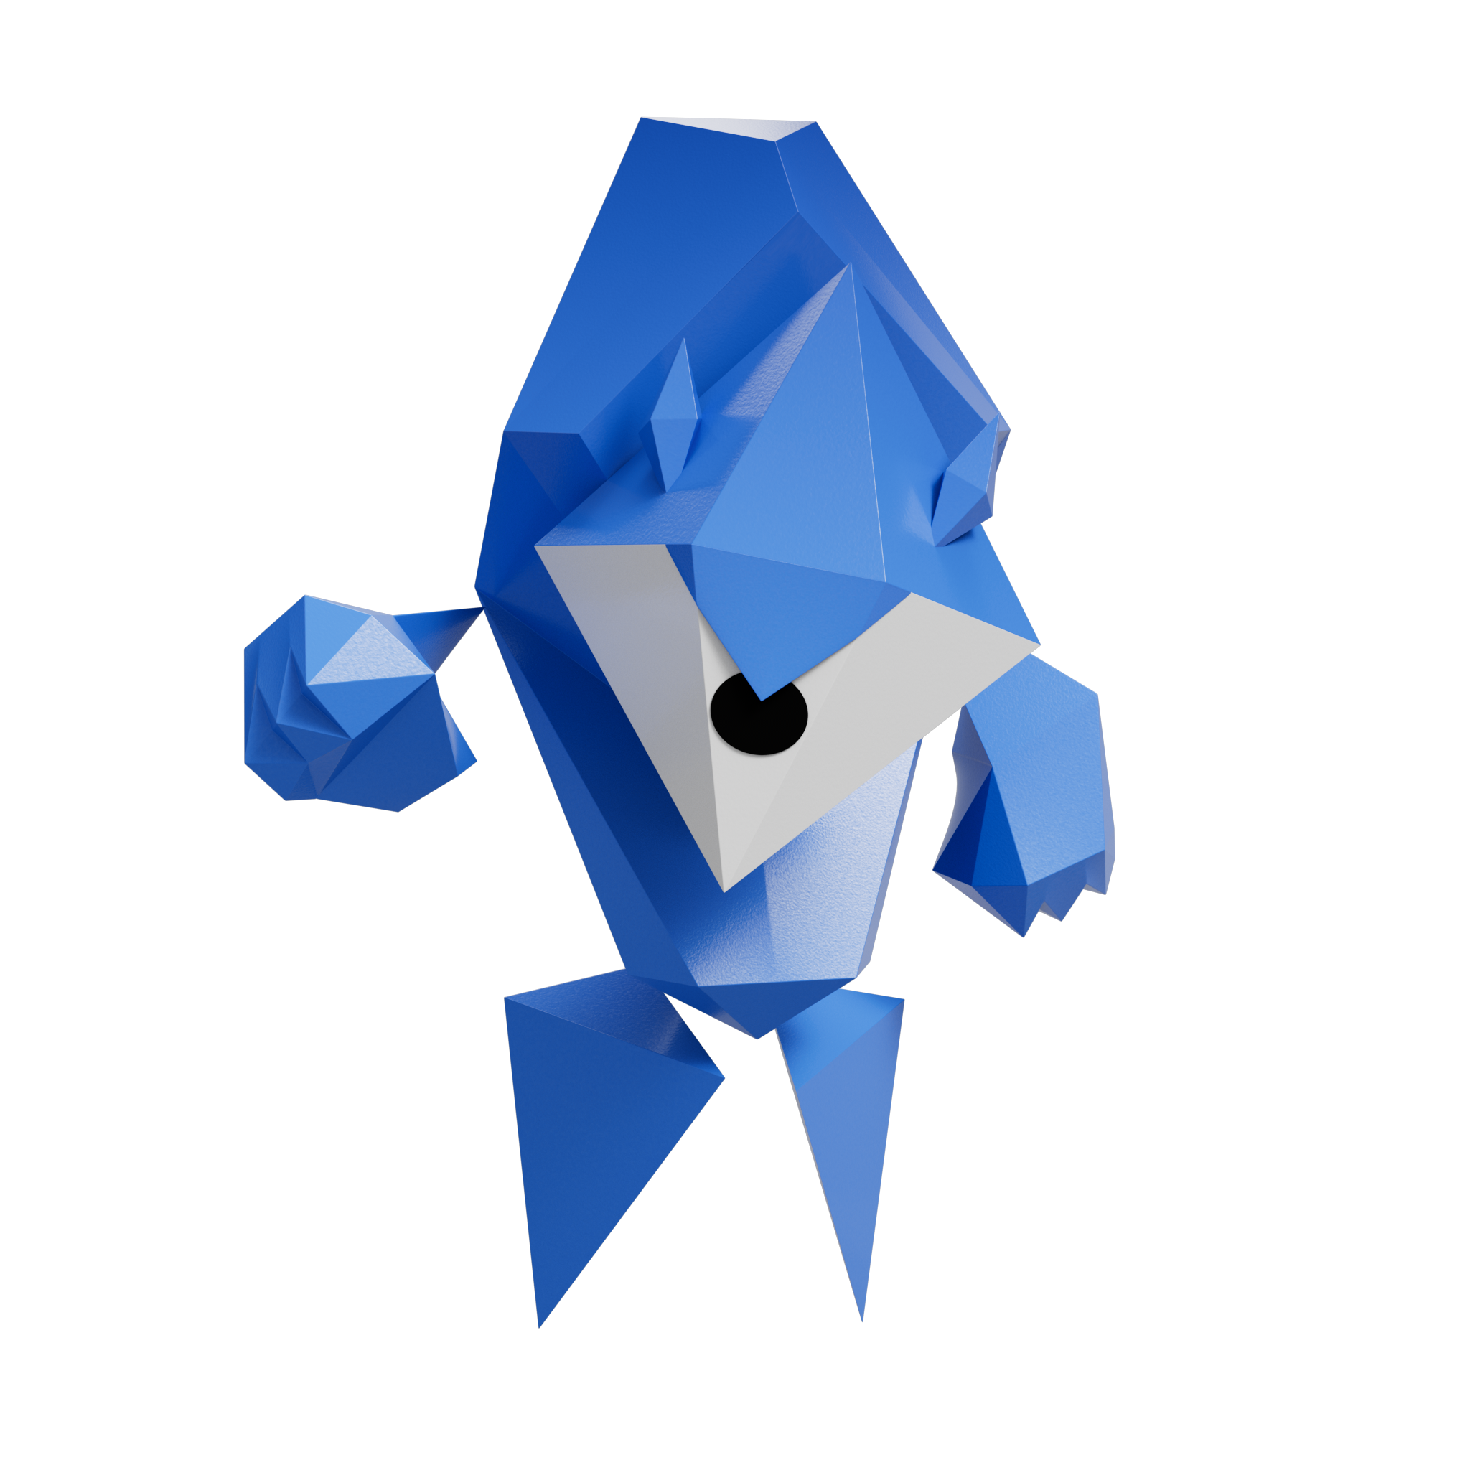
Do YOU trust the Phisher?
A phisher is someone tries to trick you into sharing your login or other personal information online.
Notes:
We just watched a video from the Legends Family Adventure. We met Lumen and family, who encounter a blue character called the ‘Phisher’. Lumen’s bear had gone missing and the Phisher was offering to help get it back.
[TEACHER NOTE: ASK PUPILS TO SHARE THEIR THOUGHTS]
So - how did you feel about the Phisher? Did you trust them? Why did you feel like that? What do you think the Phisher really wanted to get Lumen and family to do?
[TEACHER NOTE: FOR LIVE DIGITAL DELIVERY: Ask the questions above with responses in the chat]
[TEACHER NOTE: IF PRE-RECORDING] Grab your pen and paper and when I say, pause your video, can you write down how you felt about the Phisher. Did you trust them? When you are done, un-pause the video and we can continue the lesson. Pause your video now.

Slide 4
What is phishing?
Notes:
Have you ever heard of phishing before? Phishing – spelt with a ph – can happen in the online world when someone tries to steal information, or tries to trick someone into doing something. Sometimes a phisher will promise something really great – like winning a prize – but things are not always as they seem.
Let’s think about that video again. The Phisher wanted Lumen’s dad to buy the Toy Tracker 5000 Plus, by saying it would help find the missing bear. But it all sounded too good to be true, didn’t it?
The Phisher then tried to trick Lumen’s dad into sharing his bank details. Lumen’s dad almost gave away important personal information to someone he didn’t know – and couldn’t trust. Luckily, Lumen’s big brother spotted that something didn’t feel right.
Sometimes phishers will use tricks – which are often called scams – by offering something too good to be true – just like the Toy Tracker. It could be something like the chance to win an awesome prize.

Slide 5
Be a digital detective!
Notes:
Scams can happen in lots of different ways.
Phishing emails try to send someone to an unsafe website or get someone to download and open an attachment that might contain a virus (also known as ‘malware’) or something bad. It can also be someone pretending to be someone else. It might be for a prank... or it might be to try and steal personal information. Just like the Phisher, who was trying to get Lumen’s dad’s bank details.
If you’re online, strangers can ask to connect with you. But it’s ALWAYS up to YOU to decide whether you want to connect with that person. You can choose how to respond.
Being Alert online is like being a digital detective to spot the clues to see if something can be trusted – or if something might be a scam or trick. And you can look for clues to help you spot if someone is trying to trick you.

Slide 6
Be a digital detective!
Trust? Don’t trust?
An email asks Lumen to enter a login and password to win an amazing prize.
Notes:
[TEACHER NOTE: For each of these five questions, ask the children if it should be trusted or not trusted. You could A) ask for a show of hands, B) ask pupils to move to a side of the classroom to show their answer, or C) write down their answers to review at the end of the quiz]
Here is a digital detective challenge to help Lumen stay safer and spot some online scams. All you need to do is decide if each of these situations can be trusted or not.
1. An email asks Lumen to enter a login and password to win an amazing prize.
Should Lumen trust it or not trust it?
[TEACHER NOTE: FOR LIVE DIGITAL DELIVERY]
Share your answers in the chat / Grab a piece of paper and write down the numbers 1 to 5. As we go through, write down Trust or Don’t Trust. Then we’ll find out the answers at the end.
[TEACHER NOTE: IF PRE-RECORDING]
Grab a piece of paper and write down the numbers 1 to 5. As we go through, write down Trust or Don’t Trust. Then we’ll find out the answers at the end.

Slide 7
Be a digital detective!
Trust? Don’t trust?
A stranger offers Lumen a really valuable trade in an online game that sounds too good to be true.
Notes:
2. A stranger offers Lumen a really valuable trade in an online game that sounds too good to be true.
Should Lumen trust it or not trust it?

Slide 8
Be a digital detective!
Trust? Don’t trust?
Lumen gets a random email from a friend - with a weird attachment called:
‘You’ll NeVR believe tHiS!’
Notes:
3. Lumen gets a random email from a friend - with a weird attachment called: ‘You’ll NeVR believe tHiS!’
Should Lumen trust it or not trust it?

Slide 9
Be a digital detective!
Trust? Don’t trust?
Lumen visits a website that has a green padlock next to the address bar.
Notes:
4. Lumen visits a website that has a green padlock next to the address bar.
Should Lumen trust it or not trust it?

Slide 10
Be a digital detective!
Trust? Don’t trust?
Lumen gets a chain email from a stranger, saying to forward it on to five friends to win a cool new phone.
Notes:
5. Lumen gets a chain email from a stranger, saying to forward it on to five friends to win a cool new phone.
Should Lumen trust it or not trust it?

Slide 11
Did you spot the scams?
A scam is a dishonest attempt to make money or gain something of value.
Notes:
How Internet Alert were you? Did you spot the scams? Let’s look back at all those situations and find out...

Slide 12
Be a digital detective!
An email asks Lumen to enter a login and password to win an amazing prize.
Don’t trust!
Notes:
1. An email asks Lumen to enter a login and password to win an amazing prize.
DON’T TRUST: It might be a scam! A trustworthy email would never ask you to share a login and password. Lumen could always check the email address too, to see if it matches with what the email is offering.

Slide 13
Be a digital detective!
Don’t trust!
A stranger offers Lumen a really valuable trade in an online game that sounds too good to be true.
Notes:
2. A stranger offers Lumen a really valuable trade in an online game that sounds too good to be true. DON’T TRUST: It might be a scam! Always think twice if a stranger offers you a trade in an online game – ESPECIALLY if that trade seems too good to be true. Sometimes people in online games can scam you out of valuable items, or not play fair in a trade. If in any doubt, Lumen can always walk away.

Slide 14
Be a digital detective!
Don’t trust!
Lumen gets a random email from a friend - with a weird attachment called:
‘You’ll NeVR believe tHiS!’
Notes:
3. Lumen gets a random email from a friend - with a weird attachment called: ‘You’ll NeVR believe tHiS!’
DON’T TRUST: It might be a scam! Sometimes, people’s emails can be hacked and send out spam email. If you get an email message that seems random or strange, the attachment could contain a virus (or malware) that could cause a problem. Lumen should mark the email as spam and let the friend know they may have been hacked.

Slide 15
Be a digital detective!
Lumen visits a website that has a green padlock next to the address bar.
Trust!
Notes:
4. Lumen visits a website that has a green padlock next to the address bar. TRUST! A green padlock is a sign that a website is secure. Lumen could also look for the website address and see if it starts with https://. But it is important to still be careful and look out for other clues, like poor spelling or a weird address, which mean it may mean the site is not as trustworthy. We’ll have a look at this more closely in a minute.

Slide 16
Be a digital detective!
Lumen gets a chain email from a stranger, saying to forward it on to five friends to win a cool new phone.
Don’t trust!
Notes:
5. Lumen gets a chain email from a stranger, saying to forward it on to five friends to win a cool new phone. DON’T TRUST: It might be a scam! This is another thing – like the Toy Tracker 5000 Plus – that sounds too good to be true. Chain emails sometimes want you to believe you’ll get something good, like a phone. But when something sounds too good to be true, it often is. Delete the email, Lumen!
How did you do? Did you spot if all these clues are real – or a scam?
[TEACHER NOTE: FOR LIVE DIGITAL DELIVERY]
How did you do? Let me know in the chat.
[TEACHER NOTE: IF PRE-RECORDING]
How did you you do? Did you spot that all these situations might have been a scam?

Slide 17
How can you spot if something is…
real or fake?
Notes:
It’s important to think twice and ask yourself questions before you click on questionable links or enter your password on risky websites. We call this ‘critical thinking’. Your critical thinking skills are brilliant to help you stop scams, even when things seem too good to be true.
It’s just like Lumen’s big brother – who felt something wasn’t right about the Phisher’s Toy Tracker 5000 Plus, especially when they tried to get dad’s bank details. That was an example of some legendary critical thinking skills. And you can have those skills too.
[TEACHER NOTE: GET THOUGHTS FROM CLASS]
Does anyone have any ideas of how to spot if a website or online message is trustworthy?
[TEACHER NOTE: FOR LIVE DIGITAL DELIVERY]
Does anyone have any ideas of how to spot if a website or online message is trustworthy? Share your thoughts in the chat.
[TEACHER NOTE: IF PRE-RECORDING]
Do you have any ideas about how to spot if a website or online message is trustworthy? Pause the video and write down three things you can think of. When you’re done, press play.
Here are some questions to ask yourself when you go online or get a message:
Does a site have things you might expect, like badges and logos you know?
Does a site address (URL) match what youʼre looking for?
Are there any pop-ups? Often, these are bad news… especially if they’re offering something that sounds too good to be true.
Does the URL start with ‘https://’ next to a green padlock? (The green padlock shows the site is encrypted and secure. Encryption means that other people cannot see your information on a site.)

Slide 18
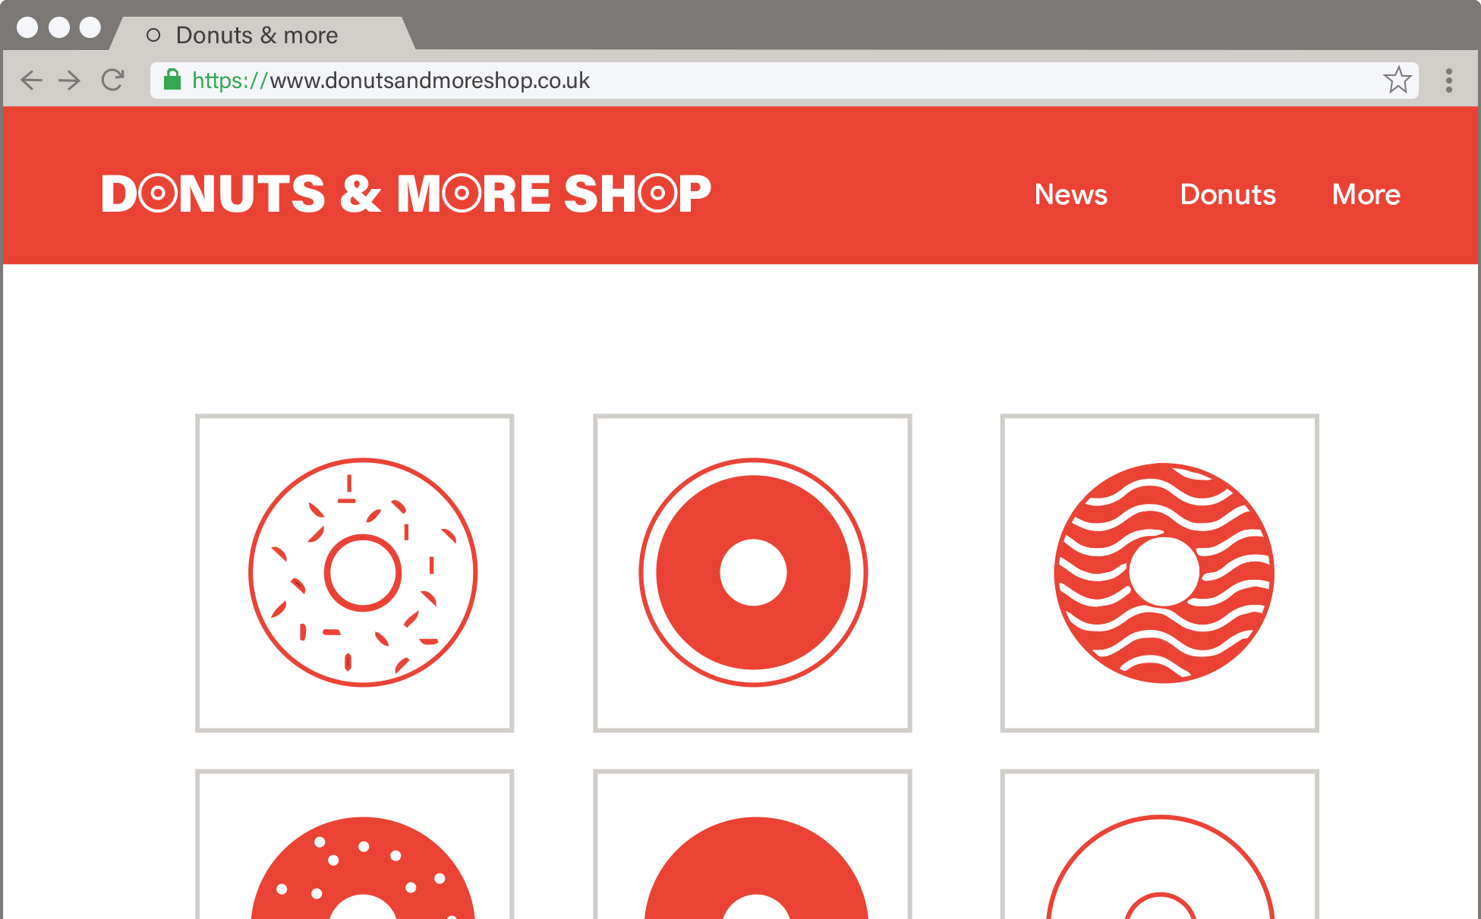
Spotting a trustworthy site
Notes:
Have a look at this website. What clues can YOU spot to help Lumen know it is a site that can be trusted?
[TEACHER NOTE: Ask pupils to call out things they can spot]
[CLUES TO SPOT]
ADDRESS BAR: Green padlock and the https:// means the site is secure and encrypted.
ADDRESS BAR: The site address (URL) matches the title of the page.
PAGE TITLE/CONTENT: The page seems to have a proper title and there are no obvious spelling mistakes.
[TEACHER NOTE: FOR LIVE DIGITAL DELIVERY]
Does anyone have any ideas of how to spot why this website is trustworthy? Share your thoughts in the chat.
[TEACHER NOTE: IF PRE-RECORDING]
Pause the video and have a look at this webpage. See if you can spot three clues that this site is trustworthy. When you’re done, press play.

Slide 19
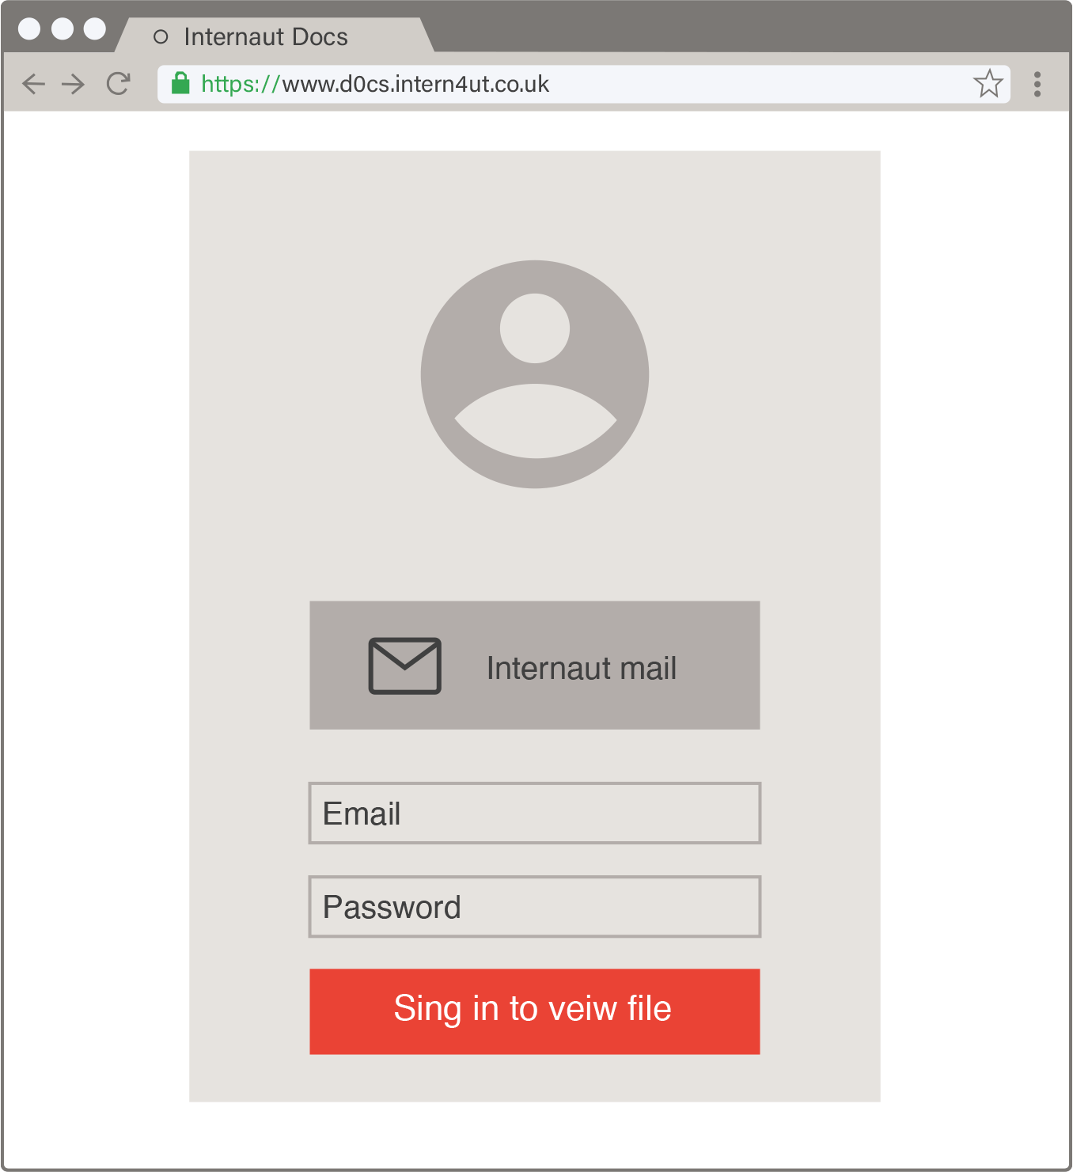
Spotting an untrustworthy website
Notes:
Have a look at this website. What clues can YOU spot to help Lumen know it is a site that cannot be trusted?
[TEACHER NOTE: Ask pupils to call out things they can spot - or run through the points]
[CLUES TO SPOT]
ADDRESS BAR: No green padlock or https:// means the site is not secure and unencrypted.
ADDRESS BAR: The site address (URL) doesn’t match the title of the page. It has strange numbers instead of letters.
SPELLING MISTAKE: Can you spot the spelling mistake? [TEXT: ‘SING IN TO VIEW FILE’ - ART TO AMEND]
EMAIL/PASSWORD BOXES: The page seems wants you to put your email and password in. Why does it need that information – and what file is it?
[TEACHER NOTE: FOR LIVE DIGITAL DELIVERY]
Does anyone have any ideas of how to spot why this website is NOT trustworthy? Share your thoughts in the chat.
[TEACHER NOTE: IF PRE-RECORDING]
Pause the video and have a look at this webpage. See if you can spot three clues that this site is NOT trustworthy. When you’re done, press play.

Slide 20
But what if you DO fall for a scam?
Notes:
Of course, it is not always easy – and even the most legendary internet user can fall for a scam, or be tricked by what they have seen. So what do you do if you fall for a scam? Or you think something is trying to scam you?
First, don’t panic! You should tell your parent, teacher, or another trusted adult right away. The longer you wait, the worse things could get. And don’t worry – adults will know how to help you to know what to do.
You could also:
Change your passwords for online accounts.
Let friends know who might be targeted as a result.
Use settings to report the site message, if possible.

Slide 21
Woohoo!
Critical thinking skills are spotting if something isn’t right online, by asking questions and challenging what you see.
Be Alert and use your critical thinking skills!
Notes:
Let’s finish by thinking back to the video we watched earlier.
Lumen and family wanted to buy the Toy Tracker 5000 Plus to track down the bear. But Lumen’s big brother knew something wasn’t right.
It was all too good to be true – and he used his critical thinking skills to help his family.
Wherever you are – whether you are out and about or going online – being alert and looking for clues will help you stay safer.
And if you are ever not sure, or you think you might have seen a scam, always tell a parent, carer or trusted adult, and they can always help you.

