Slide 1
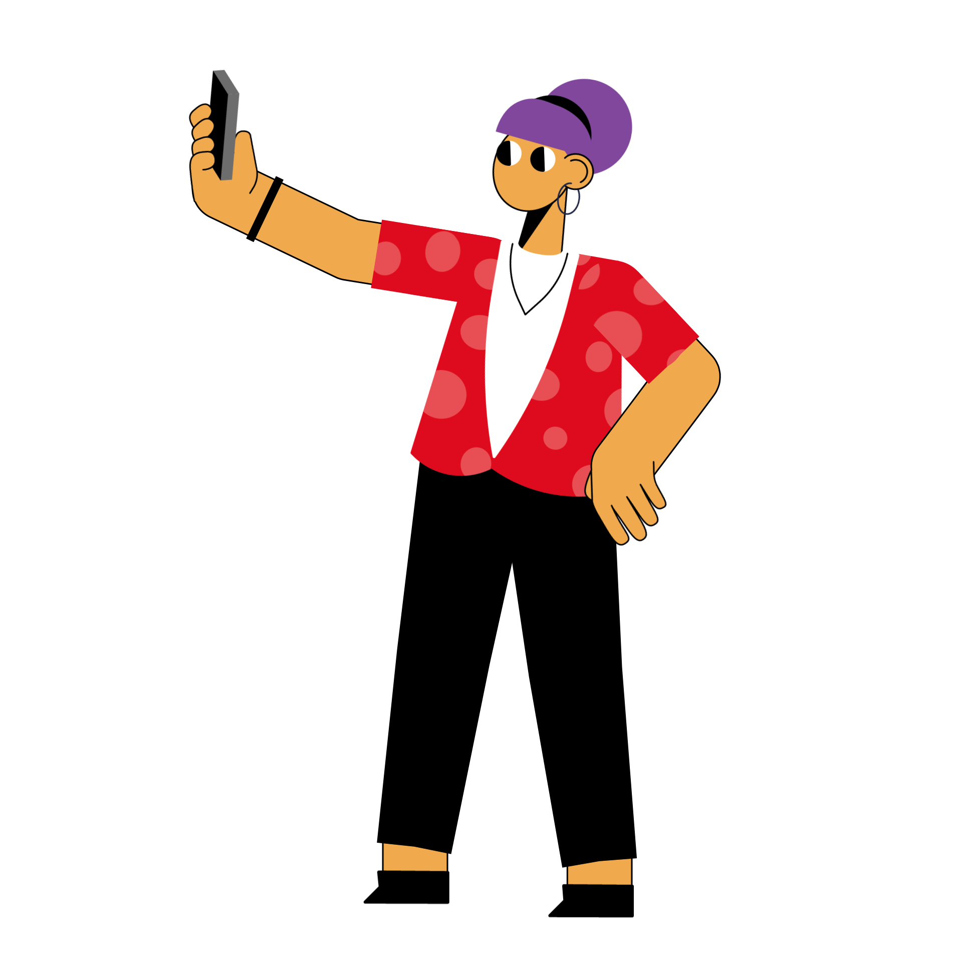
Your Digital Family
Notes:
[HOST/TEACHER NOTES AND SCRIPT]
Holding slide to introduce the quiz to participants.

Slide 2
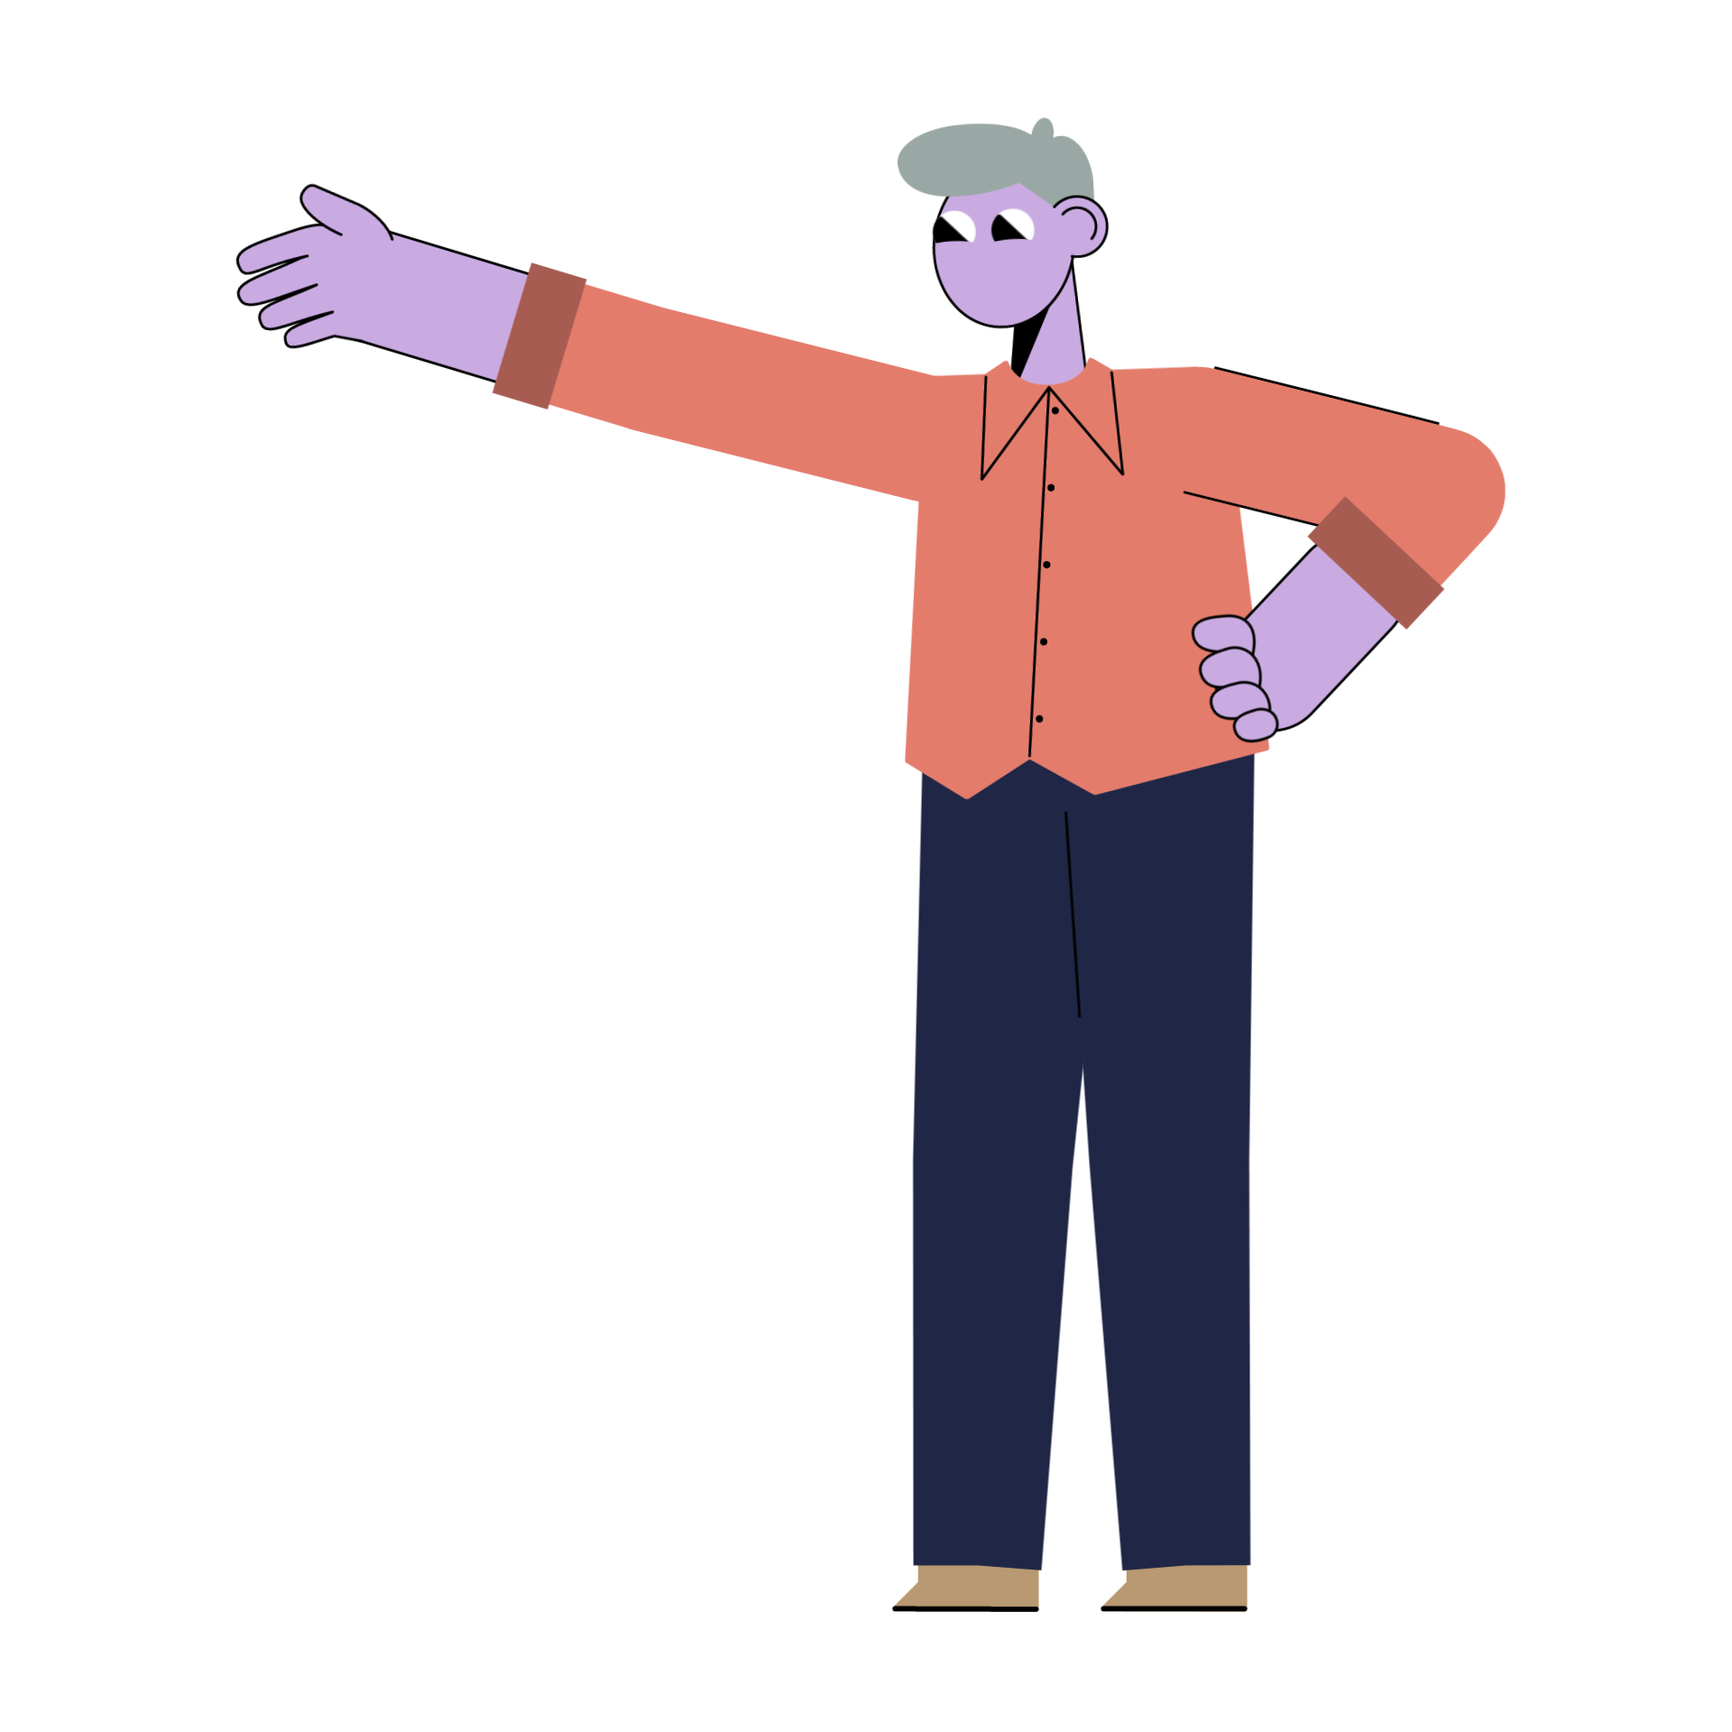
Welcome to your Digital Family!
Notes:
[HOST/TEACHER NOTES AND SCRIPT]
Welcome to the Your Digital Family quiz. It was created by Parent Zone, together with Meta.
If you’re the host, you can find notes to help run a fun family session, including three rounds of questions and answers.
There are 15 questions in total – and you can play in teams or individually.
The quiz supports family conversations around tech – and features a round devoted to immersive virtual experiences. You can find out more about safety within the Meta Family Center.
You’ll also find links to three short videos – which can also help support better family conversations between teens and parents about VR and supervision tools.

Slide 3
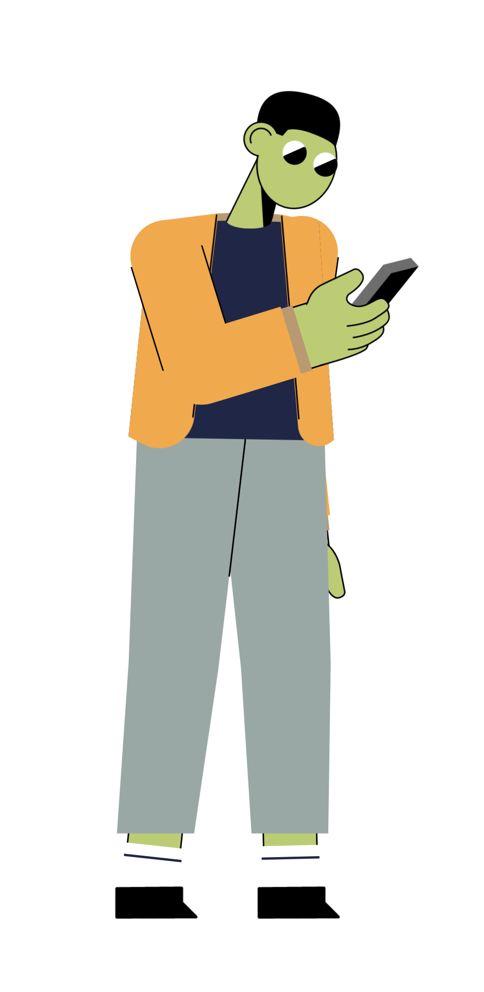
A few
simple
rules.
Notes:
[HOST/TEACHER NOTES AND SCRIPT]
Ground rules
Before beginning the quiz, it’s useful to set a couple of ground rules.

Slide 4
You can chat - in fact we want you to.
No searching for the answers!
Notes:
[HOST/TEACHER NOTES AND SCRIPT]
Feel free to delete or edit this slide to set any ground rules you would like to have in place for your quiz.
Ground rules
You can chat in deciding the answers. In fact, we want you to.
No searching for the answers. So pop away your phones and make sure you play fair!

Slide 5
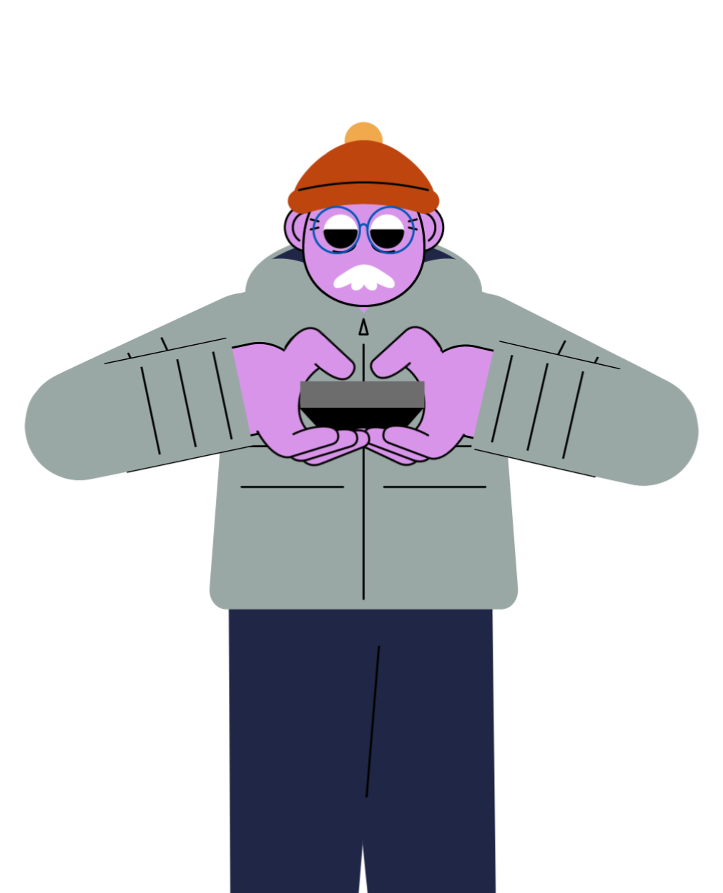
Let’s have a practice
Notes:
[HOST/TEACHER NOTES AND SCRIPT]
Time for a quick warm-up/practice question before we get started.

Slide 6
Which Facebook group in the UK has the most members?
DIY on a budget
Gardening for beginners
Natural knitters
Notes:
[HOST/TEACHER NOTES AND SCRIPT]
Which Facebook group in the UK has the most members?
DIY on a budget
Gardening for beginners
Natural knitters

Slide 7
Which Facebook group in the UK has the most members?
DIY on a budget
Notes:
[HOST/TEACHER NOTES AND SCRIPT]
The answer is A) ‘DIY on a budget’.

Slide 8
Amazing -
let’s play!
Notes:
[HOST/TEACHER NOTES AND SCRIPT]
Well done, if you got that practice question right. If not, there’s plenty of time to earn yourself some points.

Slide 9
Round 1
“Internet knowledge”
Notes:
[HOST/TEACHER NOTES AND SCRIPT]
Round 1 is a general tech knowledge round! Pens at the ready…

Slide 10
The world wide web shaped the online world. But who invented it?
Notes:
[HOST/TEACHER NOTES AND SCRIPT]
Question 1: The world wide web shaped the online world. But who invented it?

Slide 11
2. According to a 2022 report, how long does the average UK citizen spend using devices each day?
46 minutes
2 hours & 12 minutes
3 hours & 59 minutes
Notes:
[HOST/TEACHER NOTES AND SCRIPT]
Question 2: According to a 2022 report, how long does the average UK citizen spend using devices each day?
46 minutes
2 hours & 12 minutes
3 hours & 59 minutes

Slide 12
3. What is the fastest-growing app in history?
TikTok
Instagram
Threads
Notes:
[HOST/TEACHER NOTES AND SCRIPT]
Question 3: What is the fastest-growing app in history?
TikTok
Instagram
Threads

Slide 13
4. According to research, who would rather have a conversation about screen time?
Young people
Parents
Notes:
[HOST/TEACHER NOTES AND SCRIPT]
Question 4: According to research, who would rather have a conversation about screen time?
Young people
Parents

Slide 14
5. As of 2023, how many monthly active users did Instagram have?
2.35 million
28.2 million
214 million
Notes:
[HOST/TEACHER NOTES AND SCRIPT]
Question 5: As of 2023, how many monthly active users did Instagram have?
2.35 million
28.2 million
214 million

Slide 15
Round 1: answers
Tim Berners-Lee
c. 3 hours, 59 minutes
c. Threads
b. Parents (but only just…)
a. 2.35 million users
Notes:
[HOST/TEACHER NOTES AND SCRIPT]
You may want to get teams to swap answer sheets here.
Round 1 answers
Sir Tim Berners-Lee was the inventor of the world-wide web. You may also remember him from the London 2012 Olympics opening ceremony!
Answer C – 3 hours & 59 minutes.
Answer C – The answer is C, Threads. Released in 2023, Threads saw over 100 million downloads in its first five days – making it the fastest growing app in history.
Answer B – Parents. Answer: According to one piece of research, 35% of parents would like to have a conversation about screen devices, compared to 29% of young people.
NOTE: Whether it’s school, friends, or online life – having conversations with someone you trust can be really helpful – even when the topics are a bit tricky or just awkward. You can watch a video about better conversations here: https://youtu.be/iMmVVr789qQ
Answer A – Instagram has 2.35 million monthly users. Well done if you spotted the trick in that question - B is the number of annual users for Instagram.

Slide 16
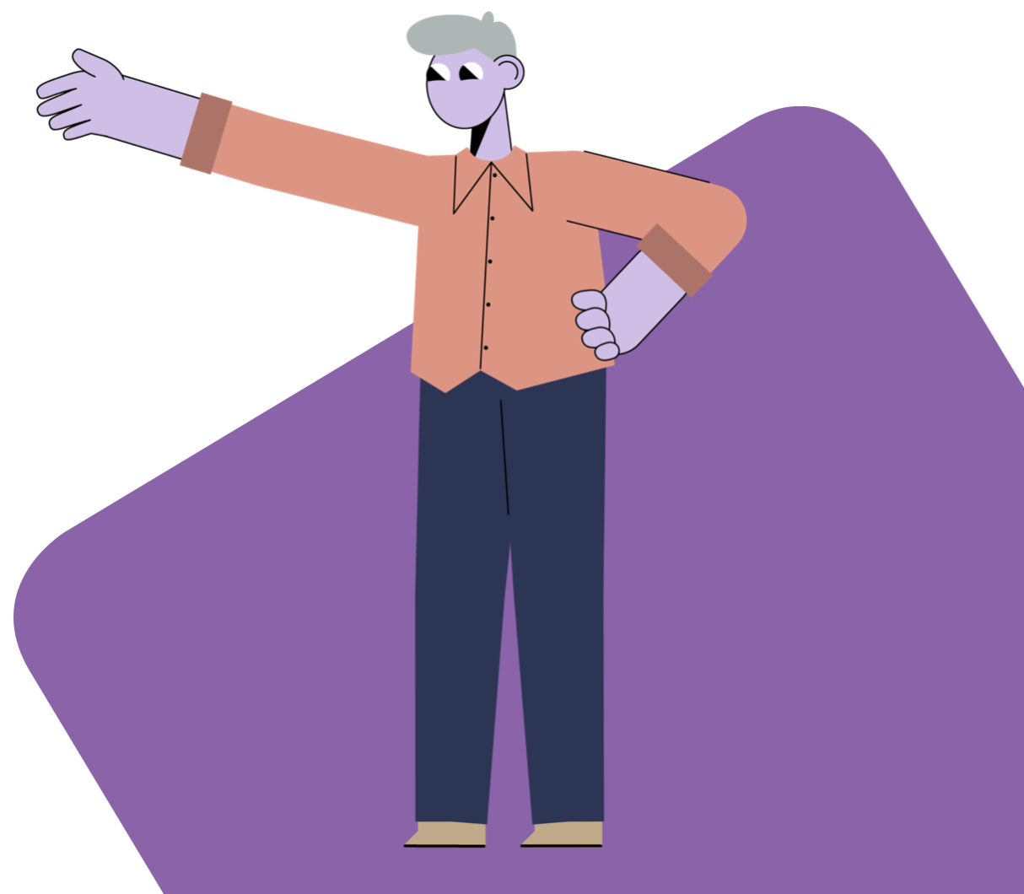
Round 2
“Let’s talk about
Virtual Reality”
Notes:
[HOST/TEACHER NOTES AND SCRIPT]
Now for round 2. This round is all about virtual reality and immersive online experiences.
Don’t worry if your families aren’t very familiar with this topic – the questions are designed to work for keen VRer’s and people who have never visited a virtual space.

Slide 17
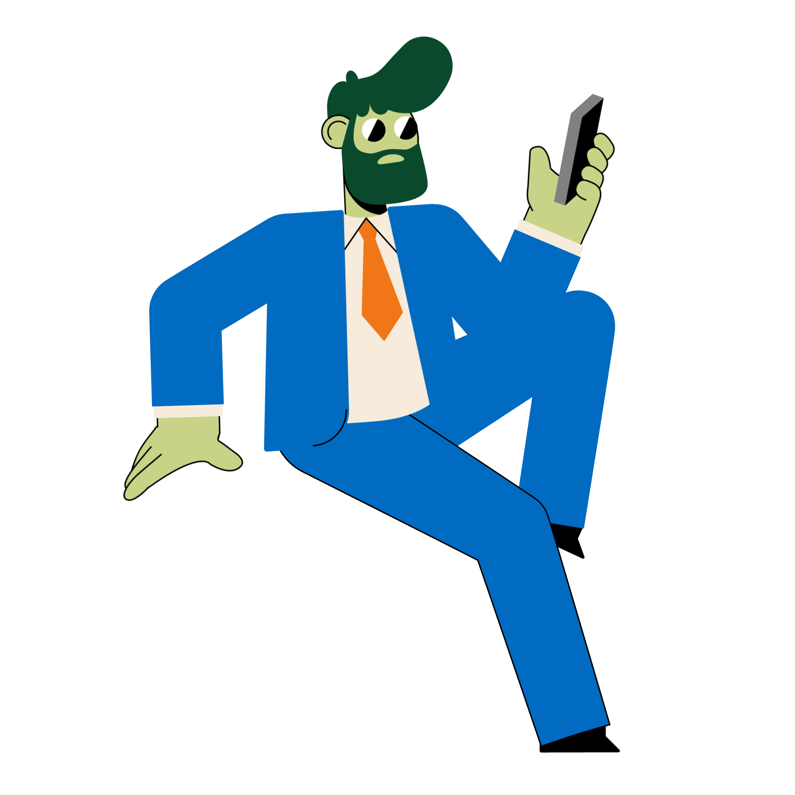
1. What is the ‘metaverse’?
An interdimensional realm in the Marvel cinematic universe
A collection of virtual, interactive online spaces
A new social media platform
Notes:
[HOST/TEACHER NOTES AND SCRIPT]
Question 1: What is the ‘metaverse’?
An interdimensional realm in the Marvel cinematic universe
A collection of virtual, interactive online spaces
A new social media platform

Slide 18
2. The term ‘parental supervision’ refers to…
Co-gaming with a parent
Making a parent a ‘friend’
A range of tools for families
Notes:
[HOST/TEACHER NOTES AND SCRIPT]
Question 2: The term ‘parental supervision’ refers to…
Co-gaming with a parent
Making a parent a ‘friend’
A range of safety tools for families

Slide 19
3. The first virtual reality headset appeared in which year?
1968
1996
2012
Notes:
[HOST/TEACHER NOTES AND SCRIPT]
Question 3: The first virtual reality headset appeared in which year?
1968
1996
2012

Slide 20
4. In virtual realities, a ‘personal boundary or bubble’ refers to…?
A screen time limit
A space for solo-gaming
A space around your avatar
Notes:
[HOST/TEACHER NOTES AND SCRIPT]
Question 4: In virtual realities, a ‘personal boundary or bubble’ refers to…
A screen time limit
A space for solo-gaming
A space around your avatar

Slide 21
5. Over 170 million people used virtual reality tech in 2022. But which country used it the most?
USA
China
UK
Notes:
[HOST/TEACHER NOTES AND SCRIPT]
Question 5: ‘Over 170 million people used virtual reality tech in 2022. But which country used it the most?’
USA
China
UK

Slide 22
Round 2: answers!
b. Virtual, interactive online spaces
c. A range of safety tools
b. 1968
c. A space around your avatar
a. USA
Notes:
[HOST/TEACHER NOTES AND SCRIPT]
You may want to get teams to swap answer sheets here
Round 2 answers
Answer B – The metaverse is best described as ‘a collection of virtual, interactive online spaces’. You can read more here: parentzone.org.uk/article/metaverse.
Answer C – ‘Parental Supervision’ refers to a number of easy-to-use, easy-to-access tools designed to create a level of safety and supervision that’s right for families.
Healthy conversations is always the best approach, but supervision tools can also help to support these conversations, but helping parents see how an online platform might be being used. Have a watch of this video, which explains a bit more about the benefits of supervision tools online, including in immersive virtual environments: https://youtu.be/C8T10L6yflE
Answer A – The first virtual reality headset appeared in 1968. Back then, the visuals shown to users were super basic, and the headset was so heavy it had to be suspended from the ceiling.
In Meta Horizon Worlds, the ‘personal boundary’ setting creates an invisible barrier between your avatar and others, in case anyone is getting a little too close, or you just want a bit more personal space.
Answer A – The USA. Over 60 million people used VR tech in the USA during 2022, but it’s really popular in the UK and China, too.
As with any new tech, families might have questions about how it works or just how safe it is. In Meta Horizon Worlds, you’ll find tools to limit unwanted voice contact from others, as well as ways to establish personal space in your virtual experiences. Watch this video to learn a bit more https://youtu.be/jBj3bKy5sw8

Slide 23
Round 3
“Record Breakers”
Notes:
[HOST/TEACHER NOTES AND SCRIPT]
Round 3 is the final round and it’s all about some tech record breakers. Let’s get ready.

Slide 24
1. How many WhatsApp messages are sent every day?
10 million
1 billion
100 billion
Notes:
[HOST/TEACHER NOTES AND SCRIPT]
Question 1: ‘How many WhatsApp messages are sent every day?’
10 million
1 billion
100 billion

Slide 25
2. What is the most-viewed music video ever on YouTube?
Despacito – Luis Fonsi
Shape of You – Ed Sheeran
Baby Shark – Pinkfong
Notes:
[HOST/TEACHER NOTES AND SCRIPT]
Question 2: What is the most-viewed music video ever on YouTube?
Despacito – Luis Fonsi
Shape of You – Ed Sheeran
Baby Shark Dance – Pinkfong

Slide 26
3. Which is the most popular subscription video platform in the UK?
Netflix
Amazon Prime
Disney+
Notes:
[HOST/TEACHER NOTES AND SCRIPT]
Question 3: ‘Which is the most popular subscription video platform in the UK?’
Netflix
Amazon Prime
Disney+

Slide 27
4. In May 2023, which English-language series broke the record for biggest-ever premiere weekend?
Ms. Marvel
Derry Girls
Stranger Things
Notes:
[HOST/TEACHER NOTES AND SCRIPT]
Question 4: ‘In May 2023, which English-language series broke the record for biggest ever premier weekend?’
Ms. Marvel
Derry Girls
Stranger Things

Slide 28
5. Two months after launch, AI chatbot ChatGPT had how many users?
326,000
5.2 million
100 million
Notes:
[HOST/TEACHER NOTES AND SCRIPT]
Question 5: ‘Two months after launch, AI chatbot ChatGPT had how many users?’
326,000
5.2 million
100 million

Slide 29
Round 3: answers!
c. 100 billion
c. Baby Shark - Pinkfong
a. Netflix
c. Stranger Things
a. 100 million
Notes:
[HOST/TEACHER NOTES AND SCRIPT]
You may want to get teams to swap answer sheets here.
Round 3 answers
Answer C – An incredible 100 billion WhatsApp messages are sent every day.
Answer C – Baby Shark Dance by Pinkfong, with 13 billion views.
Answer A – Netflix is the UK’s most popular streaming service, with 15 million households subscribing.
Answer A – Stranger Things. Season 4 volume 1 broke the record for biggest-ever premiere weekend of an English-language series – it was watched for 287 million hours on its opening weekend. The record was previously held by Season 2 of Bridgerton.
Answer C – ChatGPT had 100 million users just 2 months after it publicly launched – making it one of the fastest growing apps in history.

Slide 30
How did you get on?
parentzone.org.uk/realitycheck
Notes:
[HOST/TEACHER NOTES AND SCRIPT]
We hope you had fun running the Your Digital Family quiz. So what now?
We’d love families to continue the conversations started with this quiz because we know that regular conversations are an important way to ensure children have a safer time online.
If parents would like to find out a little more about virtual environments we have a series of video, created by Parent Zone and youth content platform VoiceBox together with Meta called Reality Check. They explore the safety and supervision tools for teens – and how to have the right kinds of family conversations around VR. Please invite all the families joining to watch them by sharing the link below.
parentzone.org.uk/realitycheck
In addition, here are some useful links that will help families around using tech – including some of the topics covered in today’s quiz. Please share the links below.
The Mix
Essential support and advice for under-25s.
www.themix.org.uk
Connect Safely
Support for online safety, security, privacy and digital wellness.
Connectsafely.org
Parent Zone library
Guides and advice around online platforms, trends and cultures.
parentzone.org.uk/library
VoiceBox
An international content platform for young people, by young people.
voicebox.site
Meta Safety Centre
Learn more about Horizon Worlds. https://familycenter.meta.com/uk/our-products/horizon-worlds/
Managing online relationships
Parent advice for helping teens manage better online relationships.
https://familycenter.meta.com/uk/education/resources/managing-relationships-bullying-instagram

